Slide 1
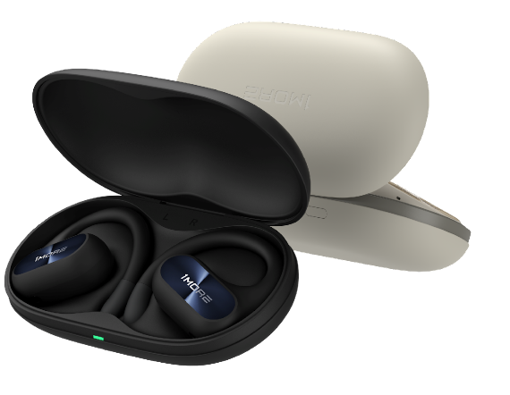
Boost Your Sports Mood
1MORE Fit SE Open Earbuds S30
Open-Air Tech
Sound Directional Tech
4-Mic Noise Canceling for Calls
IPX5 Waterproof Rating
Notes:
0601确认

Slide 2
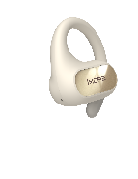
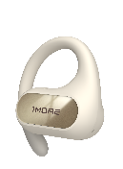
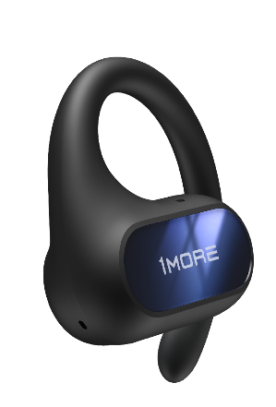
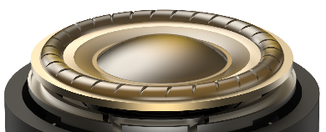
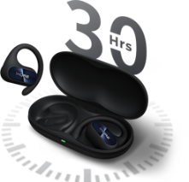
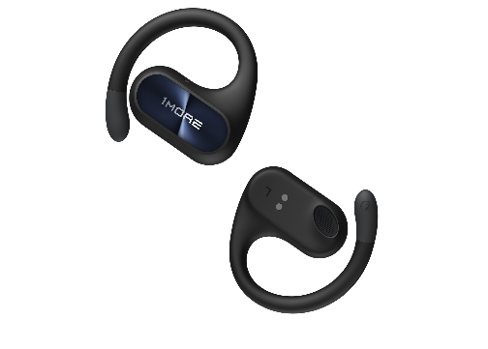
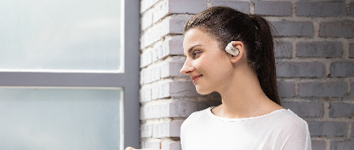
Open-Ear Uncovered Design
For Ultimate Comfort
14.2 mm Dynamic Driver with DLC Diaphragm
IPX5 Waterproof Rating
30 Hrs of Total Playtime
10 Hrs per Charge
Low-Frequency Enhancement Algorithm
Environmental Noise Canceling for Clear Calls
10g Each Earbud
Notes:
0601确认

Slide 3
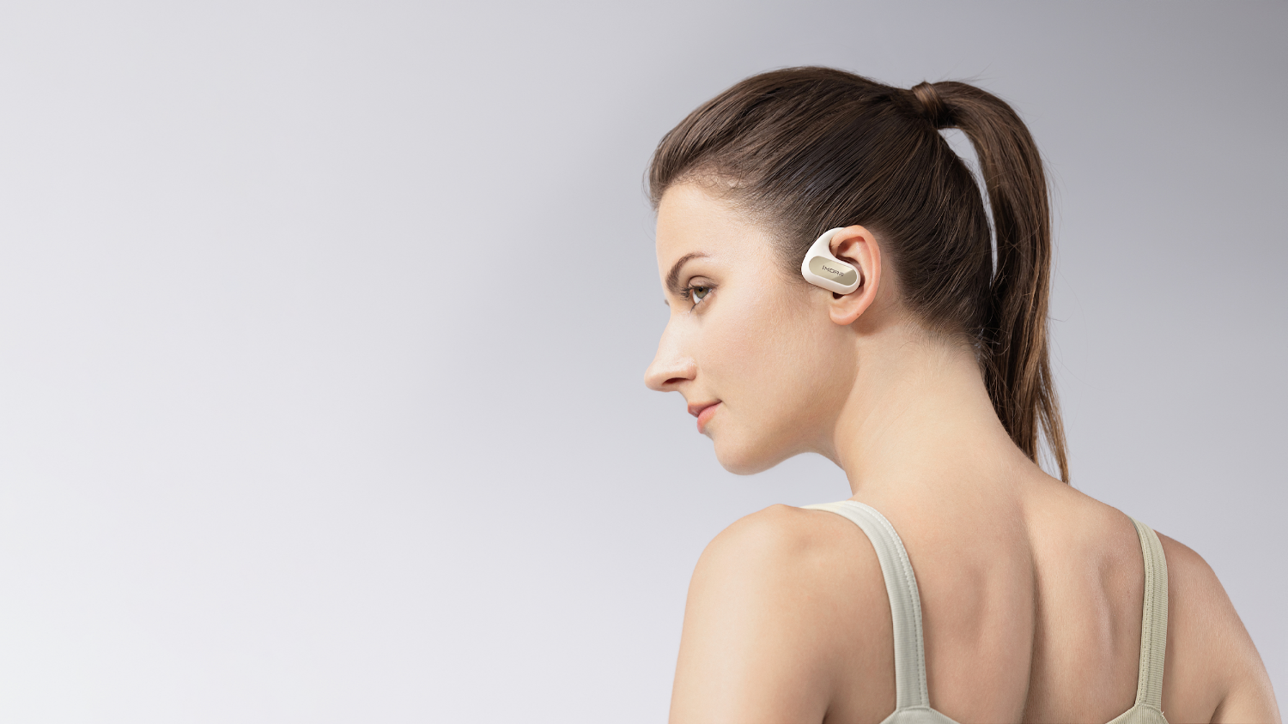
Boost Your Mood
14.2 mm Dynamic Driver with DLC Diaphragm + DBB Low-Frequency Enhancement Algorithm
Enlarged DLC diamond-like diaphragm dynamic driver with a DBB bass-enhanced algorithm elevates the sound quality, and expresses distinct, vigorous, and improved listening.
Enlarged 14.2 mm Dynamic Driver
Augmenting to a broader and more compelling power and sound
Stiff DLC Diamond-Like Carbon Diaphragm
Get better transient response and nimble sensitivity to reproduce the smallest details
Advanced Sound Directional Tech
Less leakage, more privacy, better performance
Notes:
2页

Slide 4
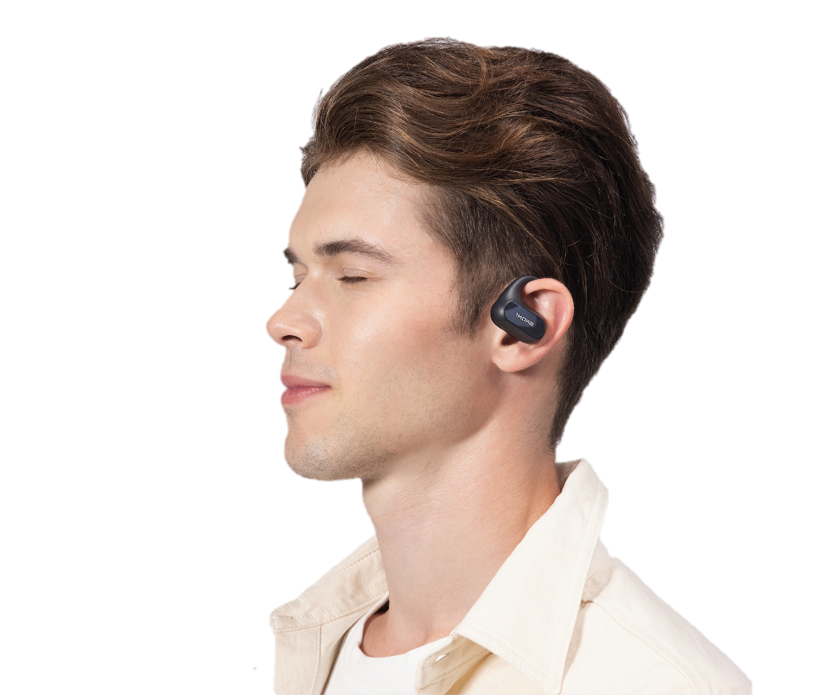
Next-Level Comfort
Uncovered, Unburdened
The open-ear design of the S30 does not pass through your ear canals, delivering an unnoticeable wearing sensation.
Lighter, More Fit 10g each Earbud
The highly-integrated earbud weighs in at only 10g each. The gentle curve snugly fits your pinna and optimized wearing gravity enhances comfort and stability when you work out.

Slide 5
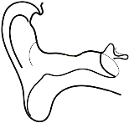
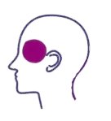
Uncovered
Airy
No Pinching
No Vibrations
Hear the music, and stay connected.
Transmit sound without vibrating on the bone to avoid spatial perception disorders.
Keep your inner ear airy and comfortable.
The split design and the ergonomic ear hooks deliver a comfortable fit.

Slide 6
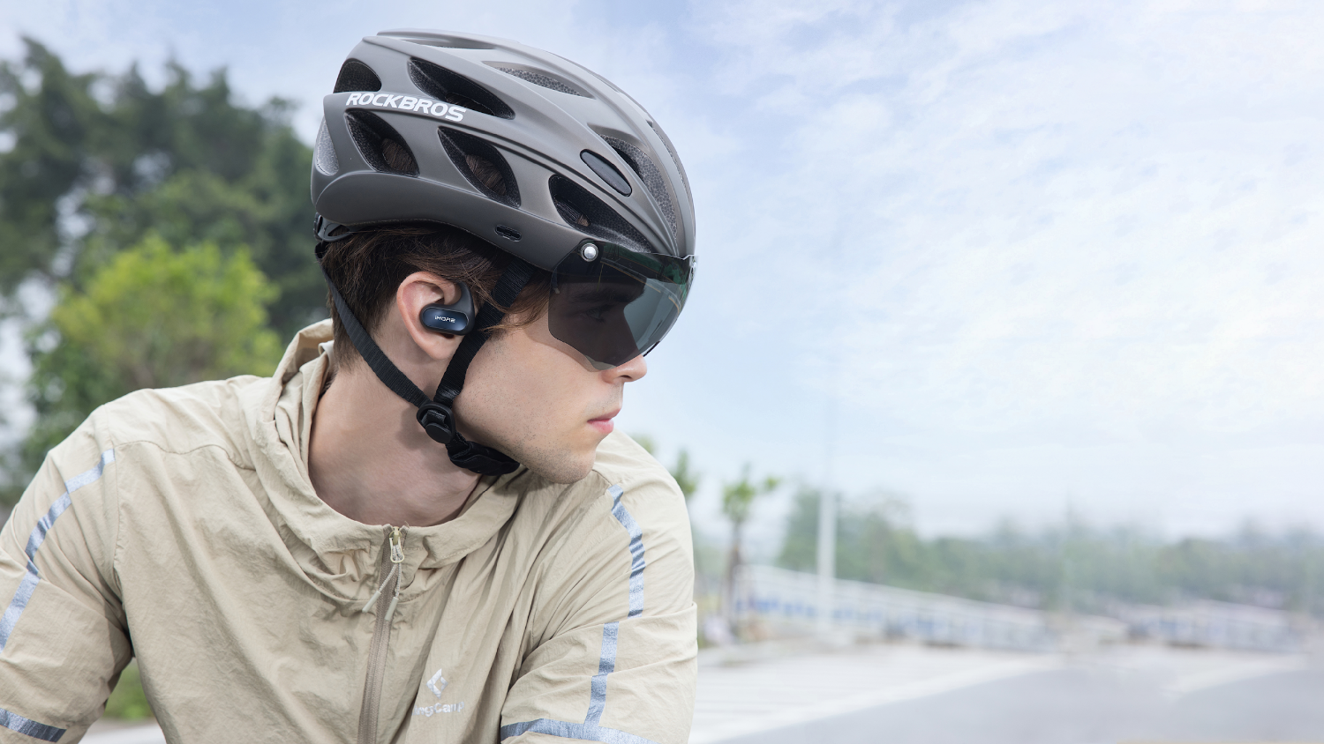
Music In, Safety In
Open-Ear Design Elevates Your Awareness on the Road
Uncompromising sound quality with the open-ear design to enhance situational awareness, the open-air tech elevates your safety.
Notes:
音质好+通透

Slide 7
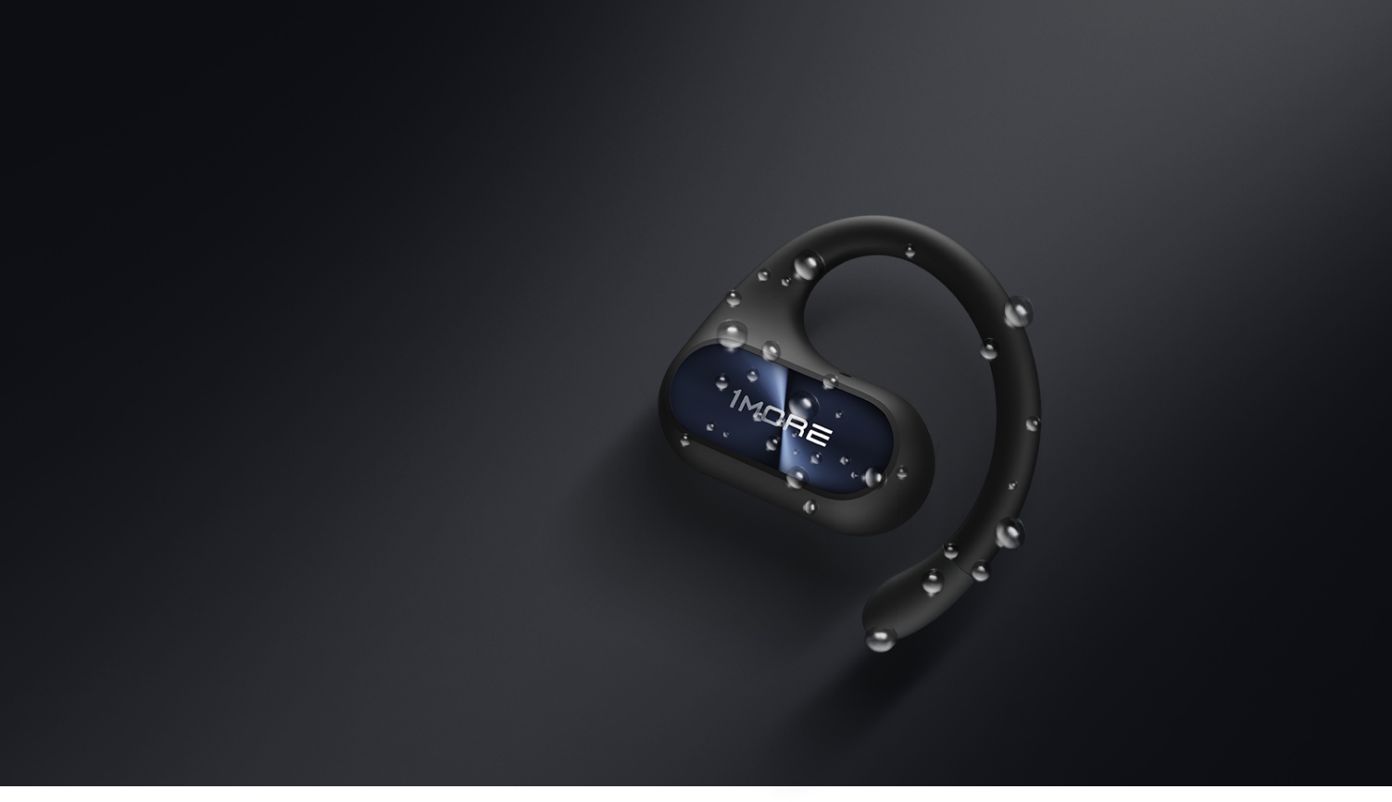
IPX5 Sweat Resistance
The solid IPX5 waterproof rating of the S30 accompanies you whether you’re sweating from your workout or confronting the changing weather.
*The charging case is not waterproof.

Slide 8
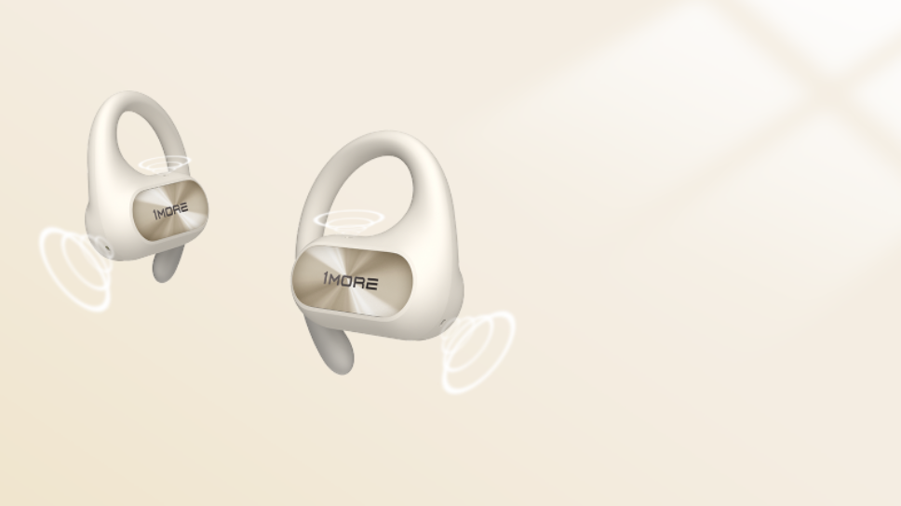
Unlimited Stellar Calls
4-Mic Intelligent Noise Cancelling
4 Built-in microphones with an intelligent noise canceling algorithm dynamically filter the environmental noise when you’re on a call, keeping all the details of your voice.
DSP
Intelligent Algorithm
Adaptively filters out ambient noise
4 MEMS Mics
Stably reproduces your every word
消噪环境噪声＞20dB

Slide 9
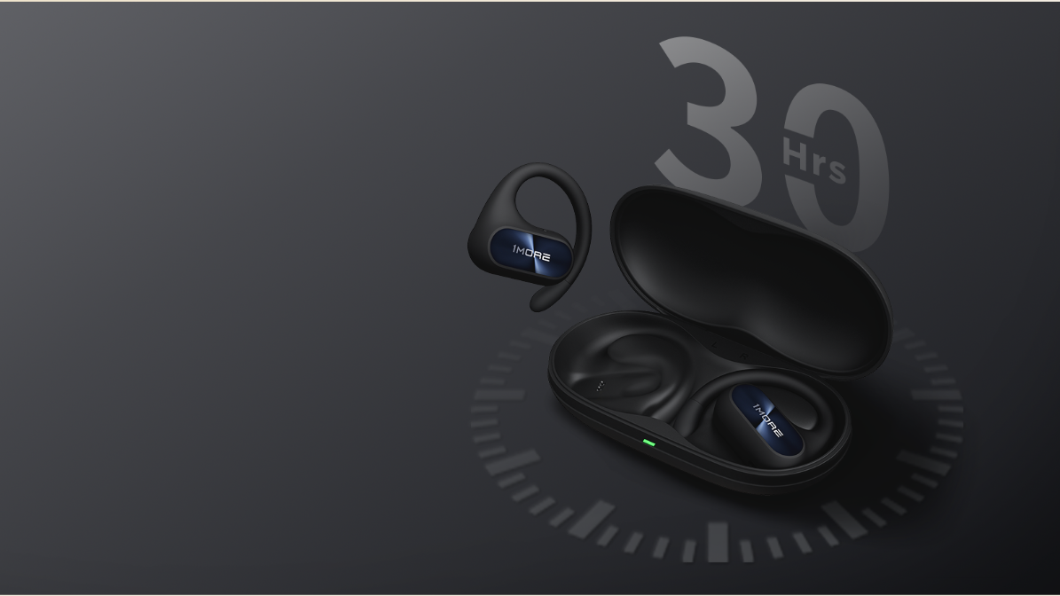
30-Hours of Sustainability
Boosting You For One More Activity
The sustainable battery of the 1MORE S30 headphones support 30 hours of continuous playback whether you’re walking, bicycling, climbing, or any other activities.
10 Hrs
Per Charge
30 Hrs of Total Playback with Case
* The playback time tested under the laboratory condition of AAC format and 50% volume, may vary with different device settings, environments, usage, and other factors.

Slide 10
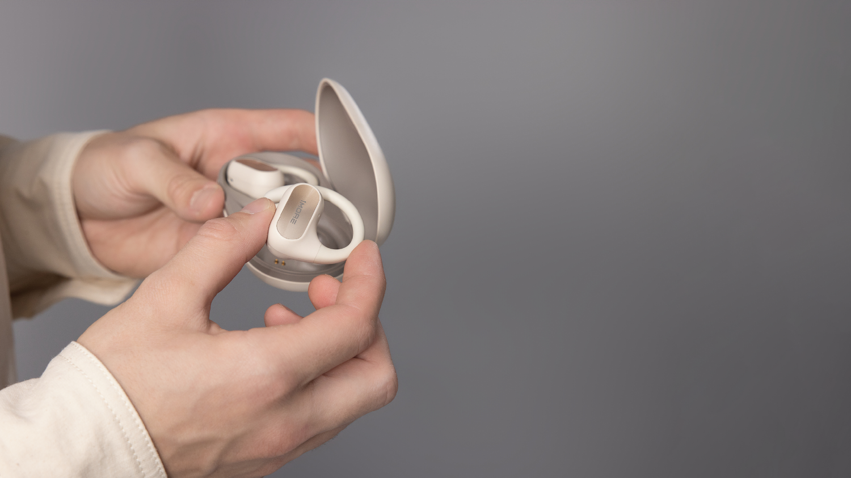
Supported by Bluetooth 5.3
Instant Connection
The 1MORE S30 features the latest Bluetooth 5.3 technology which effectively resists disturbance, and instantly connects with your devices.
Bluetooth 5.3 Transmission:
Bluetooth 5.2 Transmission:

Slide 11
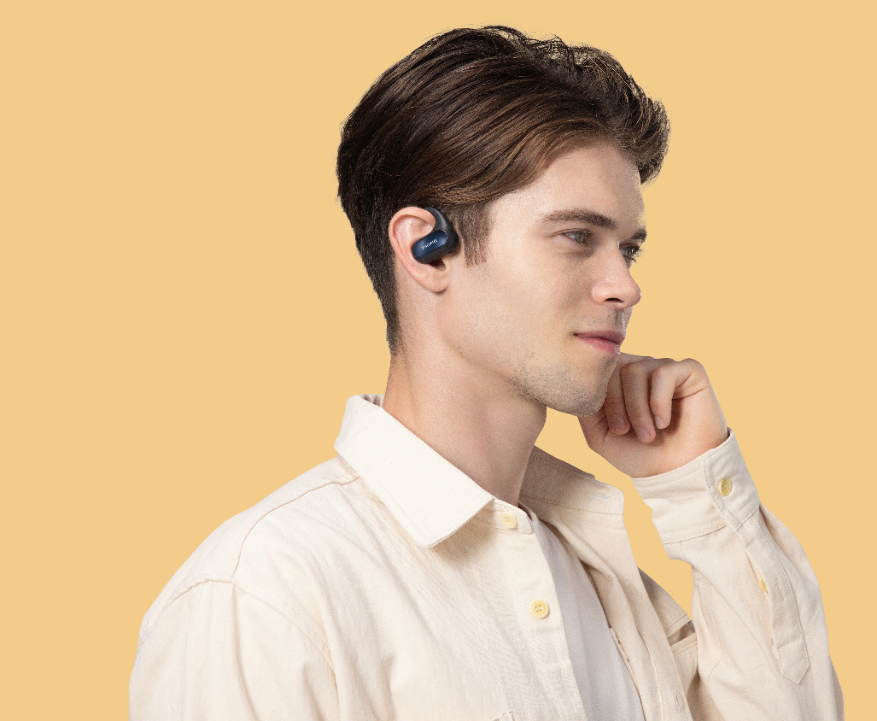
Simply Tap to Switch Rhythm
Customizable Touch Control Available
Simply touch the earbud to switch tracks, adjust volume, answer phone calls, and activate the phone assistant allowing you to control your experience whatever you’re doing. Never miss a call again.
You can also customize the control settings via the 1MORE MUSIC app.
播放 / 暂停
播放 / 暂停
音量－
音量＋

Slide 12
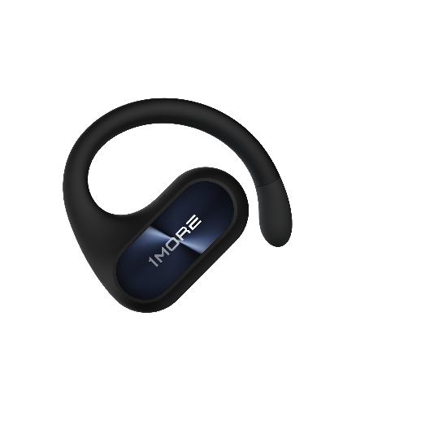
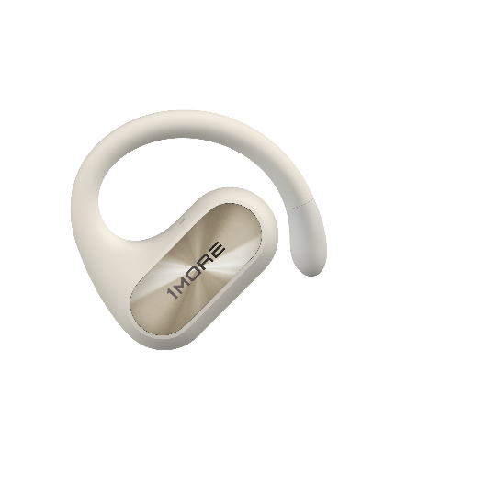
Specifications
Earbud Weight: 10 g
Case Weight: 59.7g
Product Weight: 79.7 g
Earbud Size: 44.92 × 47.11 × 22.64 mm
Case Size: 104.8 × 54.6 × 30.0 mm
Earbud Battery Capacity: 85 mAh
Case Battery Capacity: 600 mAh
Earbud Charging Time: 90 mins*
Case Charging Time: 120 mins*
Earbud Playtime (Fully Charged): 10 hrs*
Total Playtime (Fully Charged): 30 hrs*
Impedance: 16 Ω
Wireless Range: 10 m
Bluetooth: Bluetooth® 5.3
Bluetooth Protocol: HFP / A2DP / AVRCP
Input: 5V 0.5A
Working Temperature: 0 ℃ ~ 45 ℃
Frequency Band: 2.400 GHz ~ 2.4835 GHz
The specifications are acquired from laboratory tested data.
Black d
Whited

