Slide 1
1MORE Fit Open Earbuds S50
CONFIDENTIAL!

Slide 2
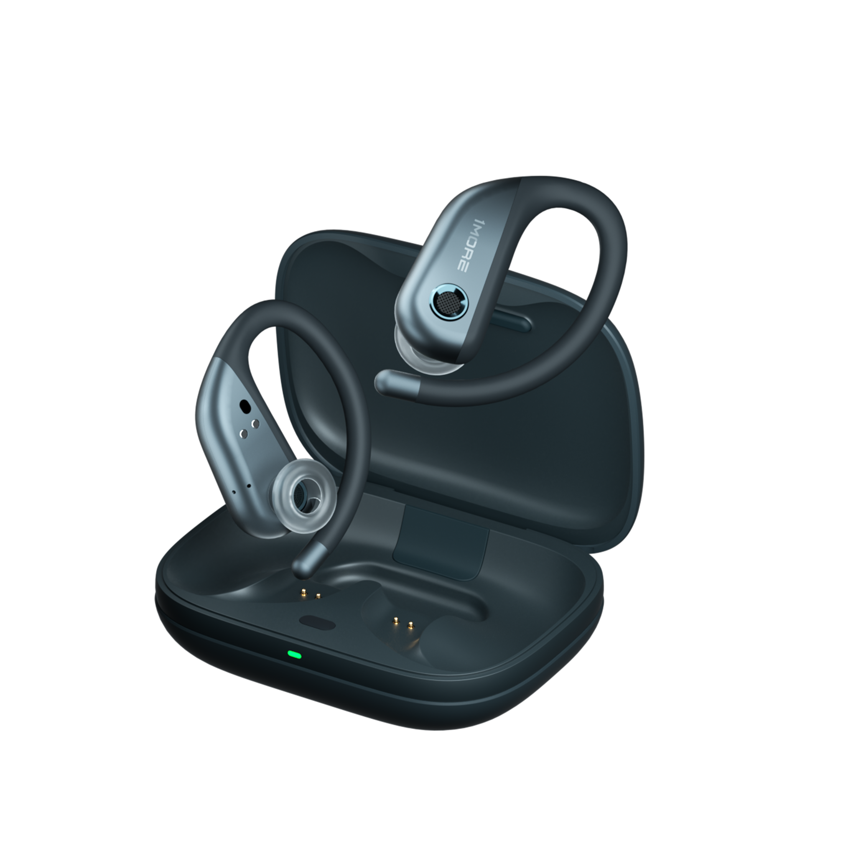
Open Ear, HiFi Music
1MORE Fit Open Earbuds S50
1MORE PurePower Driver for Impressive Sound
Open-Air Tech
IPX7 Waterproof Rating
5-Min Fast Charge for 2 Hours of Extra Listening
38 Hours Battery Life
Notes:
need to confirm what is 定向传声环设计

Slide 3
1MORE PurePower Driver
38H Total Battery Life
Crystalline Calls
Surging sound
Music never stops
Dual Microphone Array + AI ENC Algorithm
1MORE Fit Open Earbuds S50
DLC Diaphragm
Fast Charge
IPX7 Waterproof Rating
Lucid, delicate high-fidelity sound
Quick 5-min charge = 2 hours of listening
Won’t need to panic if it starts to rain
Open-Air Tech
Bluetooth 5.3
Comfortable, Stable, Without Pinching
Tuned by Grammy Winning Sound Engineer
Stable, faster connection, low-power consumption

Slide 4
1MORE PurePower Driver
Surging Sound
The embedded cutting-edge integrated dual-magnetic circuit design of the 1MORE PurePower Driver increases sensitivity to reproduce the subtle nuances of sound.
1MORE PurePower Driver
Boosts power by
40 %

Slide 5
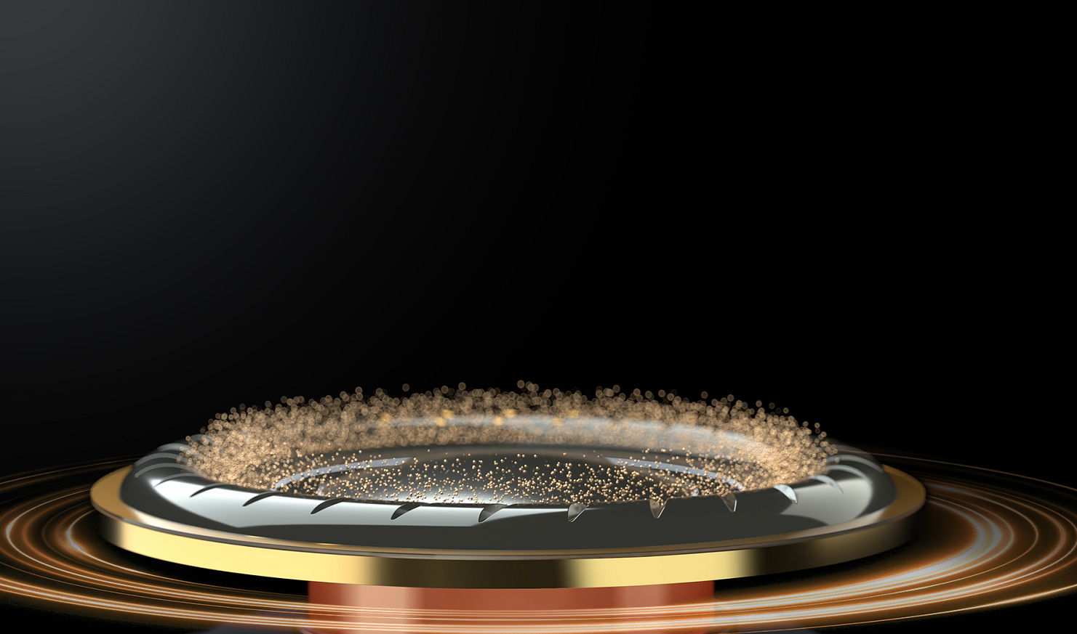
Reveal Every Finest Note
Diamond-Like Carbon Diaphragm
A Diamond-Like Carbon (DLC) Diaphragm, with a molecular structure similar to diamonds, reproduces an unexpectedly balanced sound with subtle details. The accurate reproduction of drum strokes, resonant chords, angelic voices, and slight breaths imprint in your ears.

Slide 6
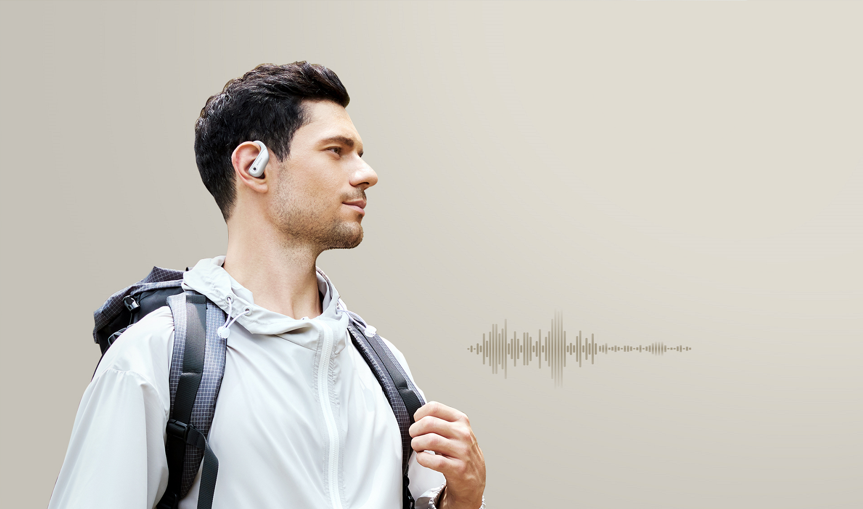
Crystalline Two-Way Communications
AI-Powered Noise-Reduction Calls
4 high-performance MEMS microphones and an AI-powered deep neural network (DNN) algorithm accurately pick up the human voice and eliminate background noise by up to 30 dB, even in bustling crowds, the two-way calls are still clear.
* Test data from 1MORE Lab

Slide 7
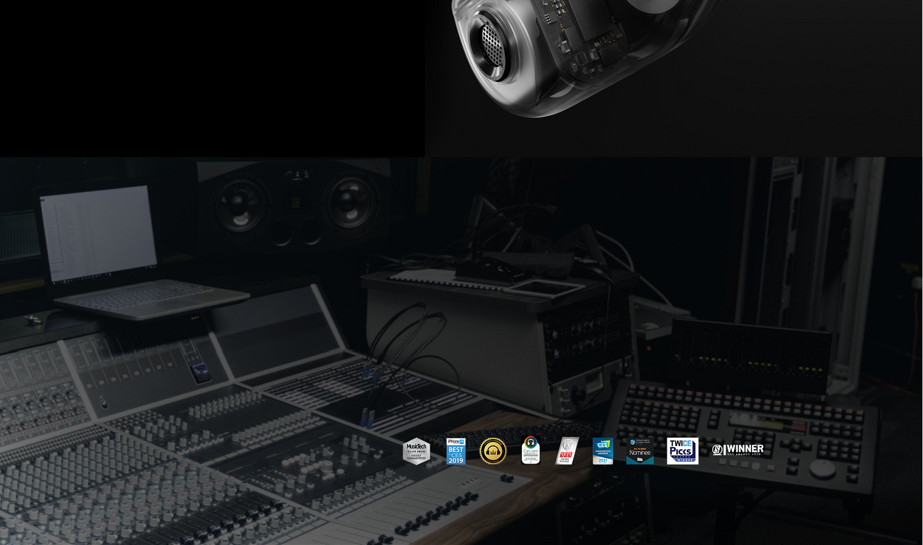
Spice It Up With Extra Flavor
Unique Sound Presets Enhance Your Listening Enjoyment
12 studio-level EQ presets from Sonarworks are delicately crafted to apply to various genres, and flavor your music with the different EQs, whether you prefer hip-hop, classical, or electronic, you can easily find one that meets your taste.
源自录音室校准技术
12 组专业音效
为双耳定制的 12 种音效，源自录音室专业调校，确保音效无“失真滤镜”，高度还原音乐的完整细节和调音风格。
Recommended by 50+ Grammy Sound Engineers
Adopted by 200,000+ Studios
Over 10 Authoritative Music Industry Awards
扬声器和耳机校准专家Sonarworks合作
……

Slide 8
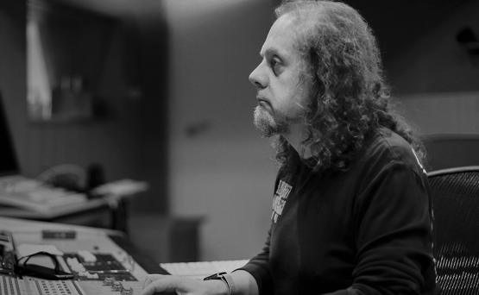
1MORE-SIGNATURE SOUND
The 4-time Grammy Award-winning sound engineer, Luca Bignardi precisely tunes each headphone for a natural, authentic sound for better enjoyment.

Slide 9
Open-Air Tech Shields Your Back
Raise Situational Awareness
An Open-air design of S50 open earbuds doesn’t block the environmental sound that is around you, allowing you to hear the peripheral sound of cars, and crowds when you are cycling, running, or walking to increase awareness and safety.

Slide 10
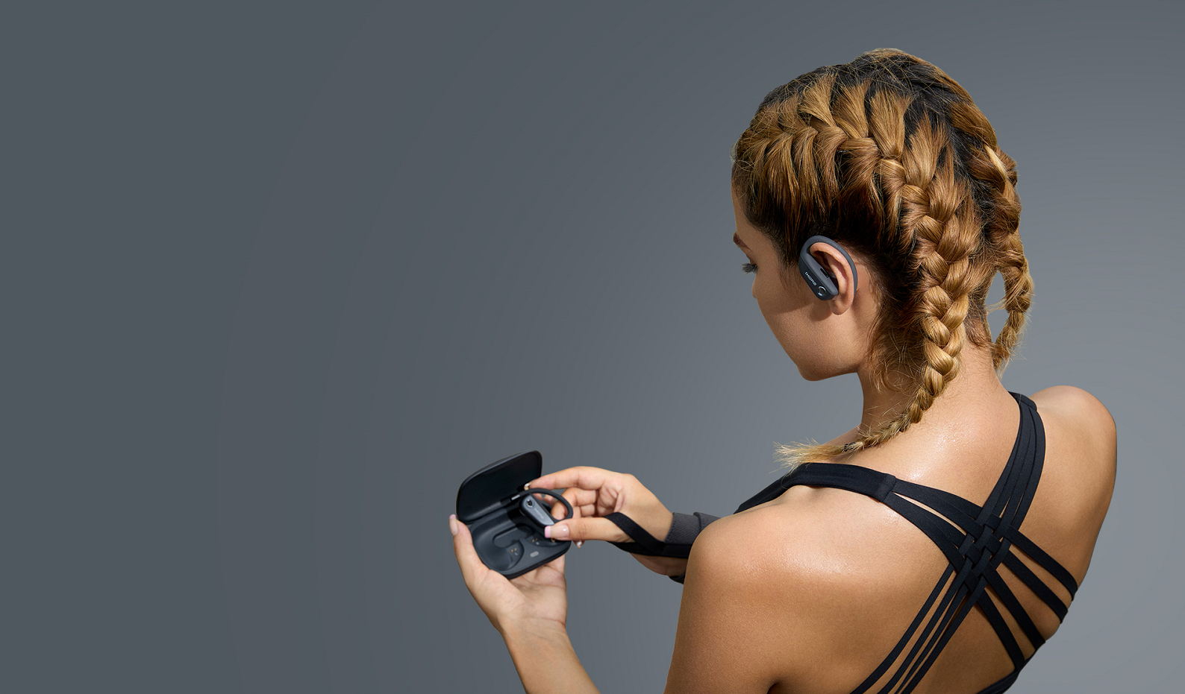
Comfortable, Stable, Without Pinching
Ergonomic Ear Hooks
The dual support points between the airy loops and the ear hooks alleviate the 10g weight of each earbud.
The Built-in memory wire and ear hooks designed by using various test models fit snugly on your ears for long-wearing comfort. Feel free no matter what hairstyle, accessories, or helmet you are wearing.

Slide 11
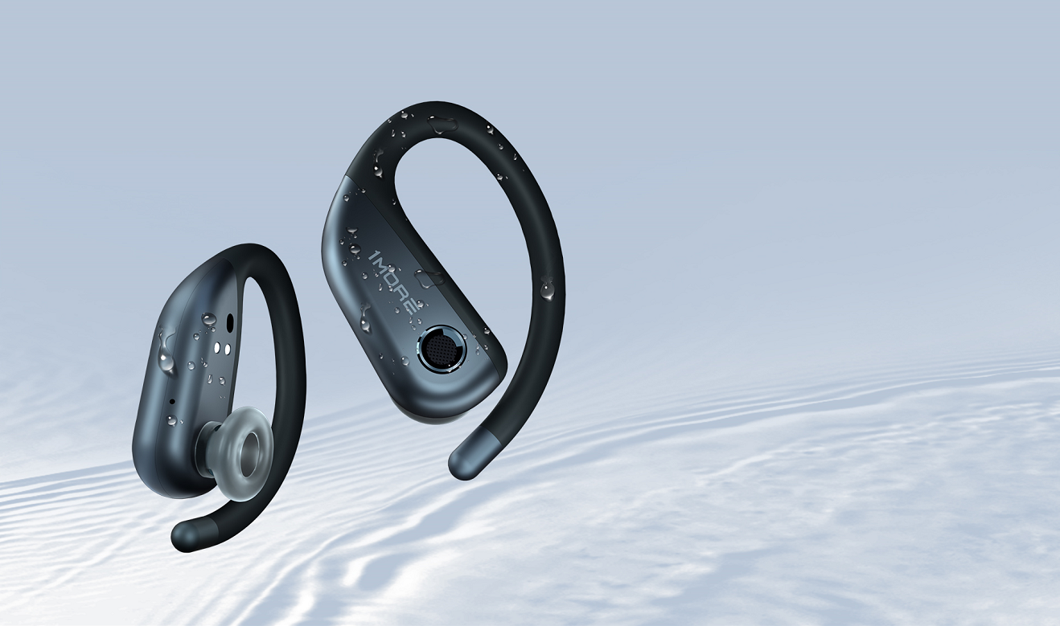
Washable Sports Earbuds
IPX7 Sweat-Resistant Design
The IPX7 waterproof rating* protects your earbuds from rain and sweat. You don’t have to panic if it starts raining.
*The charging case of the earbuds is not water-resistant.

Slide 12
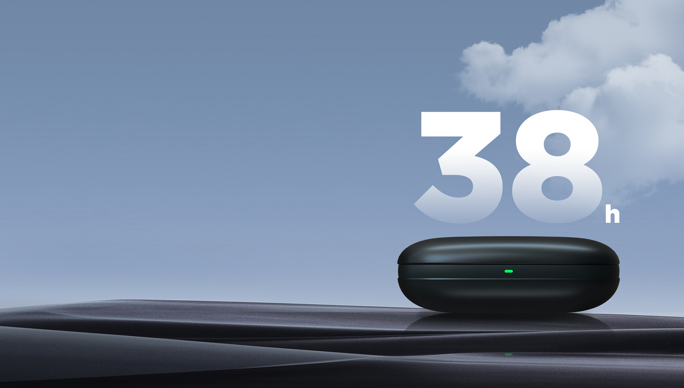
Extended 38-Hour Battery Life
5-Min Quick Charge Gets 2 Hours Extra Playtime
11 Hrs
per Charge
38 Hrs
of Total Playback with Case
5 mins=2 hrs
Fast Charge
* Playtime is tested in the laboratory under AAC format at 50% volume, which may vary according to device settings, use habits and other factors.

Slide 13
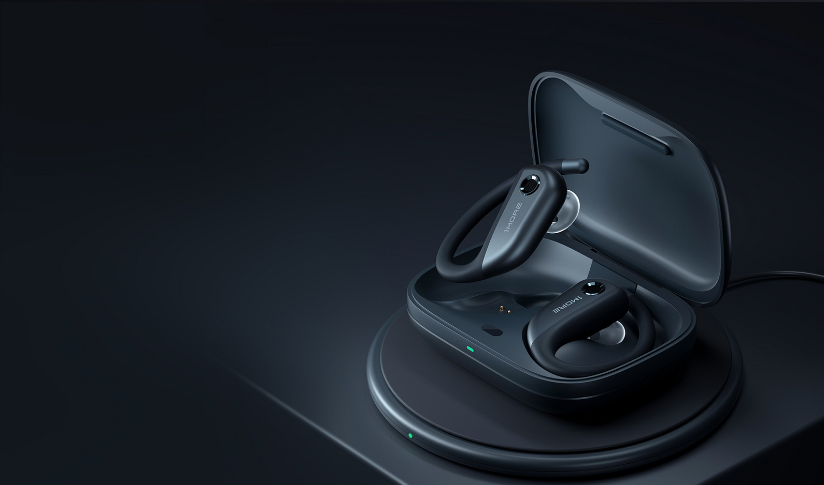
Instant Charge Without Plugging in
Qi-Enabled Wireless Charging*
Keep consistency with your other wirelessly charge-enabled devices, charging your 1MORE earbuds have never been easier.
*The wireless charger is sold separately; please charge with a Qi-enabled device to improve safety and stability.

Slide 14
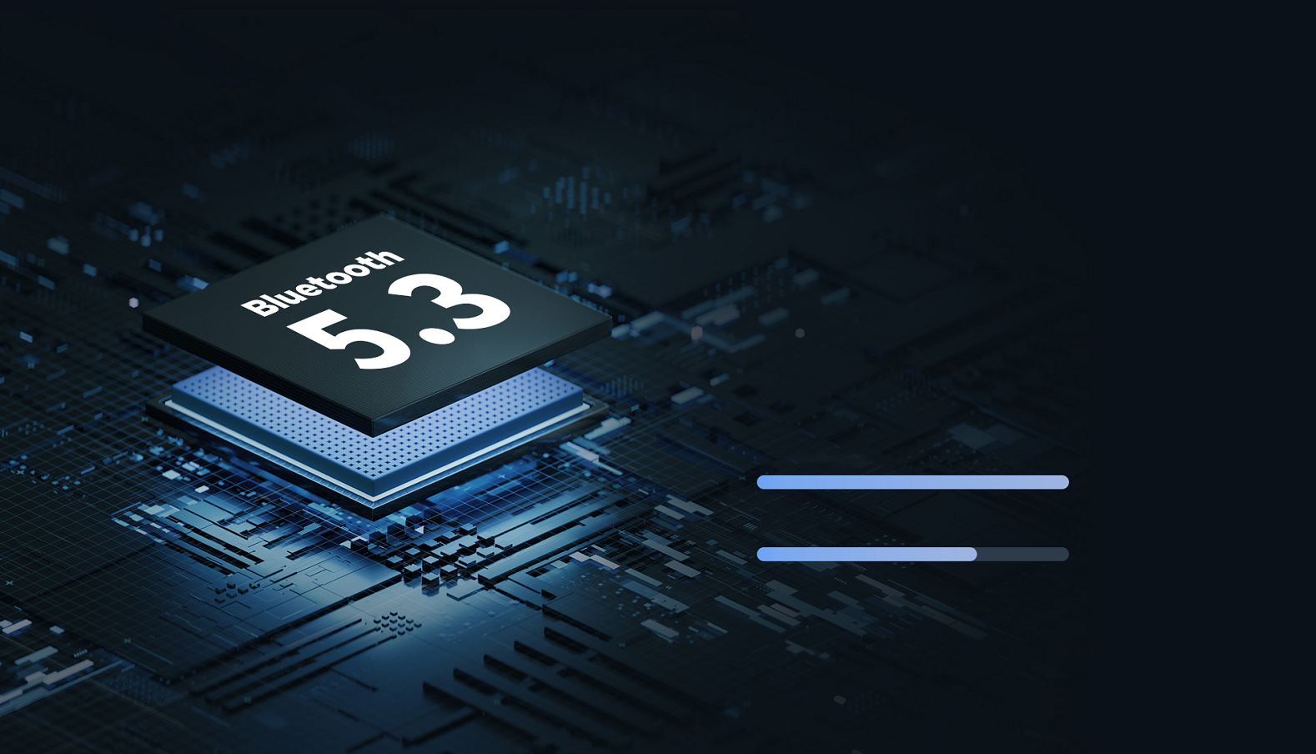
Seamlessly Connectivity
Advanced Bluetooth 5.3 Technology
The 1MORE S50 sport earbuds feature the currently most advanced Bluetooth 5.3 version. Supporting seamless use - less power consumption, strong anti-interference, effortless entertainment, and wide compatibility.
Bluetooth 5.3 Transmission
Bluetooth 5.0 Transmission

Slide 15
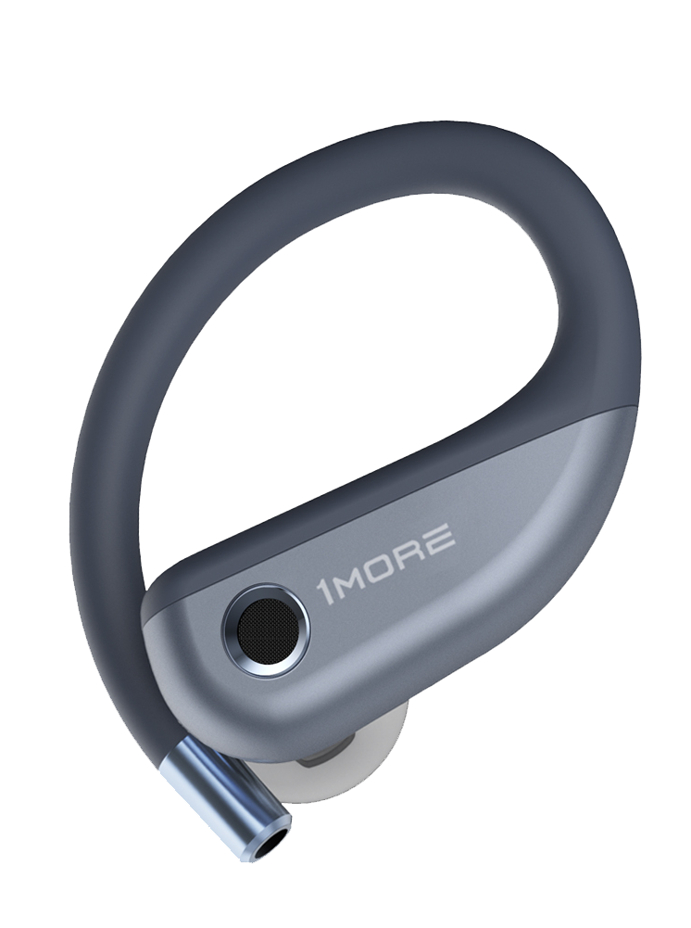
Smart Playback Keeps You In The Zone
Sensitive Touch Control
Smart Playback
Auto pause when an earbud is taken off
Music
Play / Pause: Double Tap
Calls
Answer / End Calls: Double Tap
Activate Voice Assistant
Triple Tap when connected and not in a call
Touch Control
* Reject a call via your phone or other devices; Install the 1MORE MUSIC APP to customize the controls.
The above functions apply to either bud when using single or dual mode.
* The above features may vary slightly depending on the device.

Slide 16
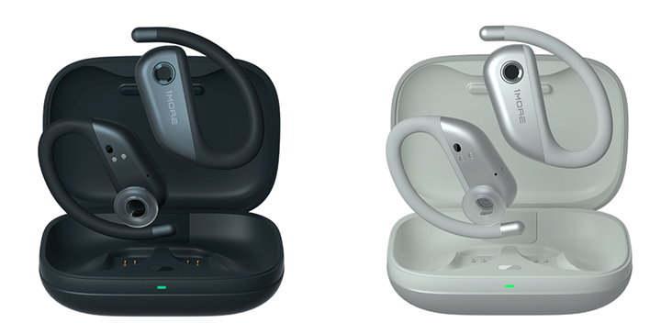
Specifications
Earbud Weigh: 10 g
Case Weight: 63 g
Product Weight: 82.5 g
Earbud Size: 50.68 × 38.27 × 20.26 mm
Case Size: 86 × 65 × 29.8 mm
Earbud Battery Capacity: 60 mAh
Case Battery Capacity 500 mAh
Earbud Charging Time: 80 mins
Case Charging Time: 90 mins
Earbud Playtime (Fully Charged): 11 hours*
Total Playtime (Fully Charged): 38 hours*
Impedance:16 Ω
Wireless Range: 10 m
Bluetooth: Bluetooth® 5.3
Bluetooth Protocol: HFP / A2DP / AVRCP
Input: 5V 1A
Working Temperature: 0 ℃ ~ 45 ℃
Frequency Band: 2.400 GHz ~ 2.4835 GHz
Grey
Silver
The specifications are acquired from laboratory tested data.
* The playback time, tested under the laboratory condition of AAC format and 50% volume, may vary with different device settings, environments, usage and other factors.

