Slide 1



blurams Home Pro
www.blurams.com

Slide 2


We Are blurams
2
Blurams is a leading, international provider of advanced, intelligent imaging technologies, products, services and platforms.
Blurams advocates technological innovation and product experience, and has built the advantages on end-to-end integrated solutions in image processing, computer vision and cloud computing, etc.
Blurams’ competitive solutions, products and services have been provided to enterprises and consumers globally with it’s determination for the smart future.
We are dedicated to make everyone live a carefree life.

Slide 3
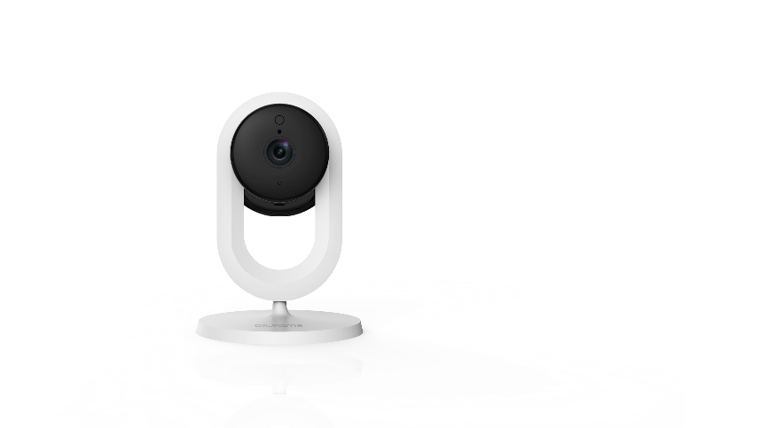
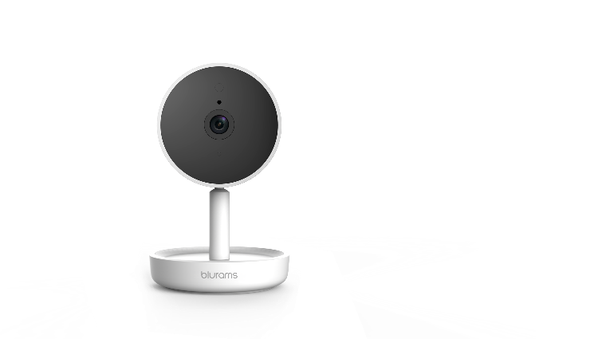
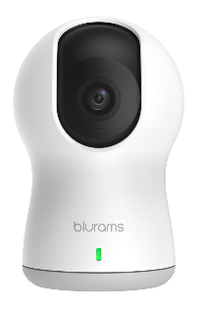
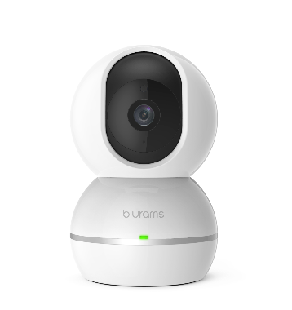
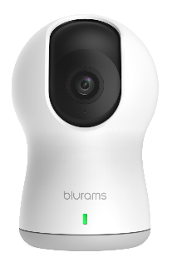
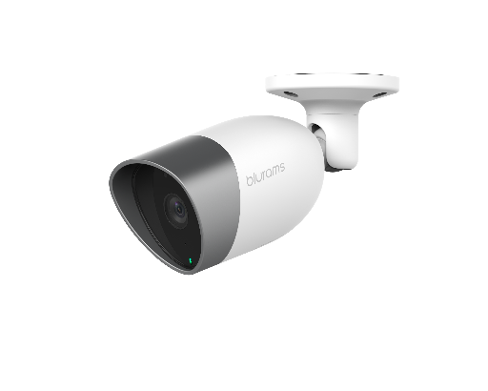
Current Product Portfolio
3
blurams Home Lite
blurams Home Pro
blurams Dome Lite
blurams Dome Pro
blurams Snowman
blurams Outdoor Pro

Slide 4
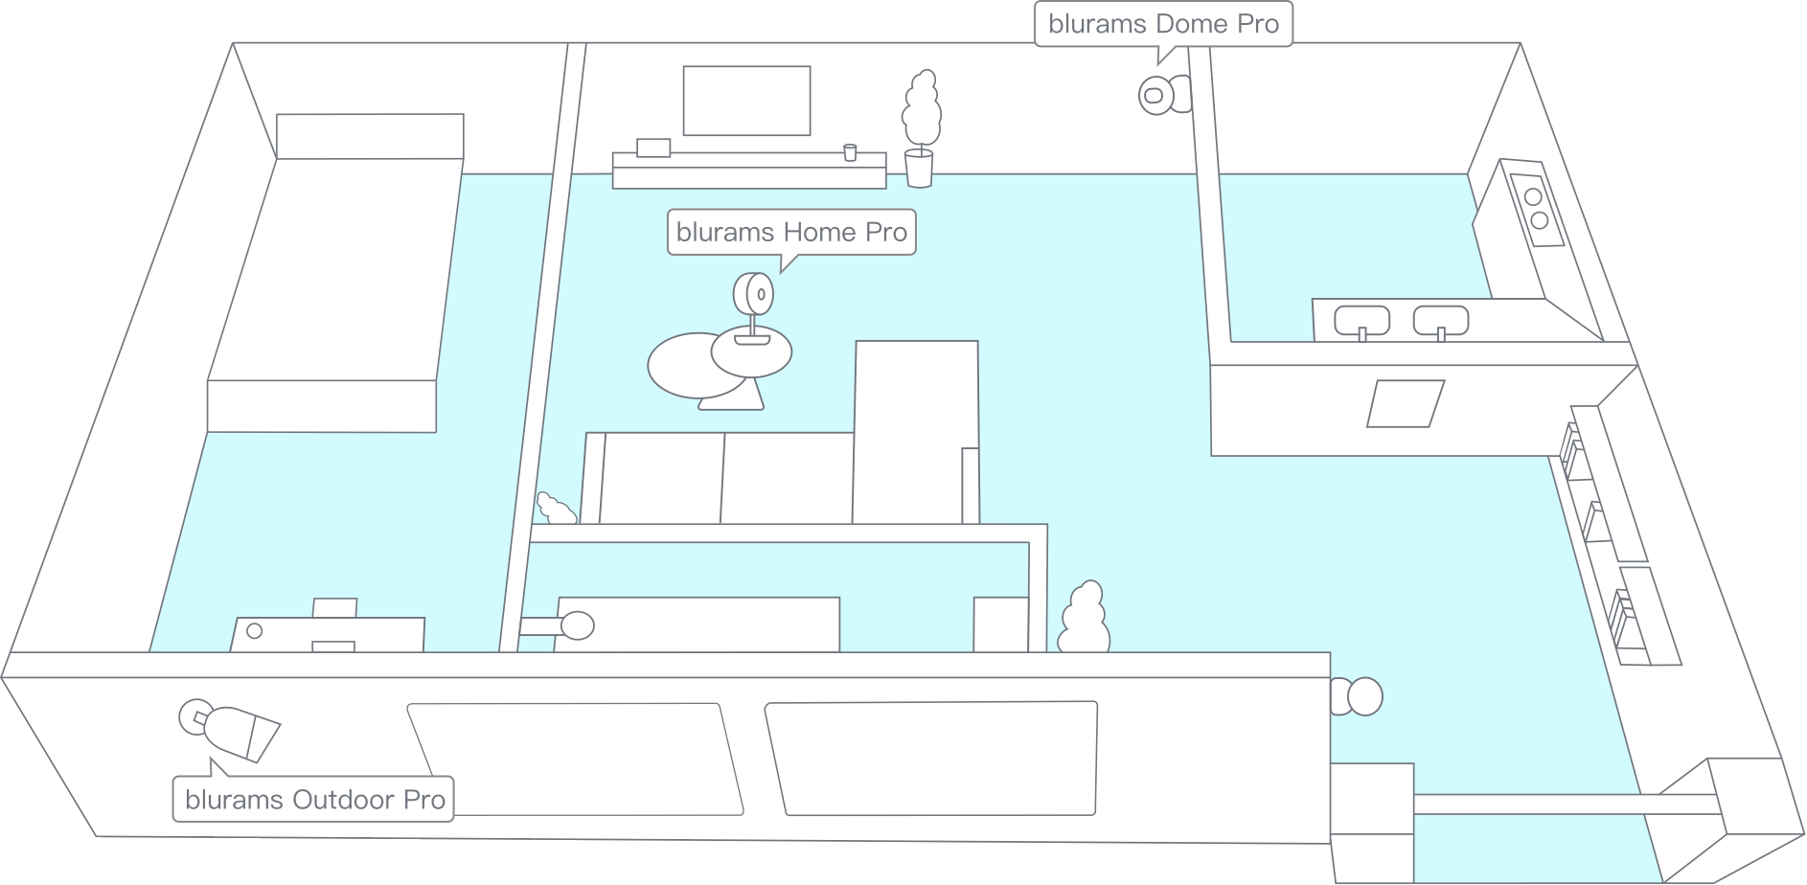
blurams Smart Home Solution
Our ecosystem of products work together in one app to cover any size home.

Slide 5
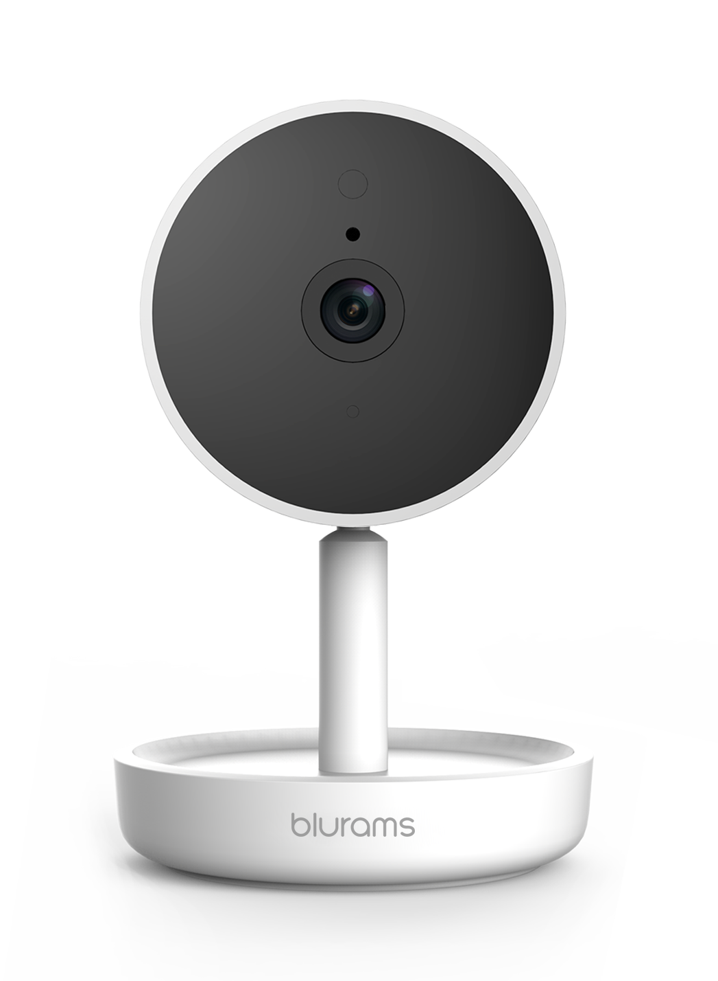










blurams Home Pro
5
Optional24/7 CVR
Intelligent Alerts
Night Vision
1080P Resolution
2-Way Audio
Human Detection
Mobile and PC App
Ultra Wide Angle

Slide 6
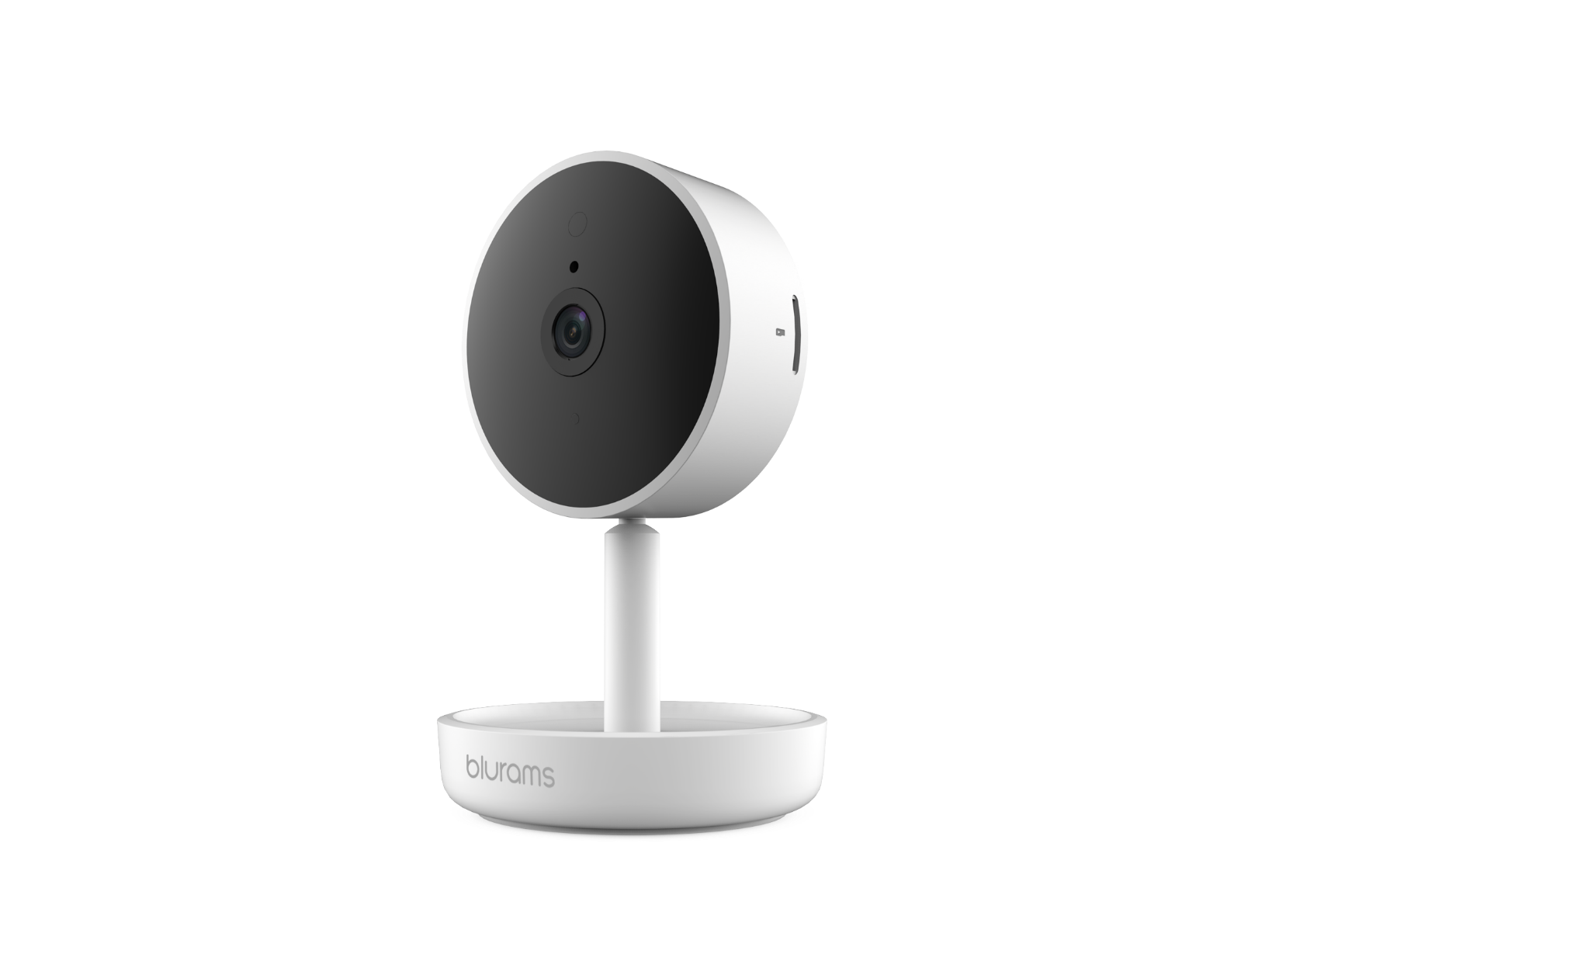
6
blurams Home Pro Highlights & Features
1080p HD Quality：Watch and record crisp HD video in more detail than ever before.
Person Alerts：Get alerts if someone is outside your home, whether they're delivering a package or trying to break in.
Night Vision：Turns on automatically in low light so you can see clearly, even in the dark.
2-Way Audio：Listen in and talk back through the camera from your smartphone.
Optional 24/7 CVR：Upgrade to keep nonstop recordings in the cloud when the camera is plugged in and used indoors.
Human Detection：You can be only informed when human intruder just appears in the view of camera.

Slide 7

7
blurams Home Pro Highlights & Features
Blurams Cloud: secure the all your blurams camera’s recordings with blurams Cloud, using financial-industry level encryption which means the safest storage solution.
Blurams App: view the live steaming through your mobile phone or PC web and set various functions on App. It only takes 1 minute to get connected.

Slide 8
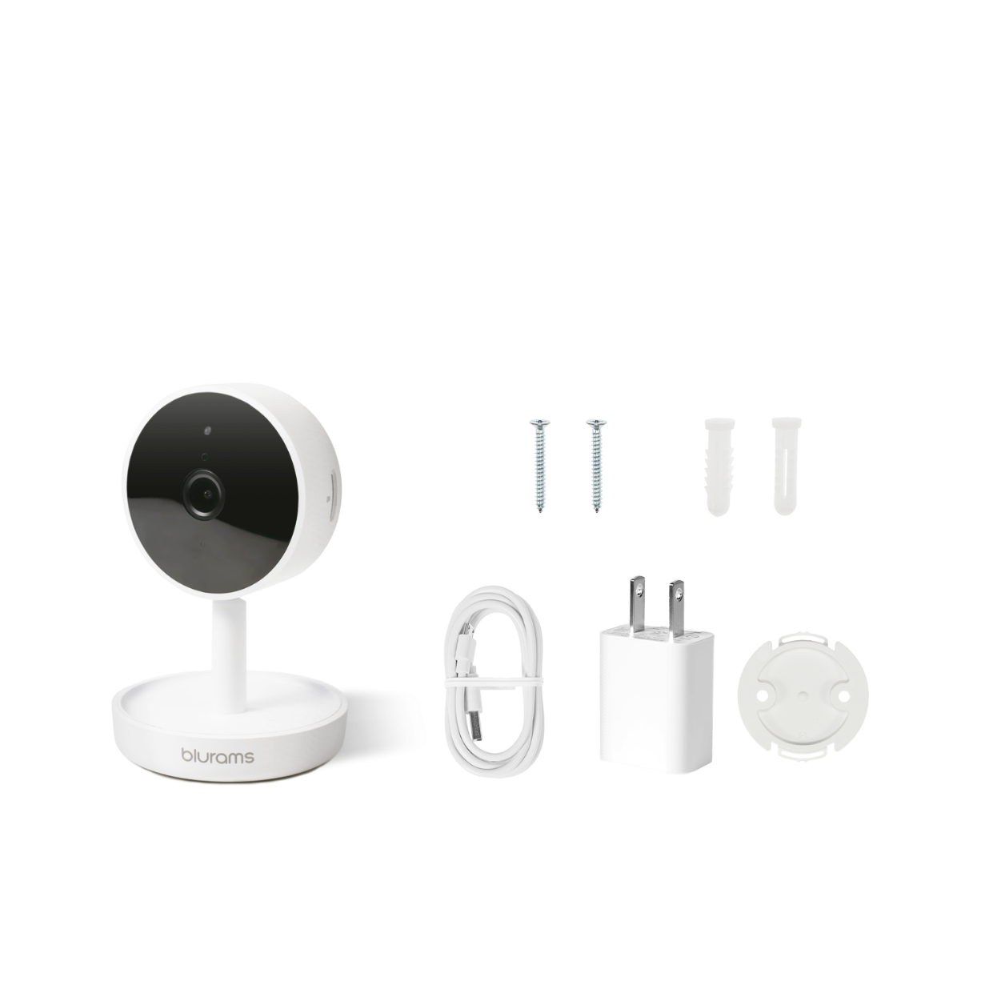
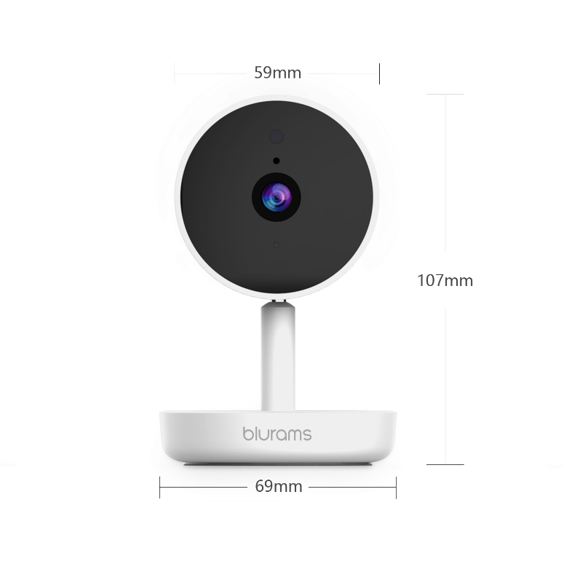
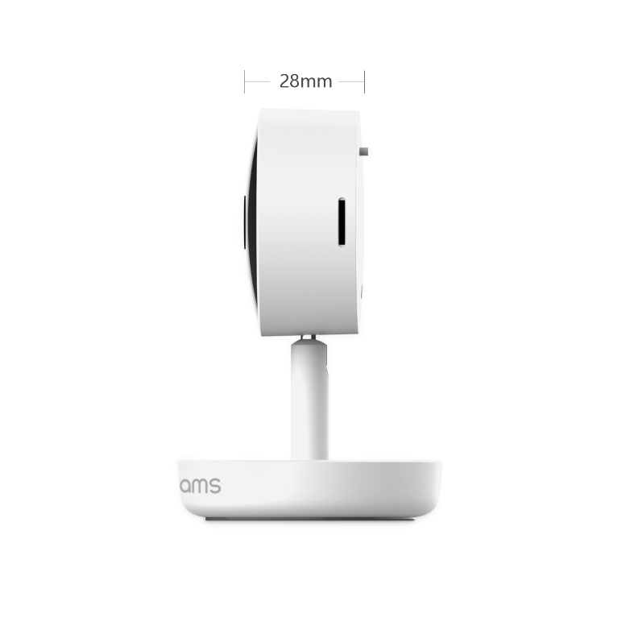
Packing list
8
Dimension: 143mm×93mm×74mm
Weight: 95g With Box: 280g

Slide 9
Technical Specs
9
Functions | blurams Home Pro
Power Supply | 2 Meter Cable DC 5V/1A Micro USB
Operating Temp. | -10℃ — 50℃
Viewing Angle | 131°wide angle
Image/Audio Enhancing | 3D Noise Reduction, 4X digital zoom, Distortion correction
Image Sensor | 1/2.7’’ 2MP CMOS Sensor
Video Streams | 1080P/15FP·S
Night Vision | 6*940nm IR LEDs & 5-7m distance
Alert Information | Sound/Motion/Human Detection

Slide 10
Technical Specs
10
Functions | blurams Home Pro
Microphone/Speaker | Two-Way Audio, Dual Modes: Intercom/Hands-free
Local Storage | Up to 128GB Micro SD
Cloud Storage | 1 month 7 days all-day plan for free then Standard and Premium plan available
Supported App | Mobile: Android/iOS (Windows Phone not supported) in 1 integrated app and PC Web App
Video Coding | H.264+
Wireless Standards | IEEE 802.11b/g/n
IPsec Protocols | 64/128-bit WEP、WPA/WPA2、WPA-PSK/WPA2-PSK、WPS

Slide 11
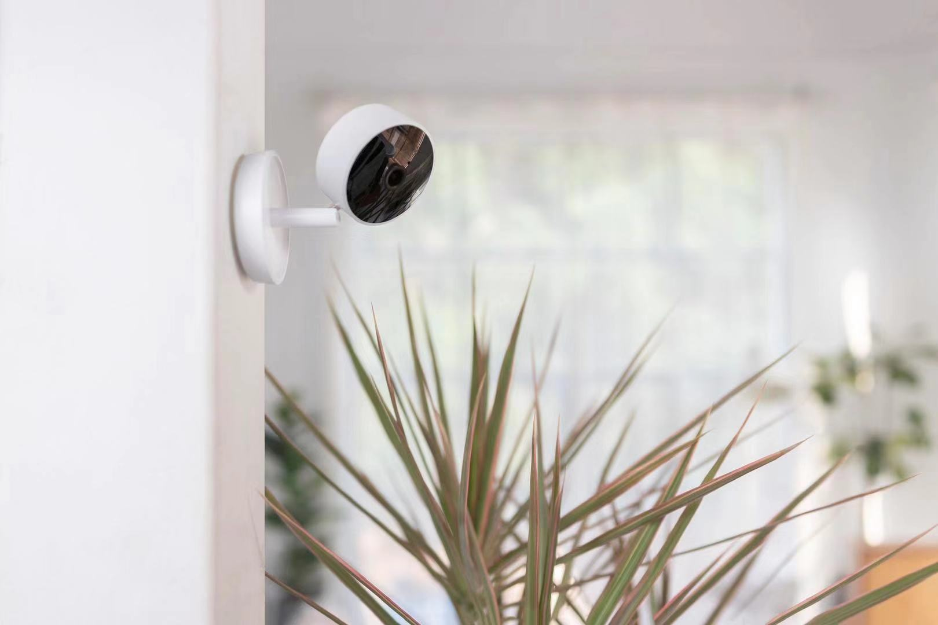

Slide 12

Living Carefree
www.blurams.com

