Slide 1



Blurams PTZ Dual-Lens Outdoor Cam 3MP
www.blurams.com

Slide 2

We Are Blurams
Blurams is a leading, international provider of advanced, intelligent imaging technologies, products, services and platforms.
Blurams advocates technological innovation and product experience, and has built the advantages on end-to-end integrated solutions in image processing, computer vision and cloud computing, etc.
Blurams competitive solutions, products and services have been provided to enterprises and consumers globally with it's determination for the smart future.
We are dedicated to making everyone live a carefree life.

Slide 3
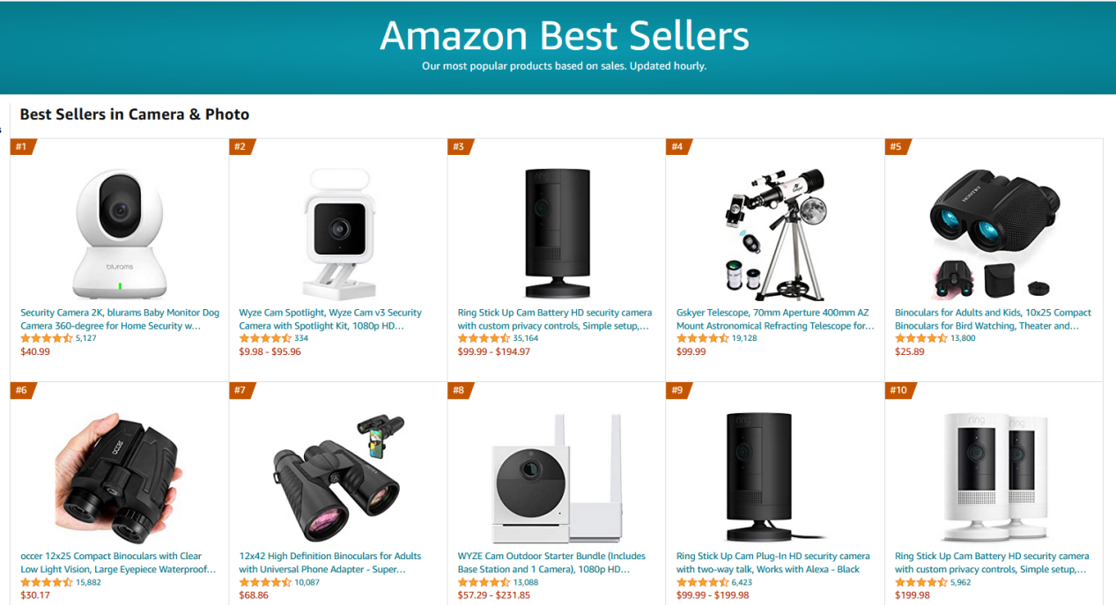
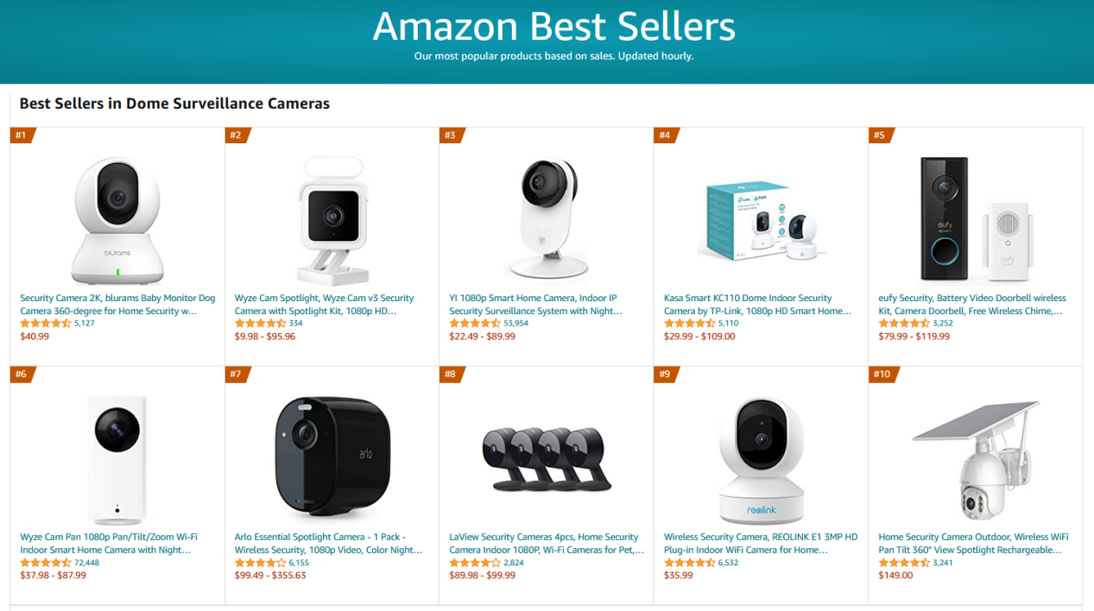
#1 Best Seller on Amazon
Camera & Photo
The largest category of cameras on Amazon
Dome Surveillance Cameras

Slide 4

Blurams Smart Home Solution
Our products work together as an ecosystem via app to cover any size of houses.

Slide 5
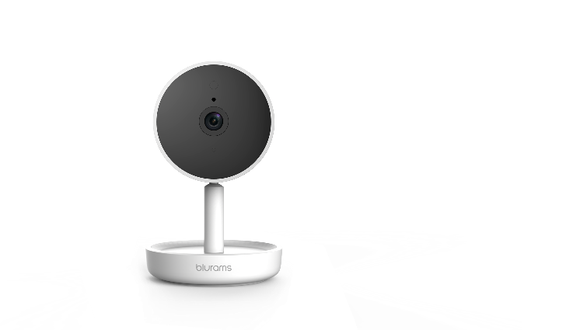
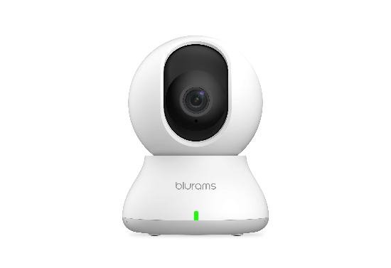
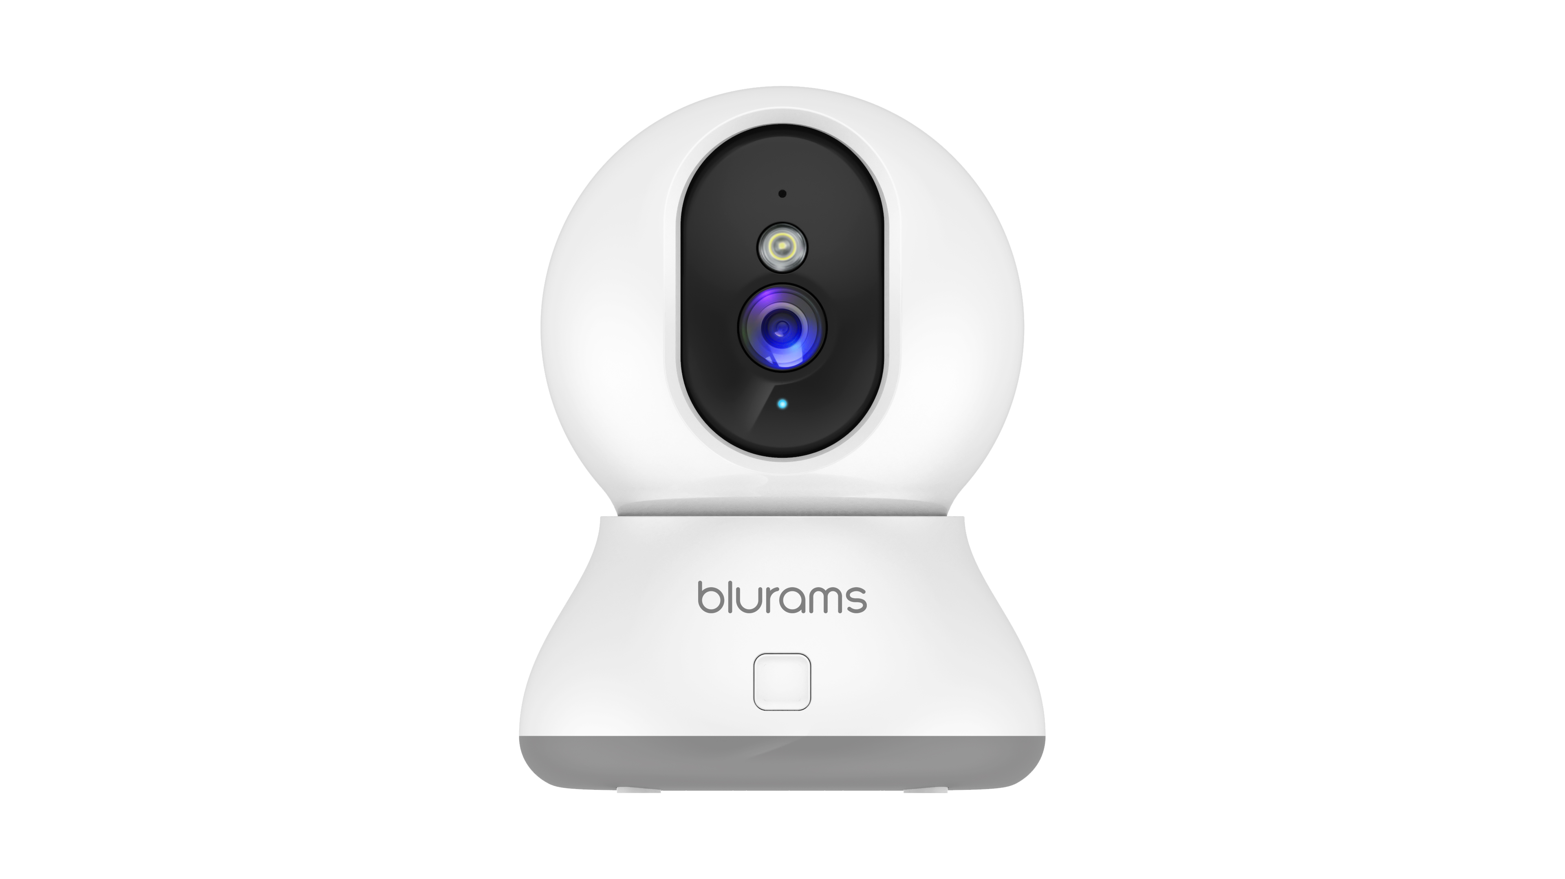
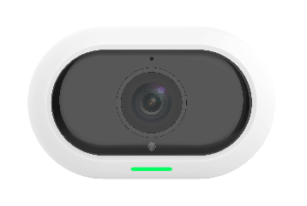
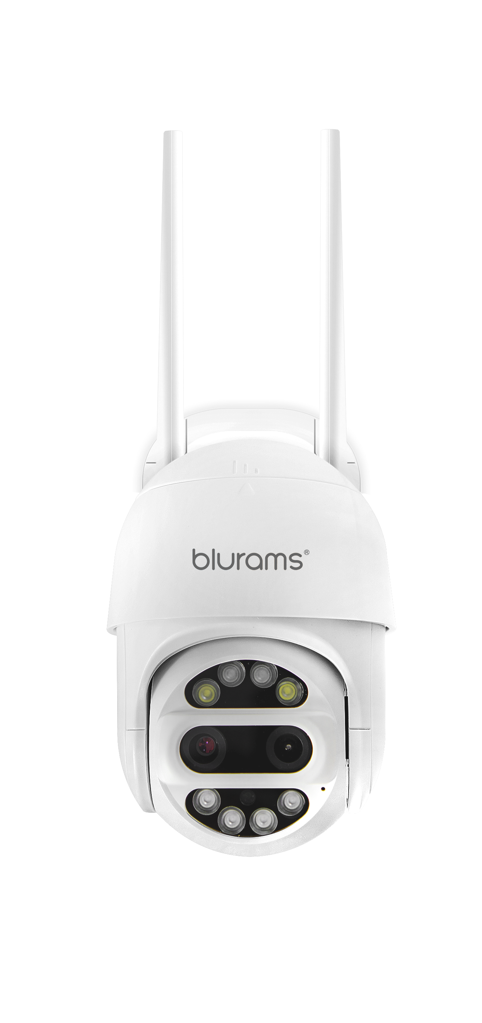
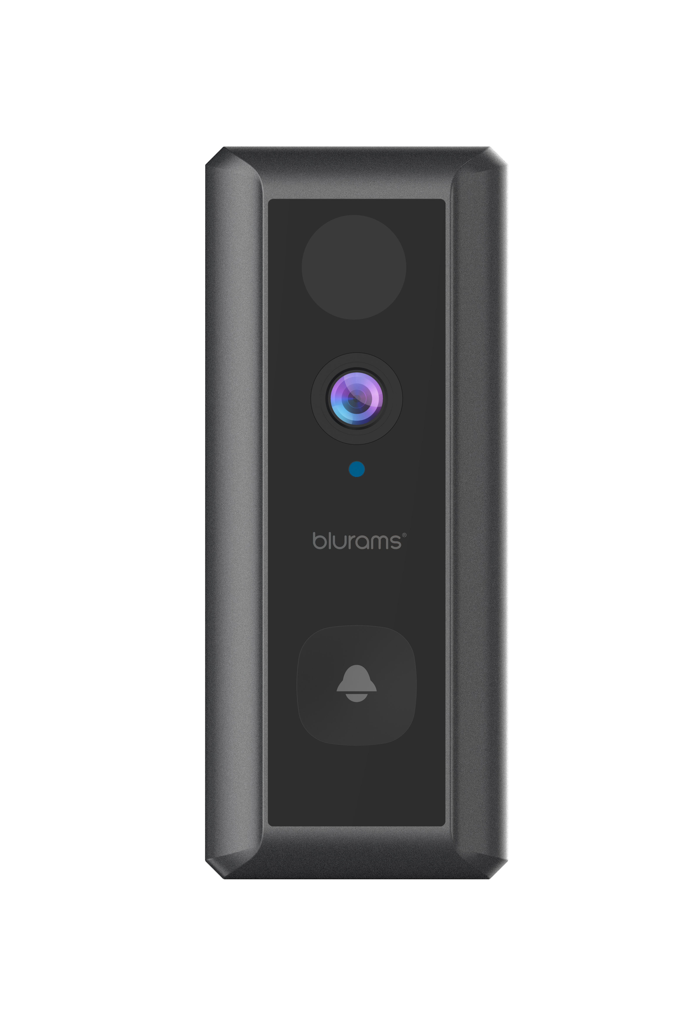
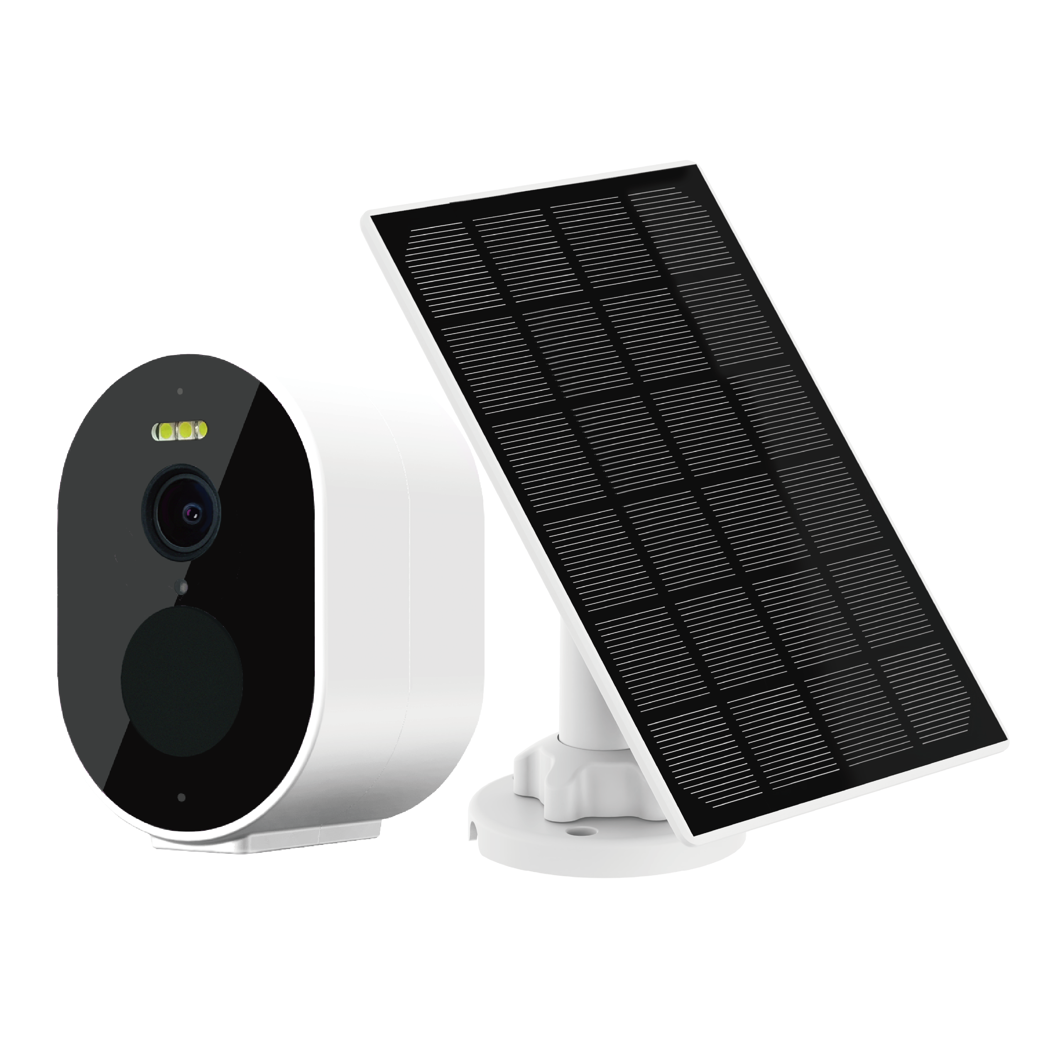
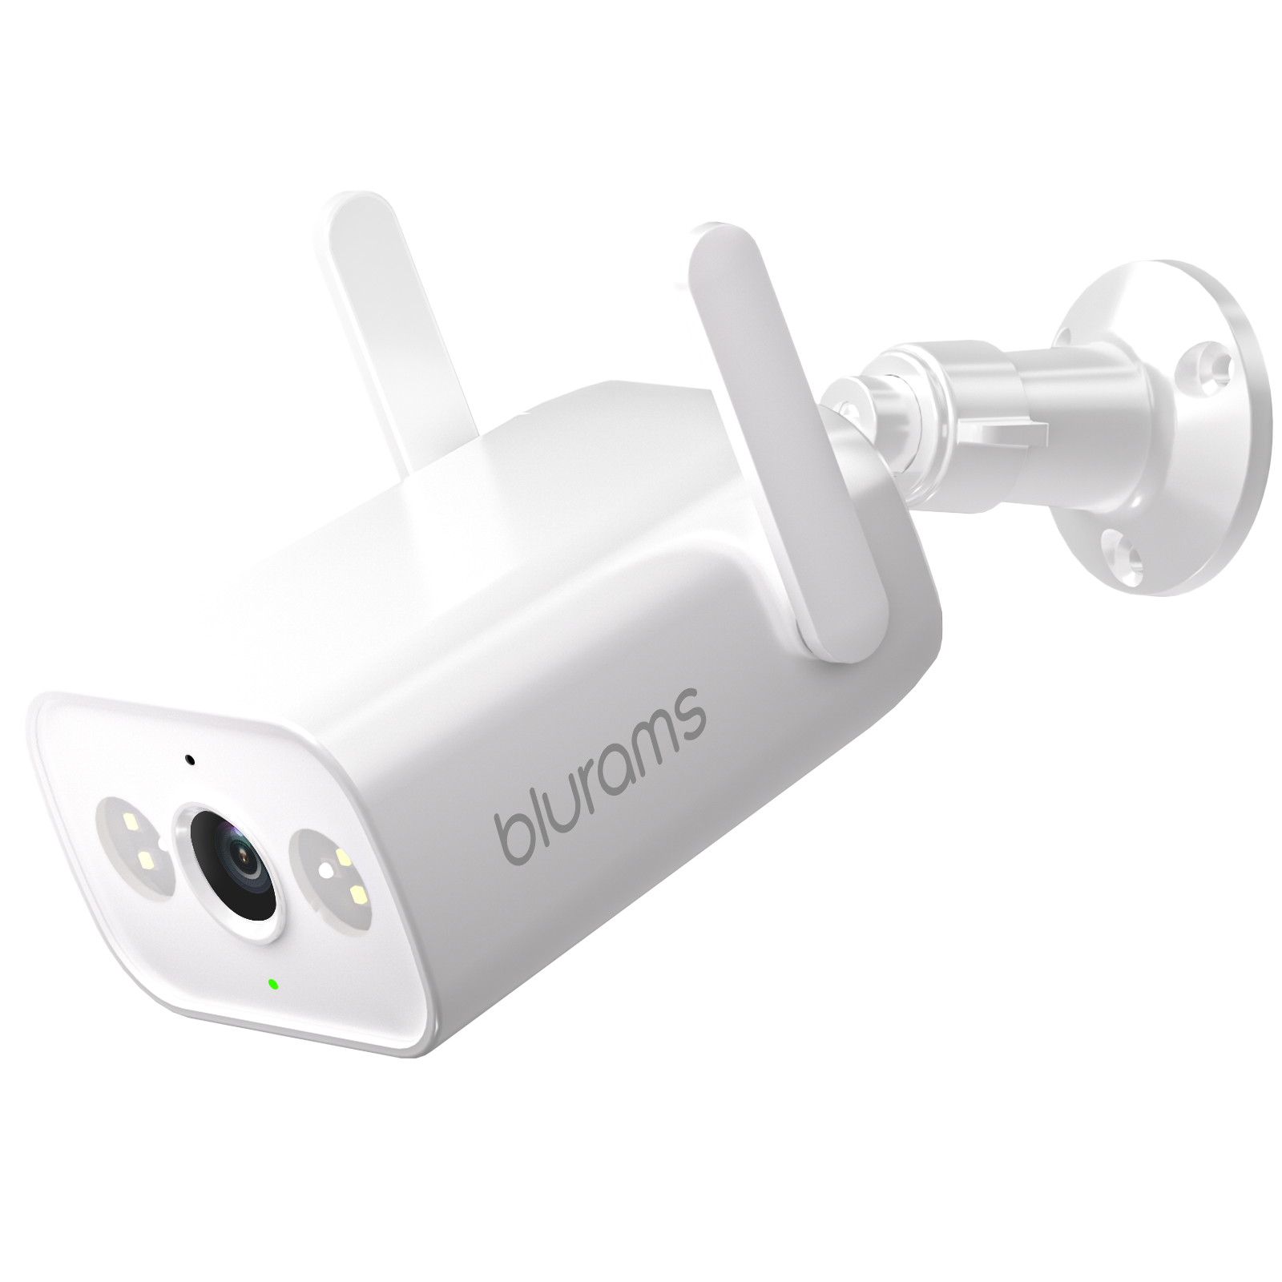
Current Product Portfolio
Blurams Dome Lite 2
Blurams Home Pro 2K
Blurams Outdoor Pro
Blurams Dome Pro 2
Blurams PTZ Dual-Lens
Outdoor Cam 3MP
Blurams Wire-Free
Camera 2K Kit
Blurams Wire-Free
Video Doorbell 2K
Blurams Outdoor Lite 4

Slide 6
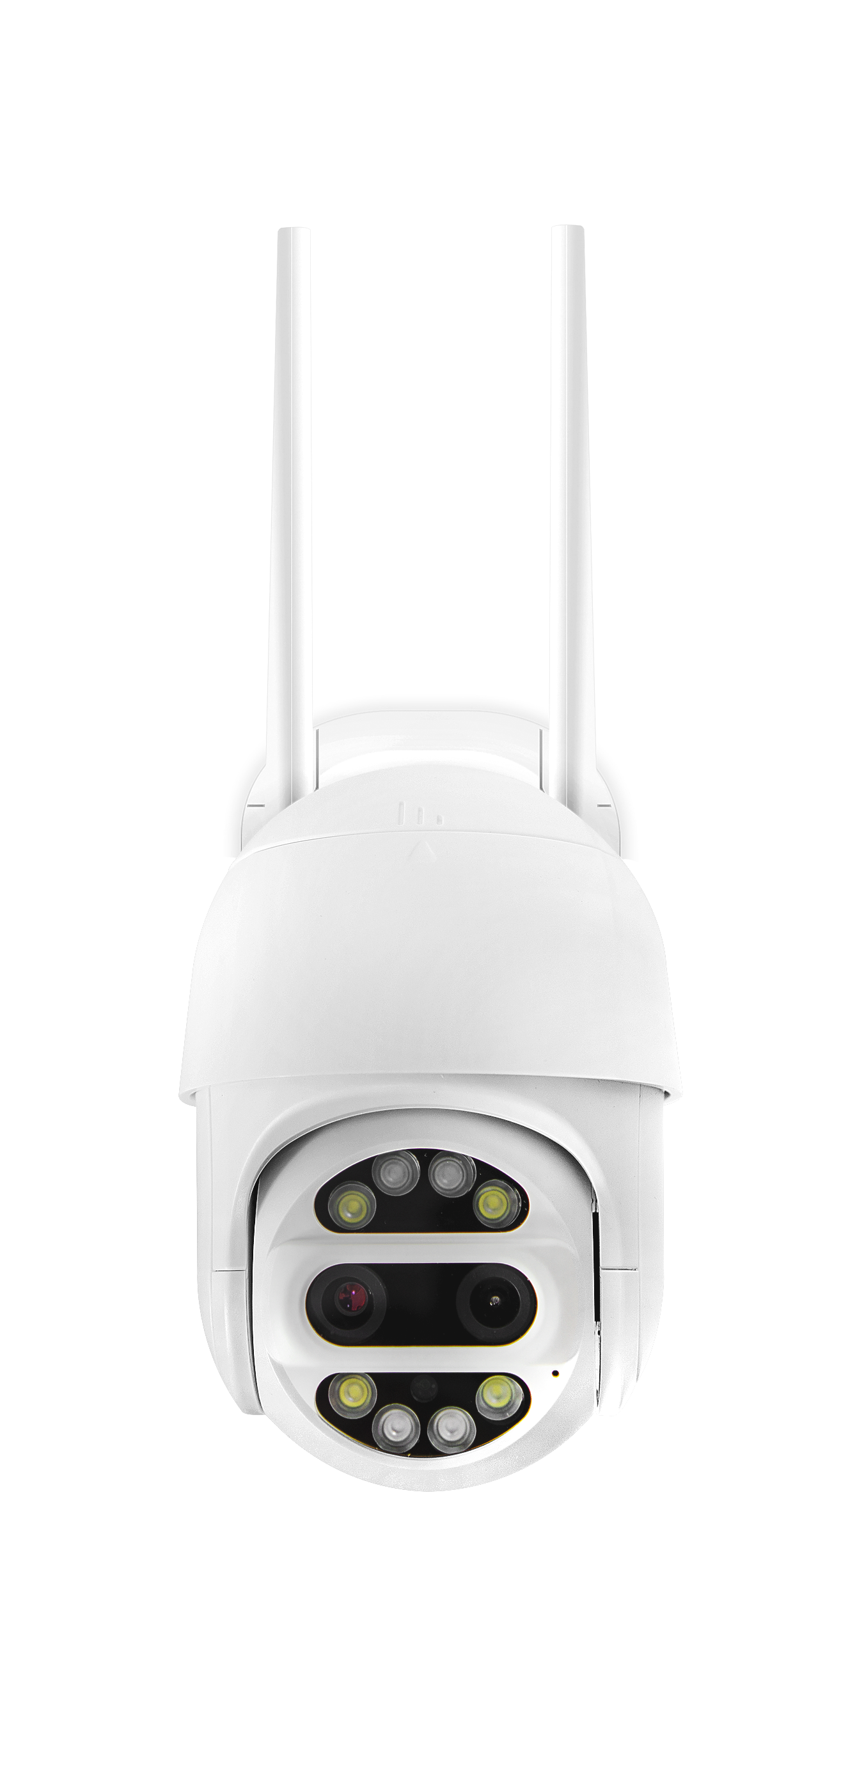














Blurams PTZ Dual-Lens Outdoor Cam 3MP
Optional 24/7 Recording
Intelligent Alerts
Color Night Vision
2K Resolution
PTZ Design
2-Way Audio
Wi-Fi & Ethernet
Mobile and Web View
IP66
Dual Lenses

Slide 7
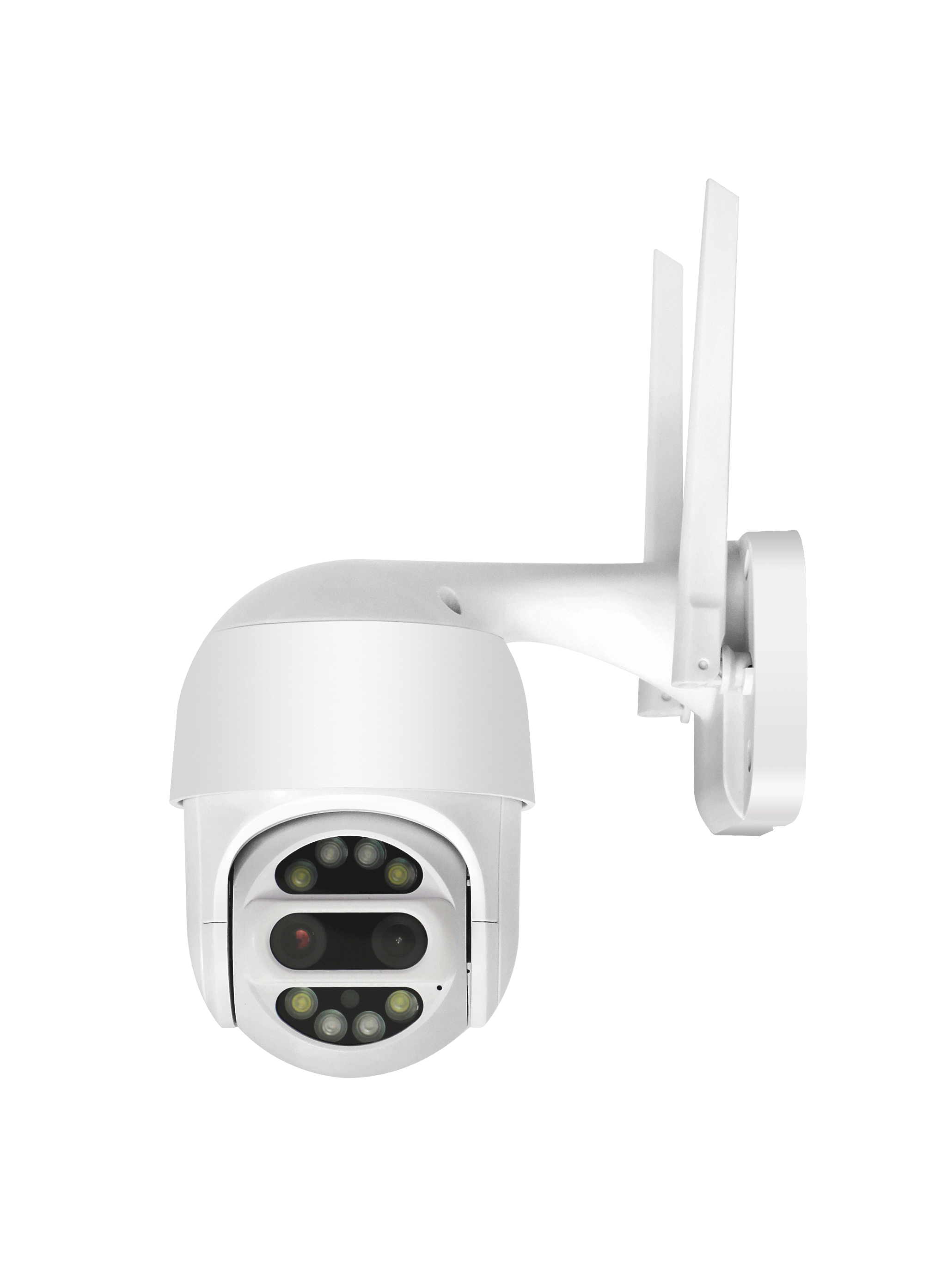
Highlights & Features
PTZ & Auto Tracking: Rotate the camera to various angle via Blurams App and it can auto track human motions and activate siren to scare strangers away.
Dual-Lens 3MP: 1X to 9X digital zoom enables you to see farther and clearer in 3MP high resolution.
Instant Alerts: Get instant notifications sent to your smartphone when detecting motions/sounds.
Color Night Vision: Built-in four 850nm IR LEDs, you can see things clearer in brighter colors within 10-15m distance.
Optional 24/7 Recording: Nonstop recording when connected to power source allows you to play complete back videos.
IP66 Certified Weather-Resistant: IP66-certified to withstand the rain, sun, heat or chill.
Wireless or Wired Connection: Connect to Wi-Fi or use an Ethernet cable to set the camera up. Two options, more flexible to use.

Slide 8

Intelligent Whole House Protection
Blurams Guard: secure all your blurams cameras recordings with blurams Cloud service, using financial-industry level encryption to offer the safest storage solution.
Blurams App: view the live steaming through your mobile phone or PC web and set various functions via App. It only takes 1 minute to get connected.

Slide 9
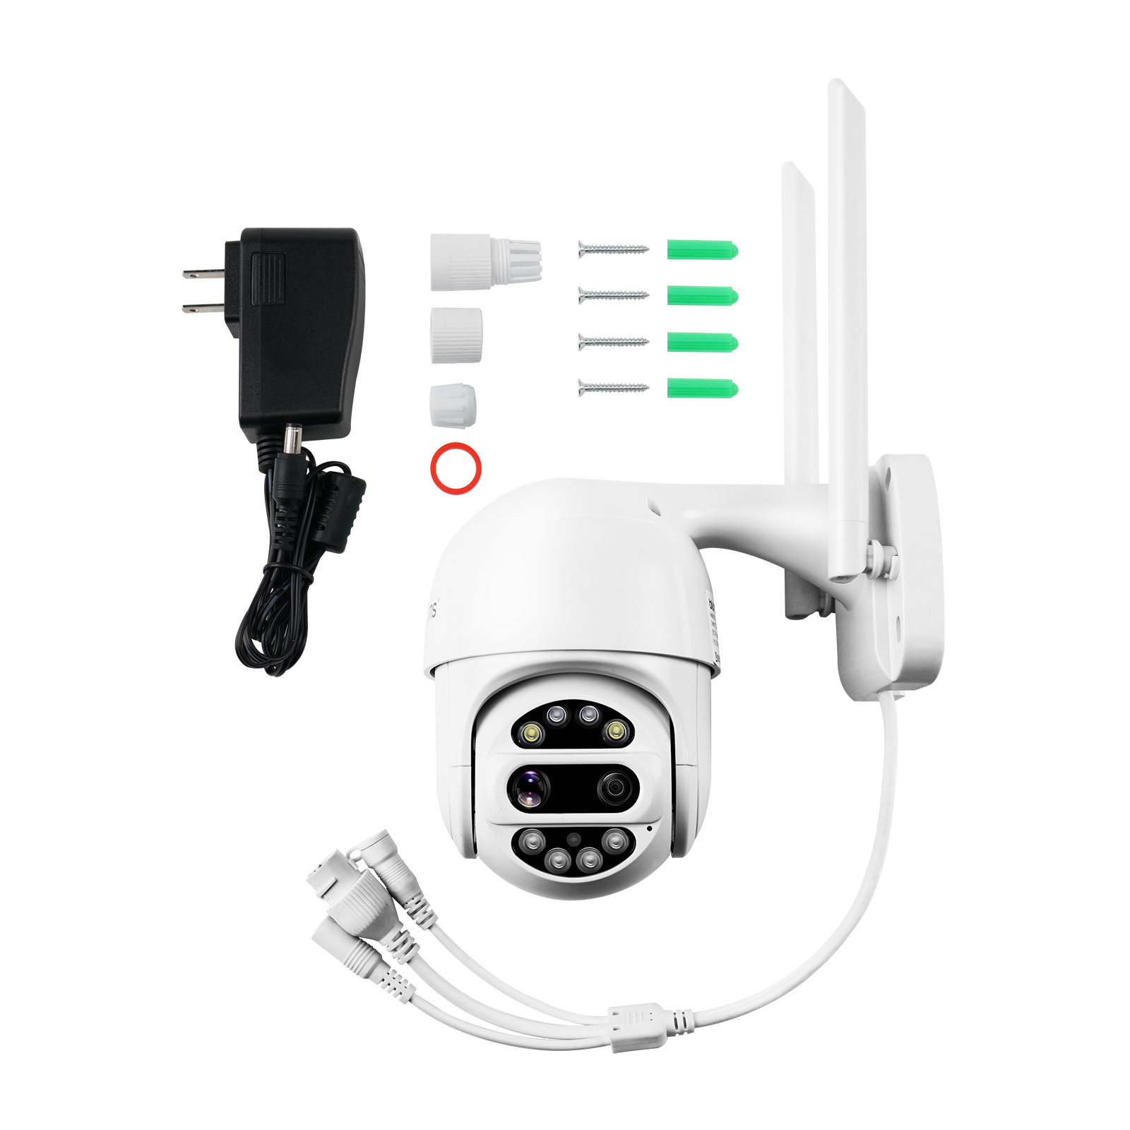
Packing List
260mm
110mm
165mm
Dimension: 260 x 165 x 110mm
Weight: 435g With box: 805g

Slide 10
Technical Specs
Functions | Blurams PTZ Dual-Lens Outdoor Cam 3MP
Power Supply | DC 12V/1A (3m Cable)
Operating Temp. | -20°C～60°C
Viewing Angle | 107° Wide Angle
Image/Audio Enhancing | 3D Noise Reduction, 9X Digital Zoom
Image Sensor | 1/3" 3.92&12mm 2MP CMOS Sensor
Video Streams | 2304*1296/15FPS
Night Vision | 4*850nm IR LEDs 10-15m (32.8-49.2ft)
Alert Information | Sound, Motion & Human Detection

Slide 11
Technical Specs
Functions | Blurams PTZ Dual-Lens Outdoor Cam 3MP
Microphone/Speaker | Two-Way Audio, Alarm Supported
Local Storage | Up to 128GB Micro SD, Hot Swap Not Supported
Cloud Storage | Free 1-Month 7-Day All-Day Plan (Standard and Premium Plan Available)
Supported App | Mobile: Android/iOS (Windows Phone not supported) in 1 Integrated App and PC Web View
Video Coding | H.265/H.264
Wireless Standards | IEEE 802.12b/g/n & Ethernet
IPsec Protocols | WPA/WPA2, WPA-PSK/WPA2-PSK

Slide 12
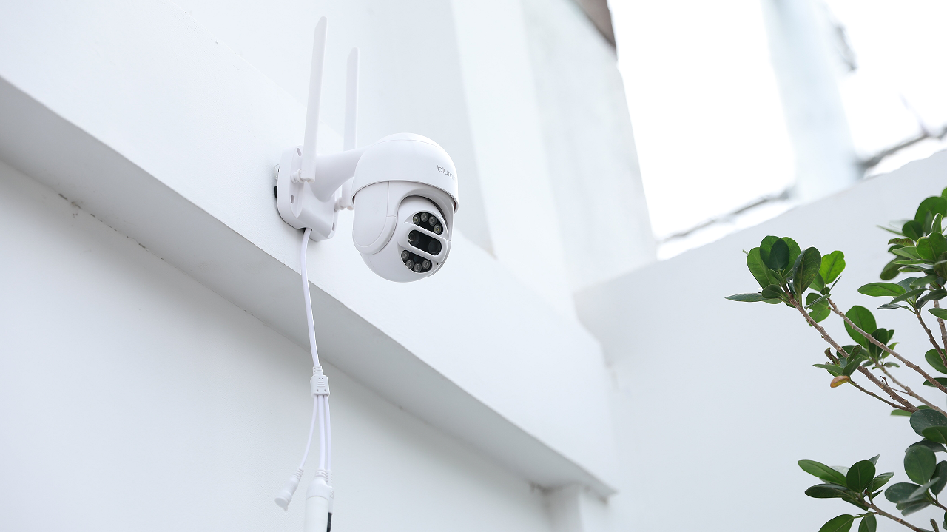

Slide 13

Living Carefree
www.blurams.com

