Slide 1



Blurams Wire-Free Video Doorbell 2K
www.blurams.com

Slide 2

We Are Blurams
2
Blurams is a leading, international provider of advanced, intelligent imaging technologies, products, services and platforms.
Blurams advocates technological innovation and product experience, and has built the advantages on end-to-end integrated solutions in image processing, computer vision and cloud computing, etc.
Blurams competitive solutions, products and services have been provided to enterprises and consumers globally with it's determination for the smart future.
We are dedicated to making everyone live a carefree life.

Slide 3
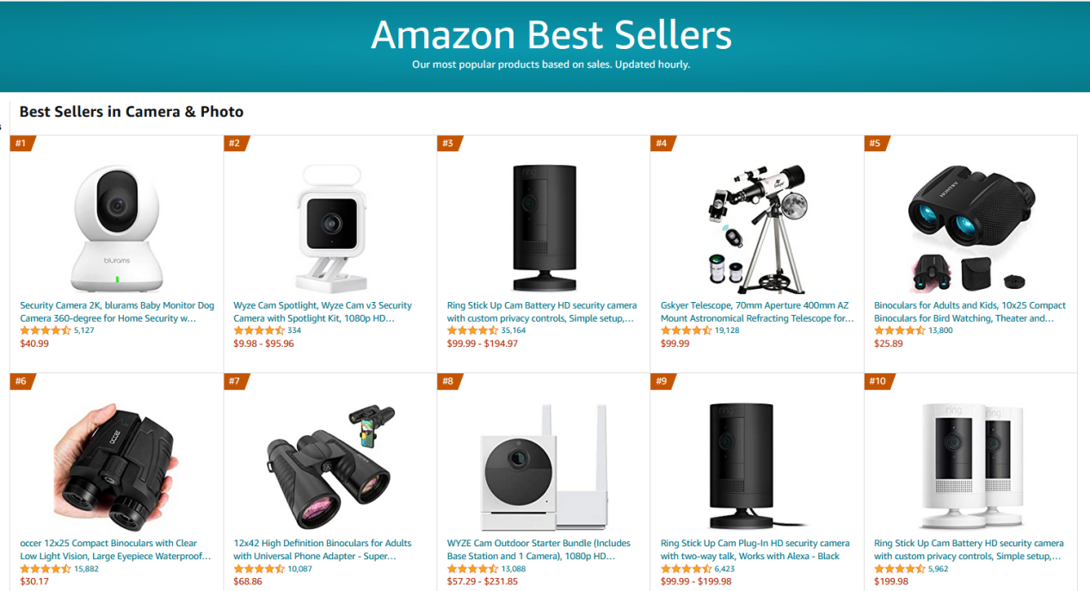
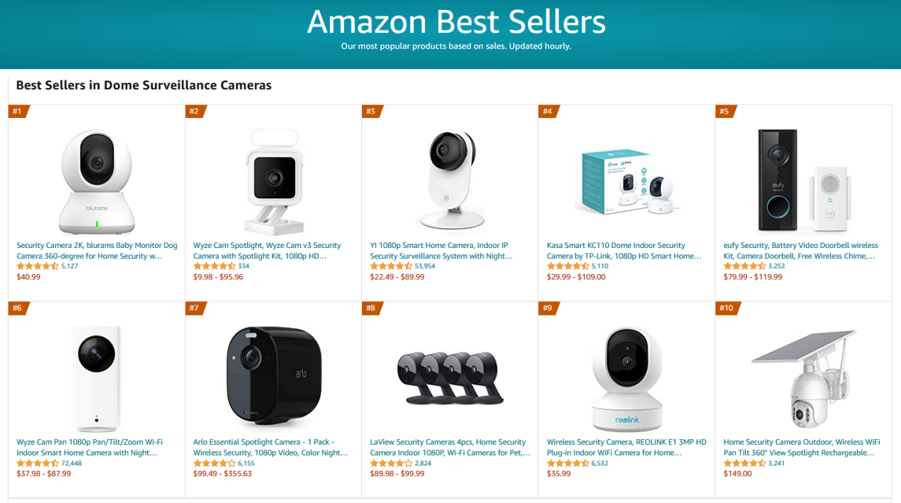
#1 Best Seller on Amazon
Camera & Photo
The largest category of cameras on Amazon
Dome Surveillance Cameras

Slide 4

Blurams Smart Home Solution
Our products work together as an ecosystem via app to cover any size of houses.

Slide 5
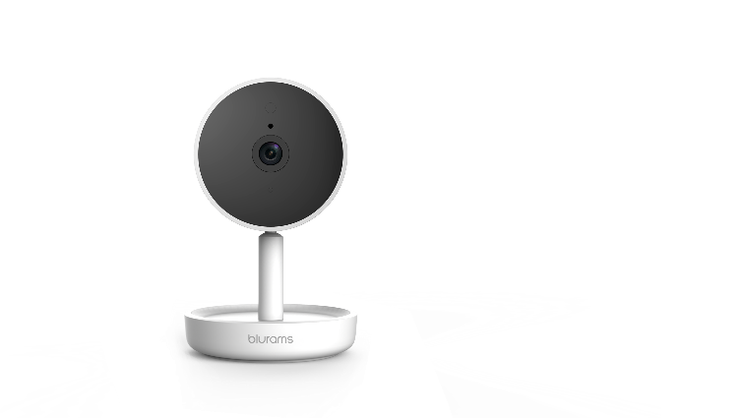
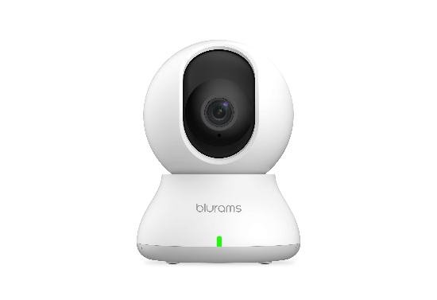
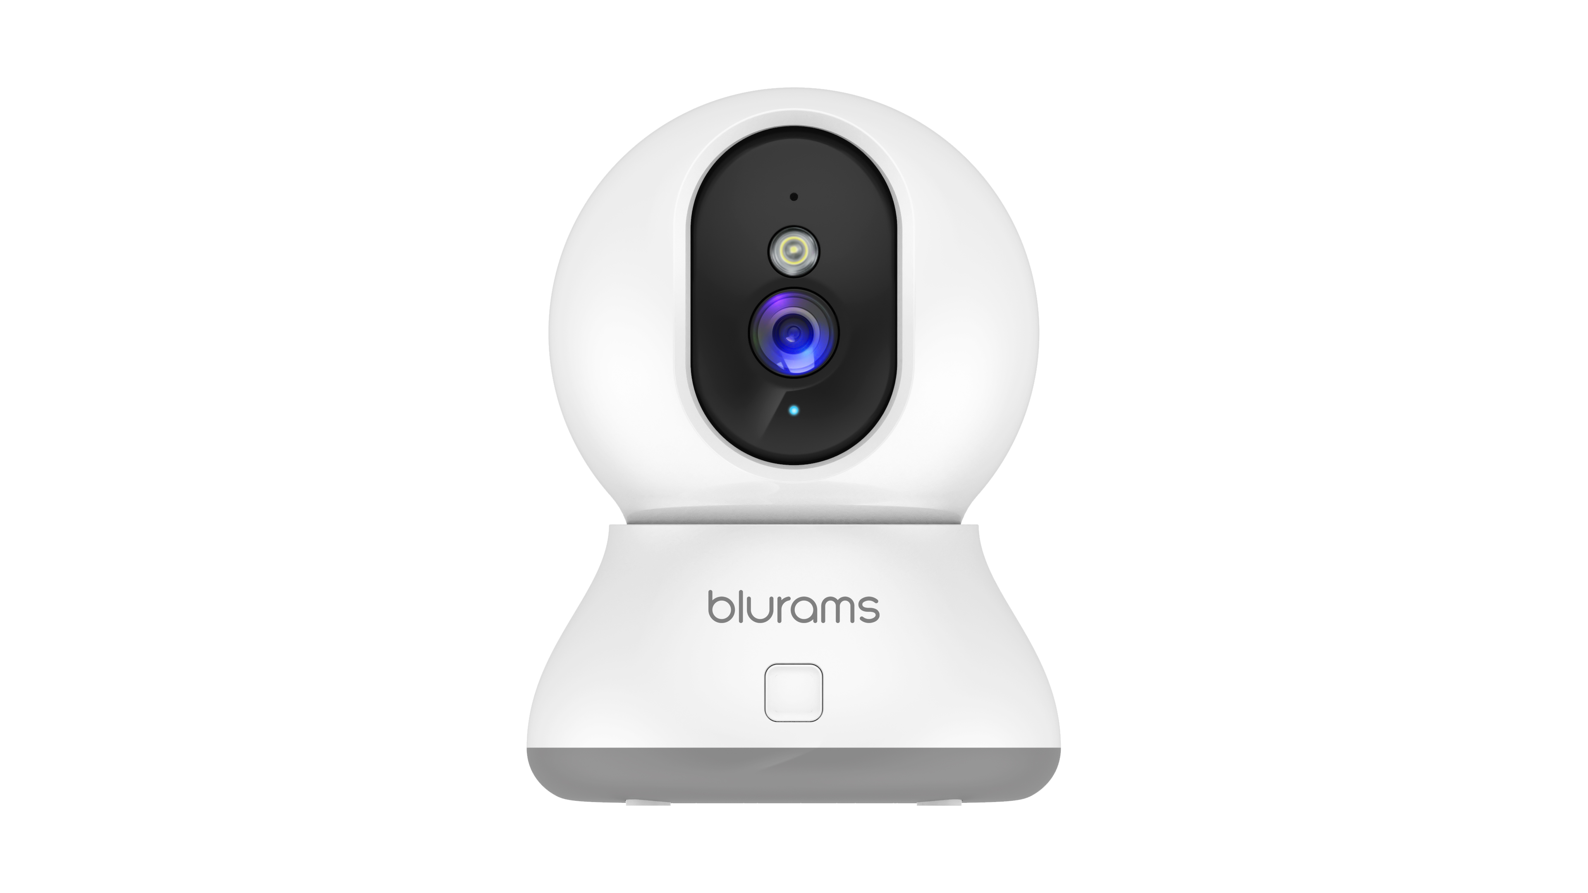
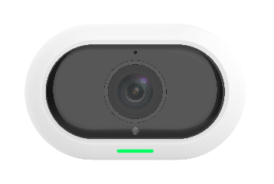
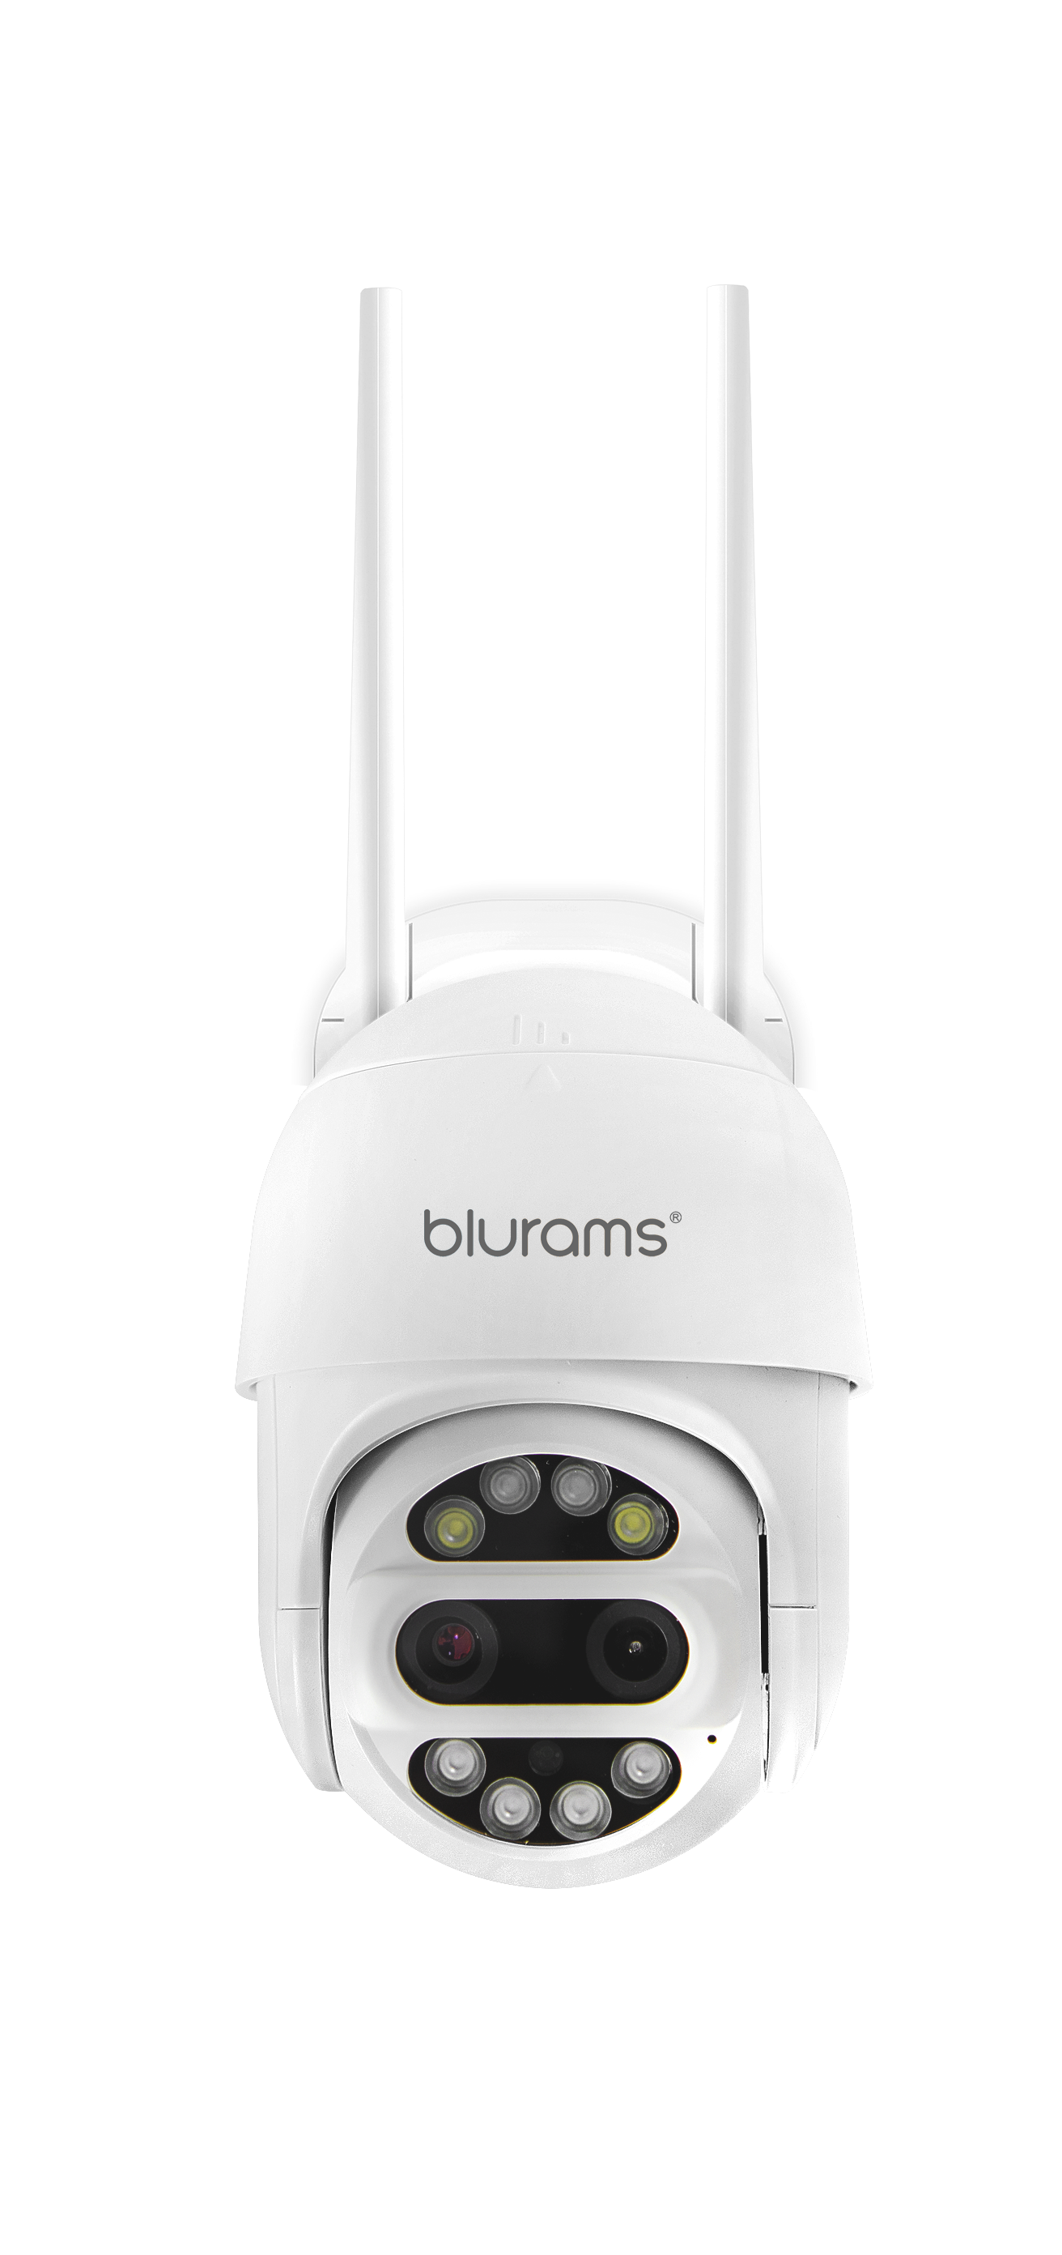
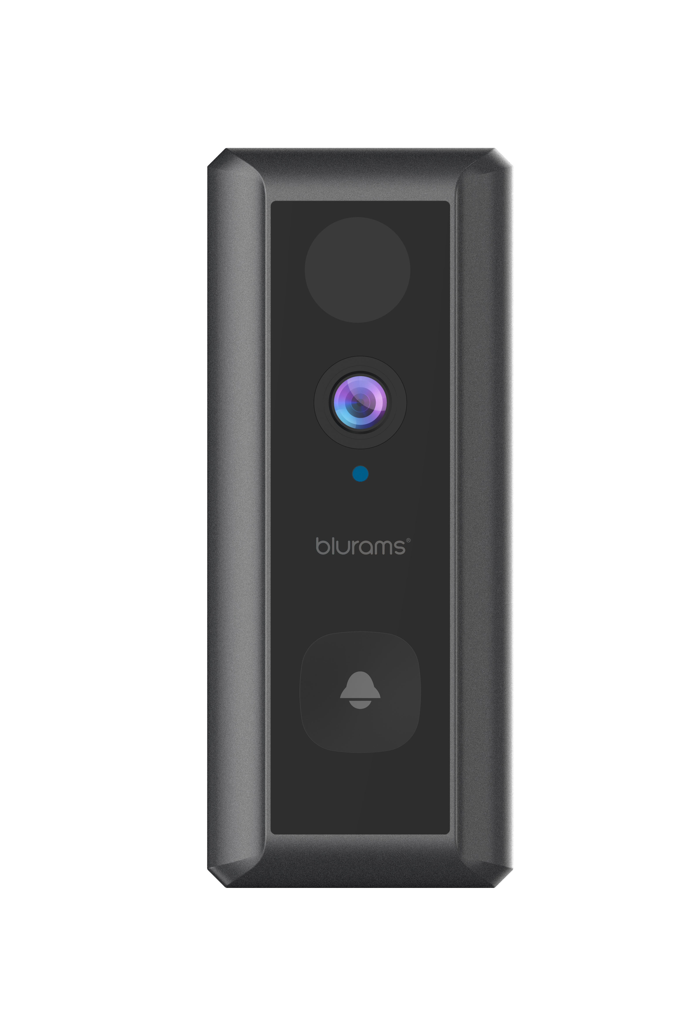
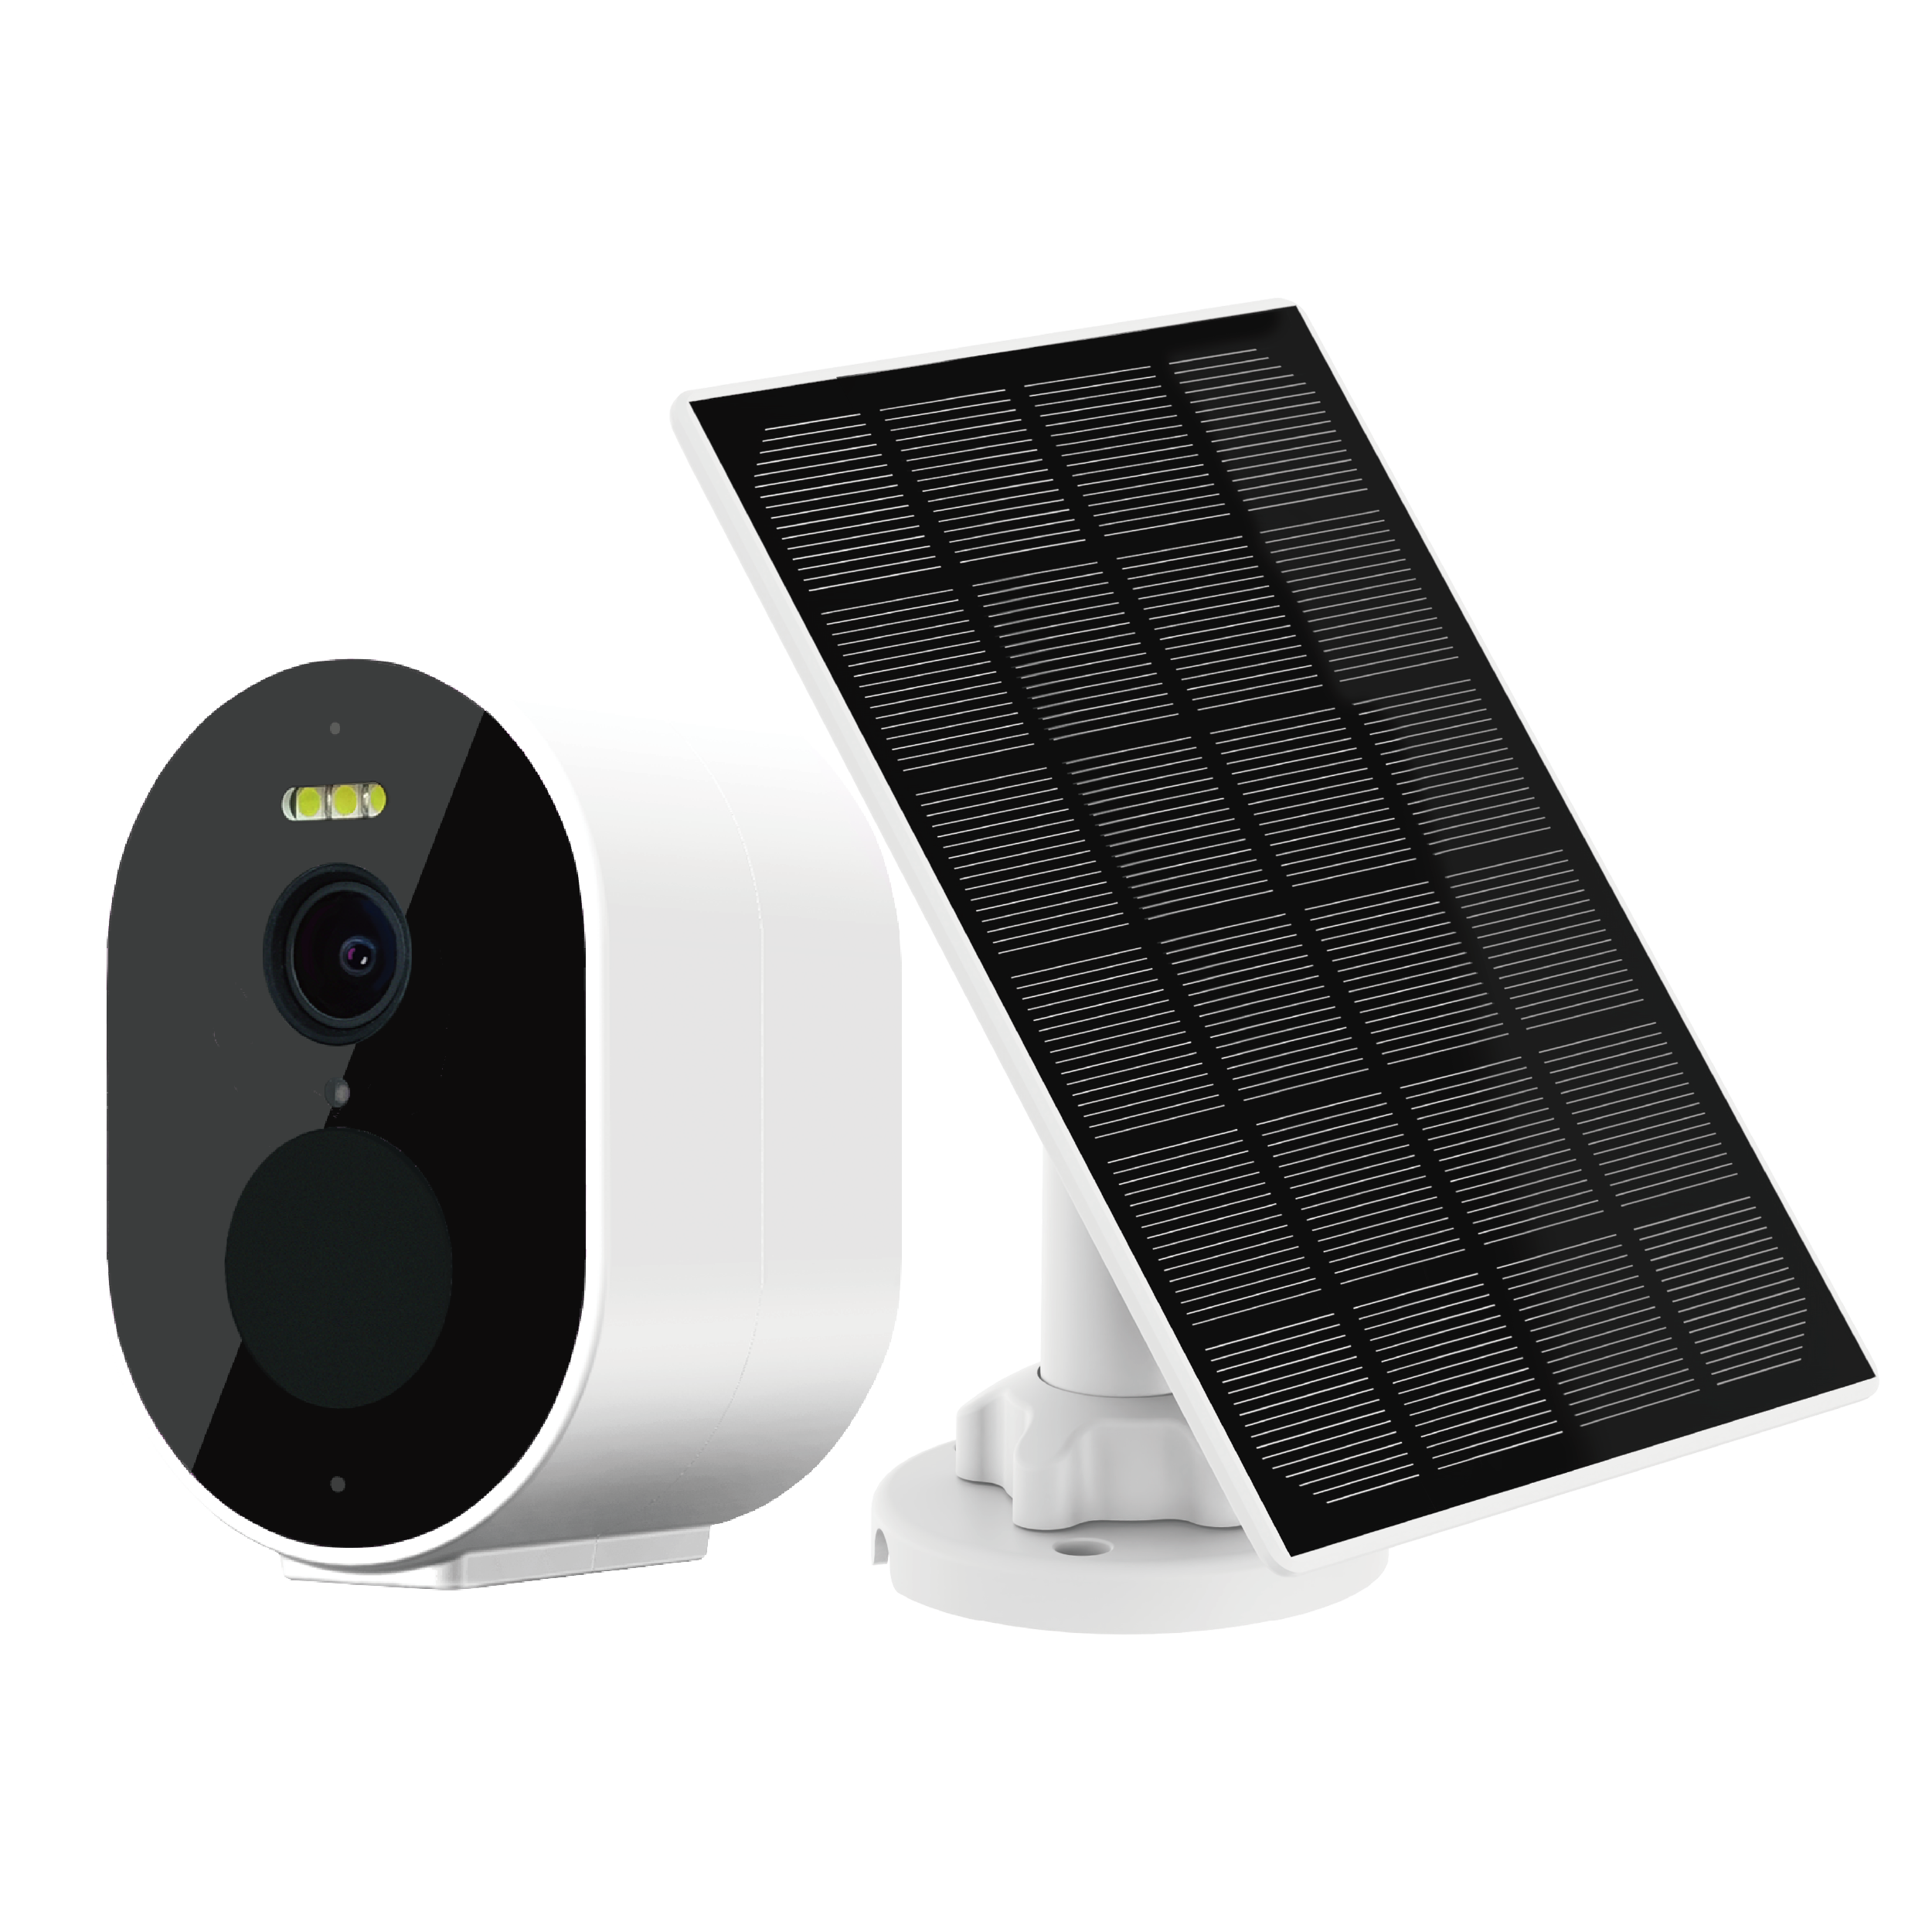
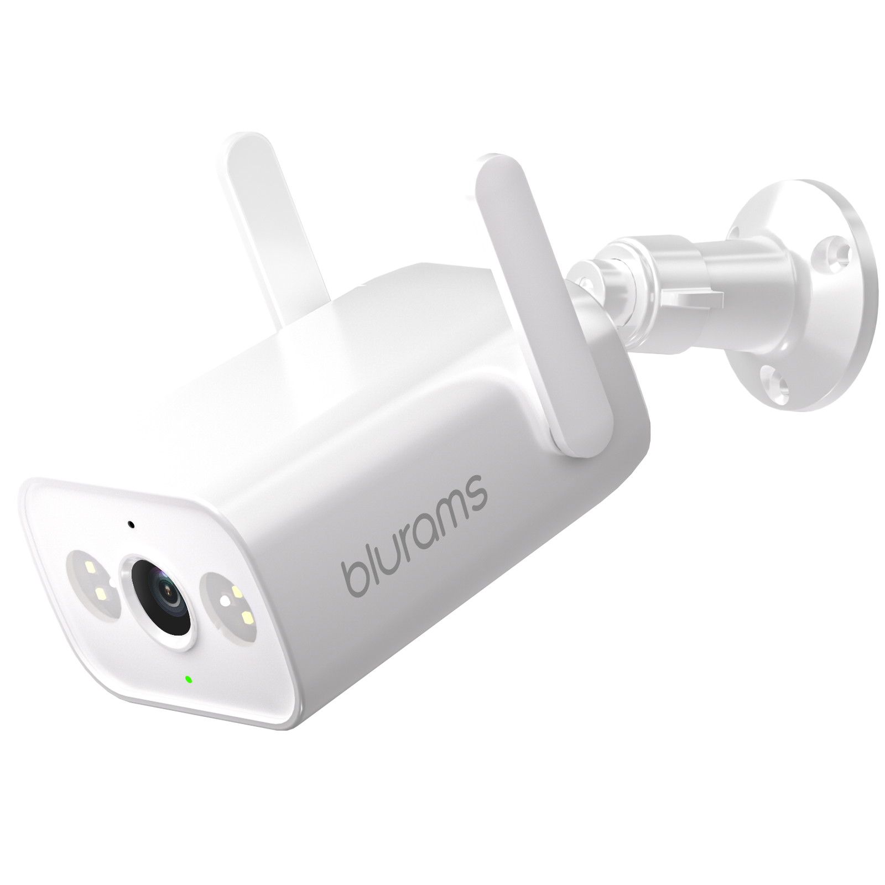
Current Product Portfolio
5
Blurams Dome Lite 2
Blurams Home Pro 2K
Blurams Outdoor Pro
Blurams Dome Pro 2
Blurams PTZ Dual-Lens
Outdoor Cam 3MP
Blurams Wire-Free
Camera 2K Kit
Blurams Wire-Free
Video Doorbell 2K
Blurams Outdoor Lite 4

Slide 6
















Blurams Wire-Free Video Doorbell 2K
6
Free Cloud Storage
Intelligent Alerts
Color Night Vision
2K Resolution
2-Way Audio
Wi-Fi Connection
Mobile and Web View
IP66
Optional
Facial Recognition
Battery-Powered
PIR Detection
Voice Message

Slide 7
7
Highlights & Features
Wire-Free Connection: Battery-powered and Wi-Fi connection, easy to install anywhere you like, suitable for all kinds of doors and walls.
Free Cloud Storage: Lifetime 24-hour 15s free cloud event recording allows you to keep an eye on everything happening at your door.
2K High Resolution: Watch and record crisp-clear videos in more details than ever before.
Instant Alerts: Get instant rich notifications sent to your smartphone when detecting motions/sounds.
Color Night Vision: Built-in four 850nm IR LEDs, you can see farther and clearer videos in full color even in the pitch dark.

Slide 8
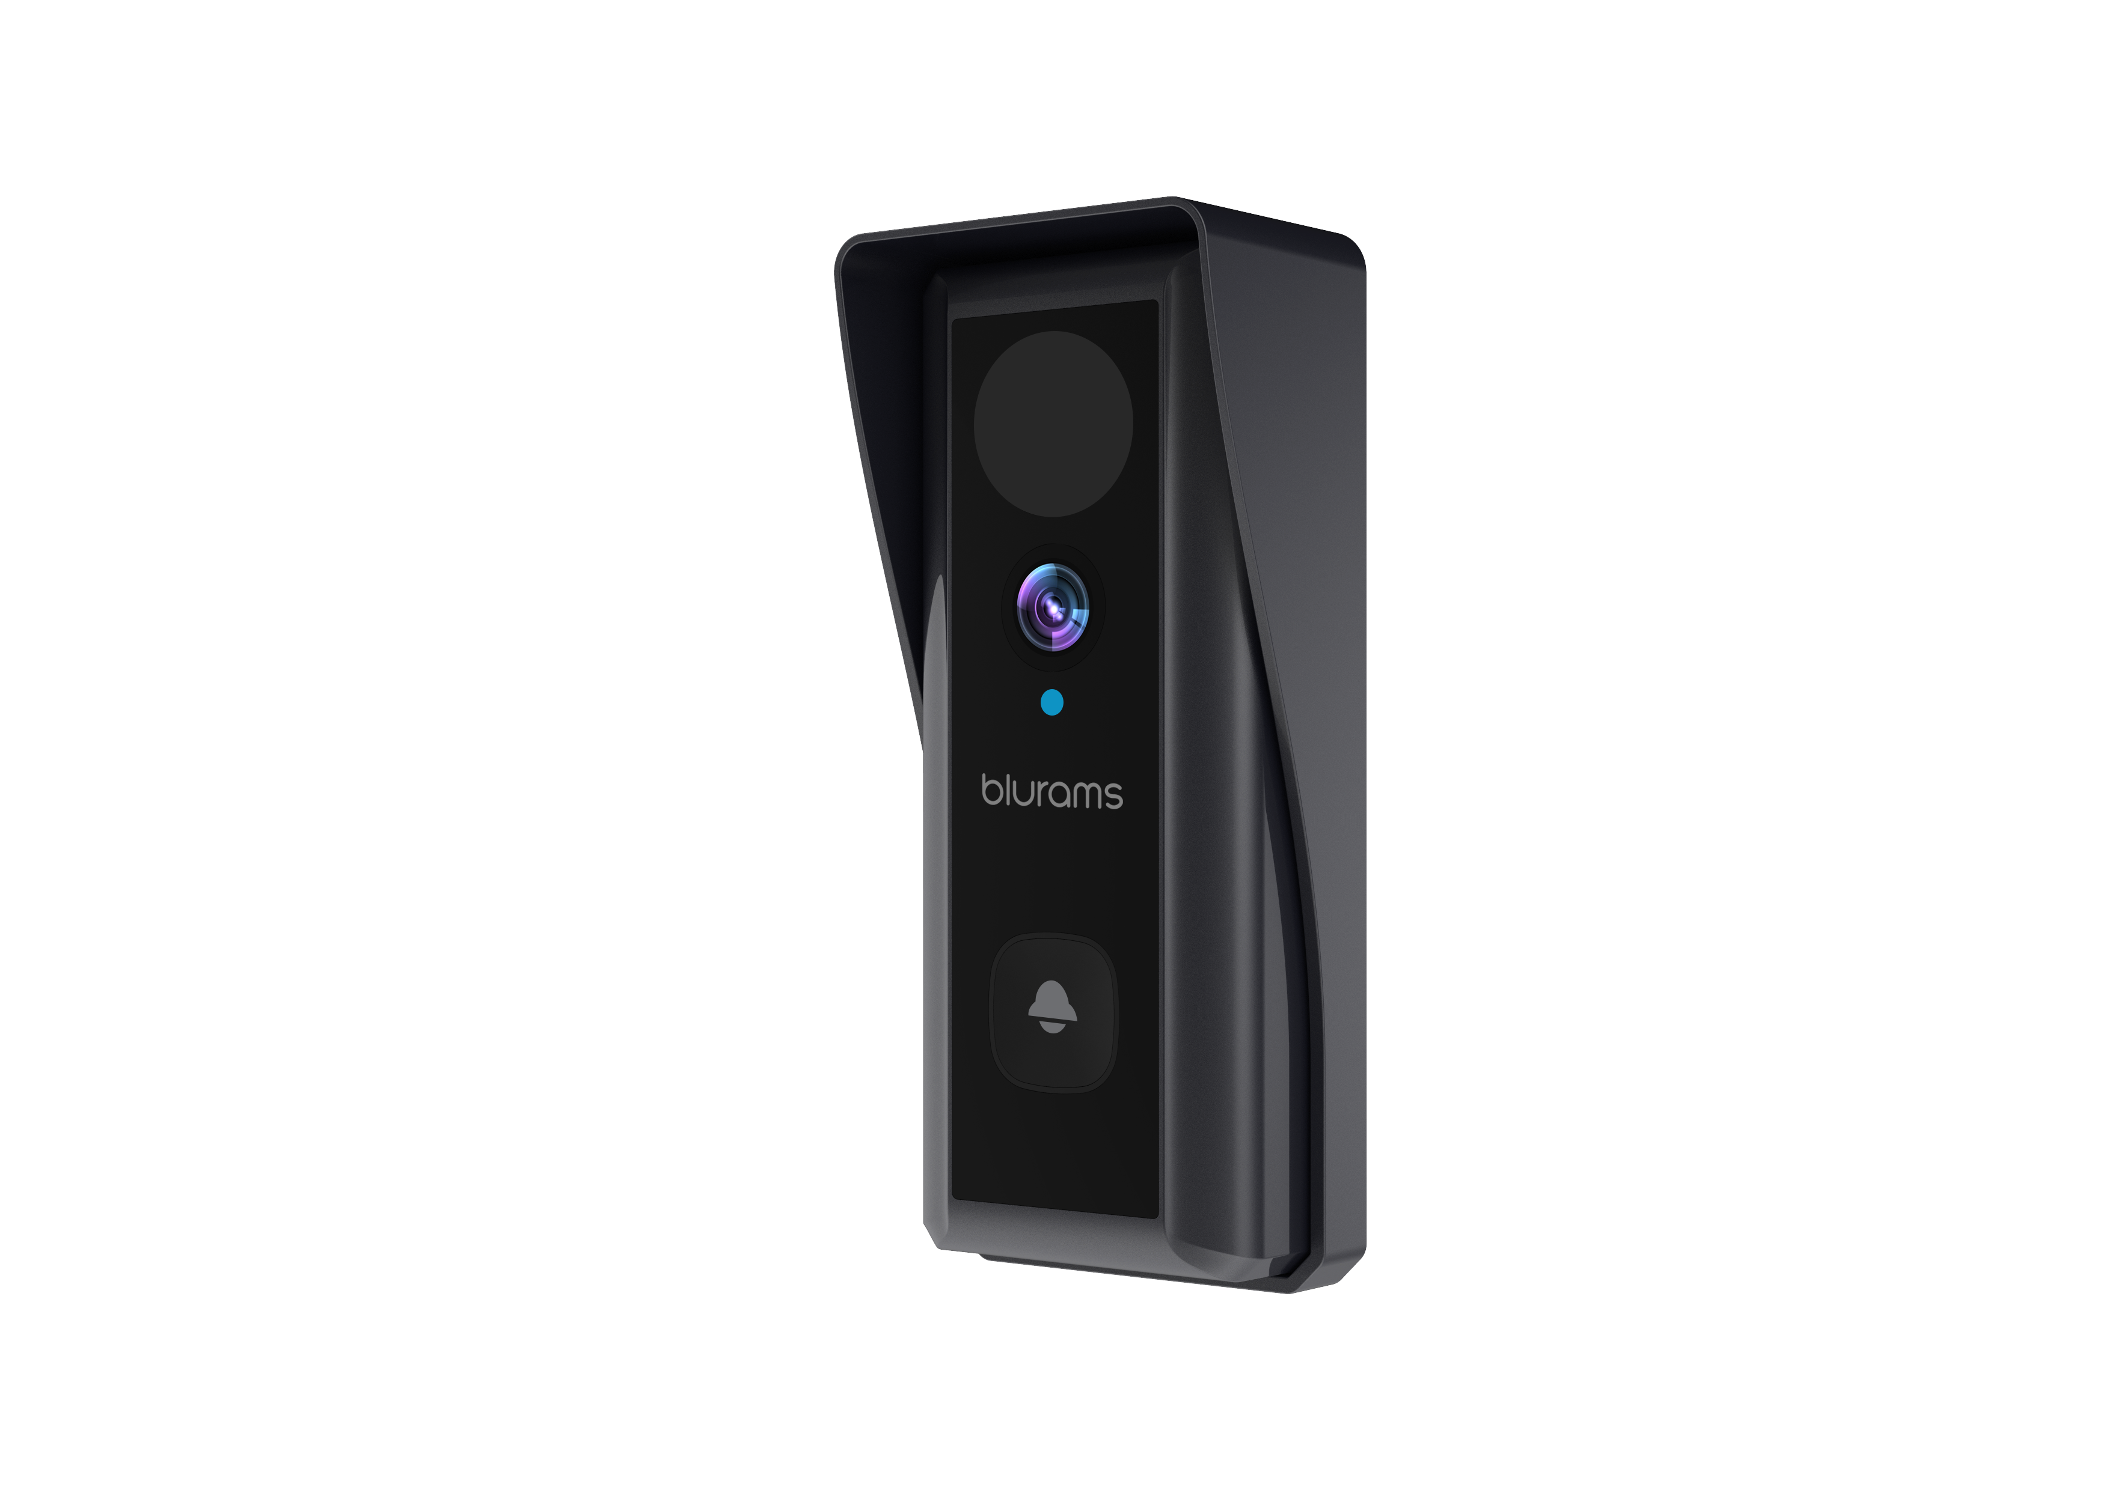
8
Highlights & Features
Optional Face Recognition: You'll get a push notification with a face picture once the doorbell detects human face. And let you know who is at your home instantly.
Customized Voice Message: As soon as the camera recognizes the person, it will play the specific voice message which you can pre-set on Blurams App, smart and intelligent!
PIR Detection: Equipped with a premium PIR sensor, the doorbell will start to record the full event when triggered by motions. Give you peace of mind even when you are not home.
IP66 Certified Weather-Resistant: IP66-certified to withstand the rain, sun, heat or chill.

Slide 9

9
Intelligent Whole House Protection
Blurams Guard: secure all your blurams cameras recordings with blurams Cloud service, using financial-industry level encryption to offer the safest storage solution.
Blurams App: view the live steaming through your mobile phone or PC web and set various functions via App. It only takes 1 minute to get connected.

Slide 10
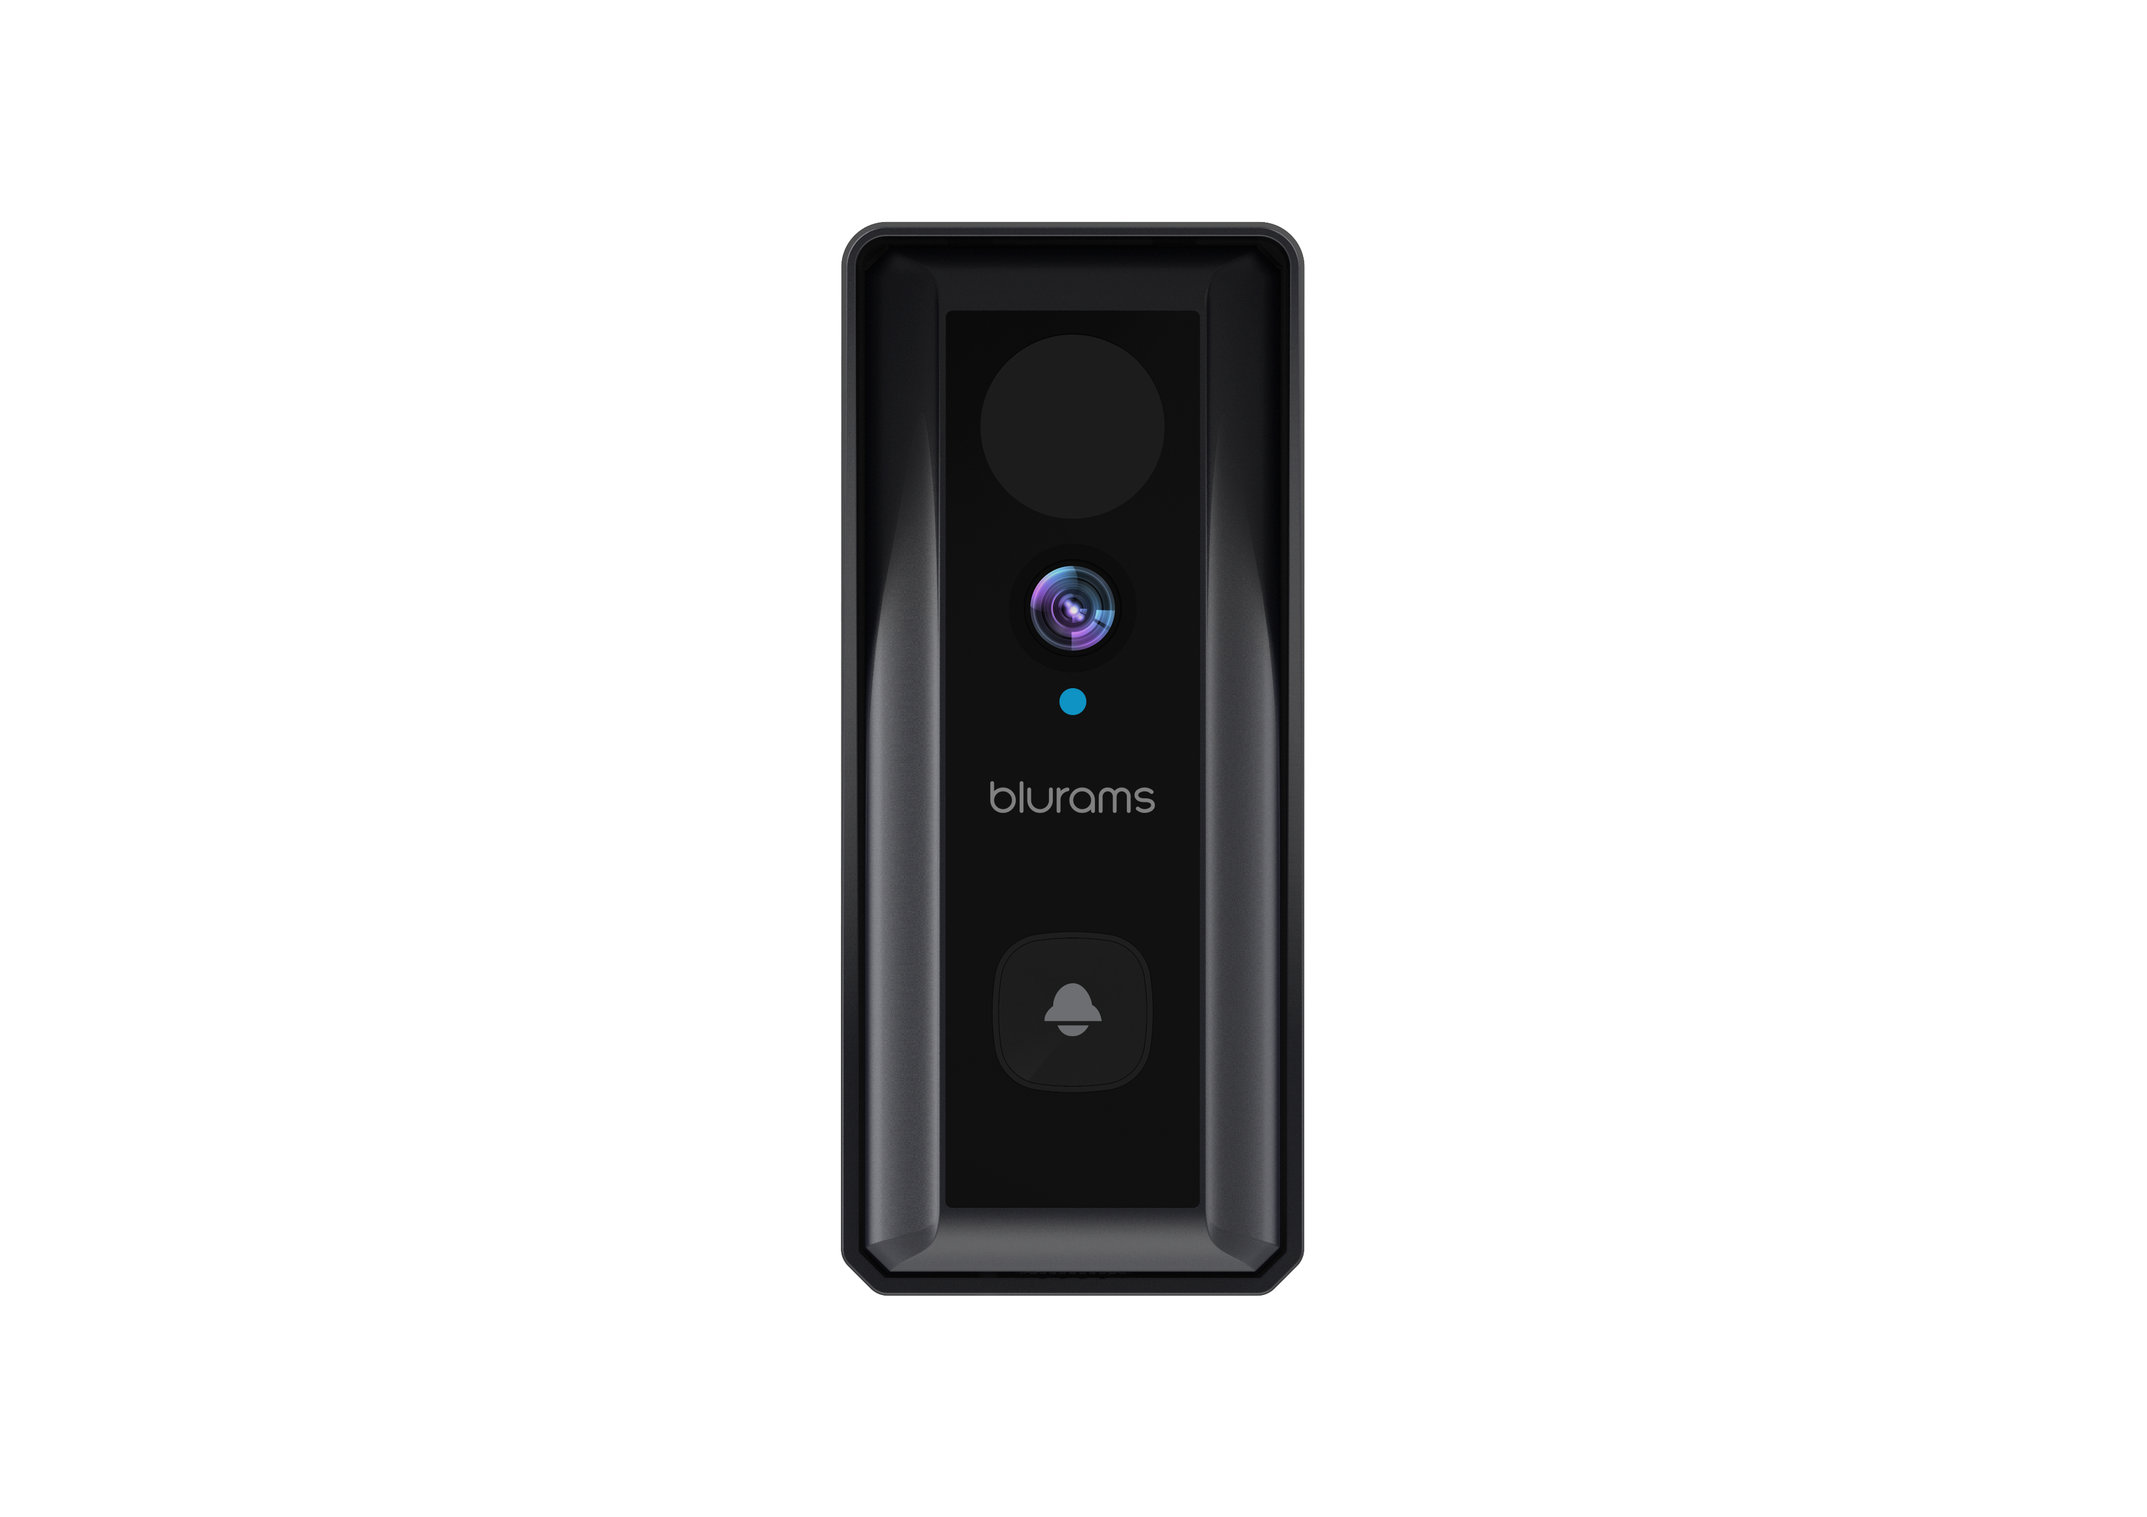
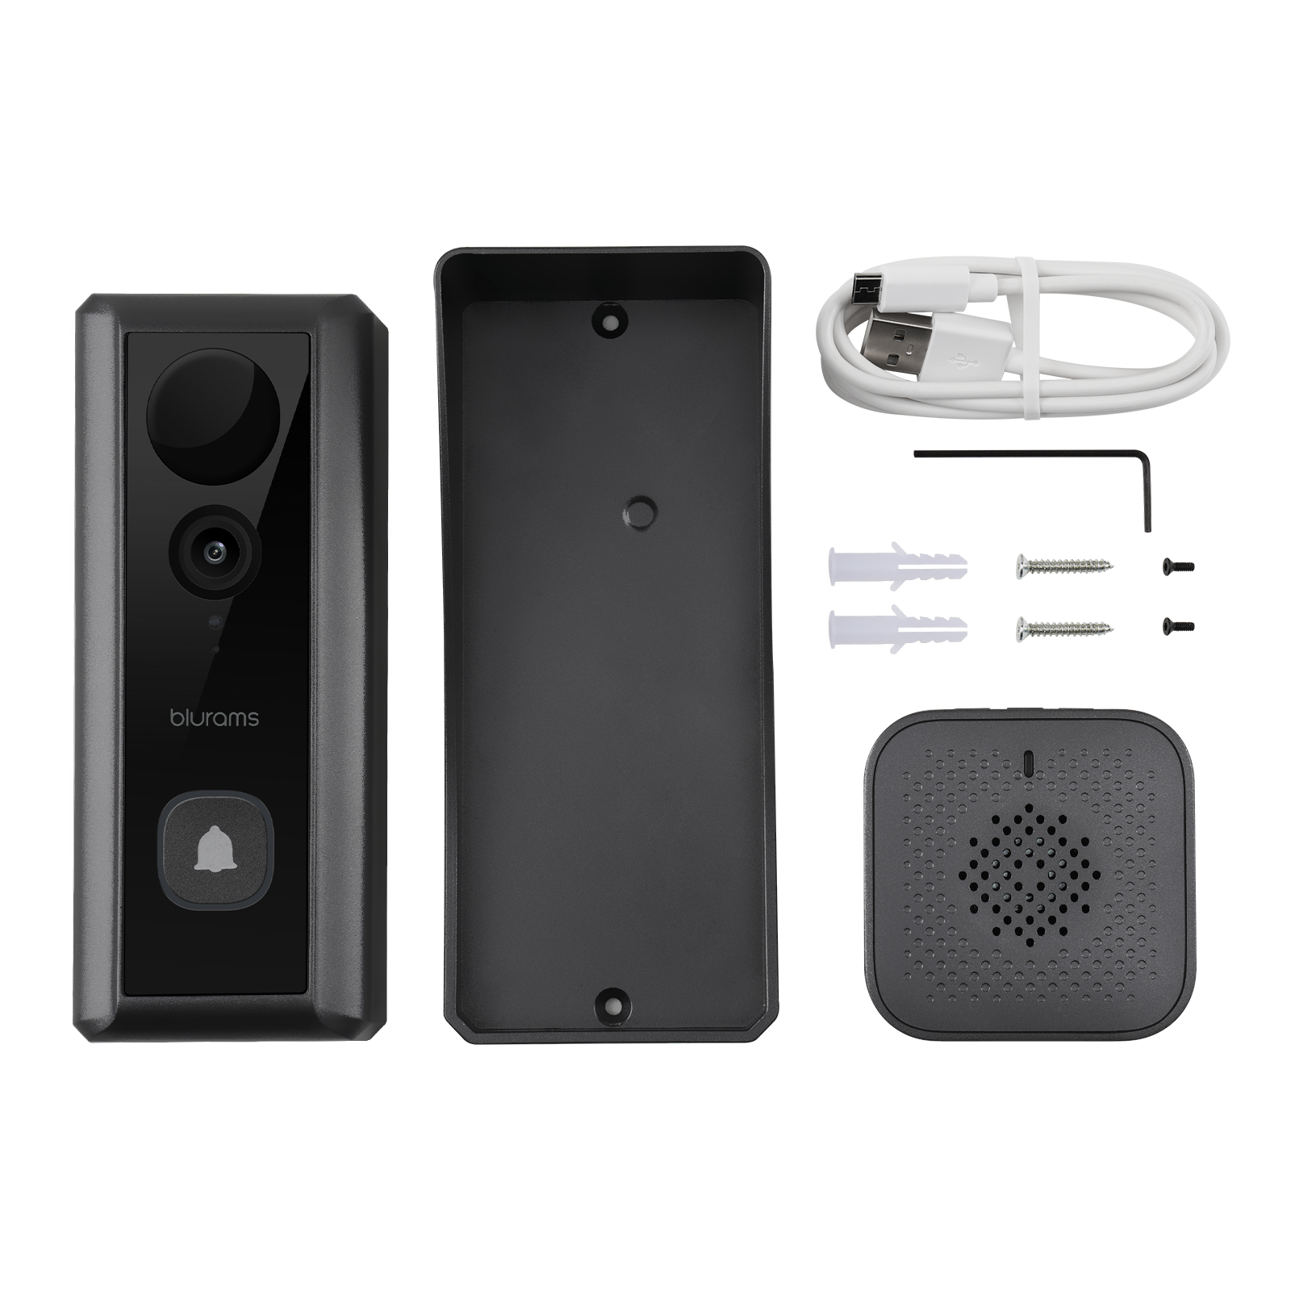
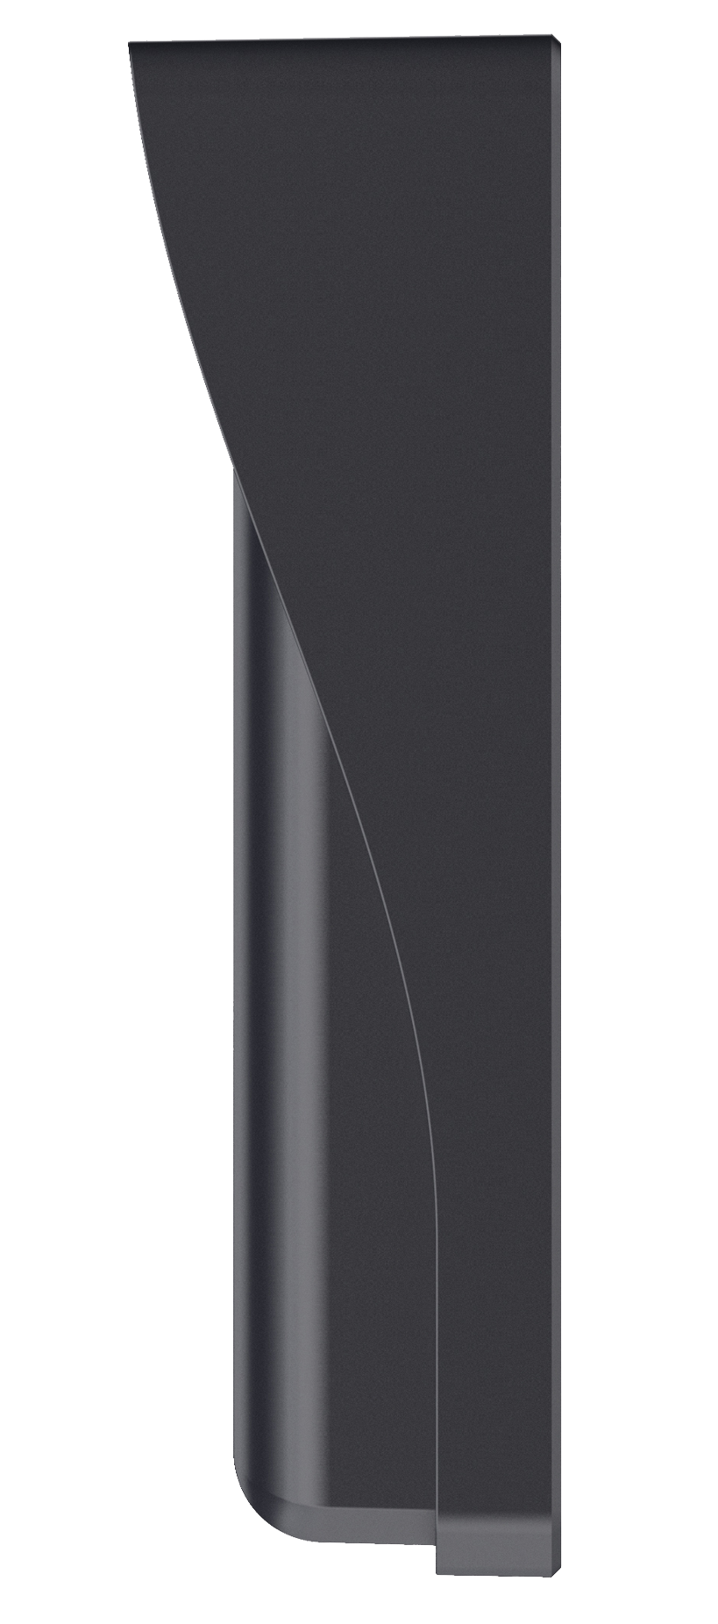
Packing List
10
40mm
145mm
55mm
35mm
Dimension: 145 x 55 x 45mm
Weight: 240g With box: 443g

Slide 11
Technical Specs
11
Functions | Blurams Wire-Free Video Doorbell 2K
Power Supply | Rechargeable Battery (Lithium 18650 battery *2)
Operating Temp. | -10°C～50°C
Viewing Angle | 130° Wide Angle
Image/Audio Enhancing | 3D Noise Reduction, 4X Digital Zoom
Image Sensor | 1/2.9" 3.6mm 2MP CMOS SENSOR
Video Streams | 2304*1296fps
Night Vision | 4*940nm IR LEDs, 5m/16.4ft
Alert Information | Motion, Human & Familiar Face Detection

Slide 12
Technical Specs
12
Functions | Blurams Wire-Free Video Doorbell 2K
Microphone/Speaker | Two-Way Audio
Local Storage | Up to 128GB Micro SD
Cloud Storage | Lifetime 24h 15s Event Recording (Standard and Premium Plan Available)
Supported App | Mobile: Android/iOS (Windows Phone not supported) in 1 Integrated App and PC Web View
Video Coding | H.265/H.264
Wireless Standards | IEEE 802.13b/g/n
IPsec Protocols | WPA/WPA2, WPA-PSK/WPA2-PSK

Slide 13


Slide 14

Living Carefree
www.blurams.com

