Slide 1



Blurams Wire-Free Camera 2K Kit
www.blurams.com

Slide 2

We Are Blurams
Blurams is a leading, international provider of advanced, intelligent imaging technologies, products, services and platforms.
Blurams advocates technological innovation and product experience, and has built the advantages on end-to-end integrated solutions in image processing, computer vision and cloud computing, etc.
Blurams competitive solutions, products and services have been provided to enterprises and consumers globally with it's determination for the smart future.
We are dedicated to making everyone live a carefree life.

Slide 3
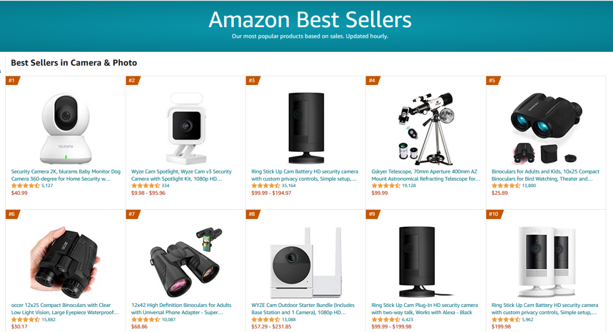
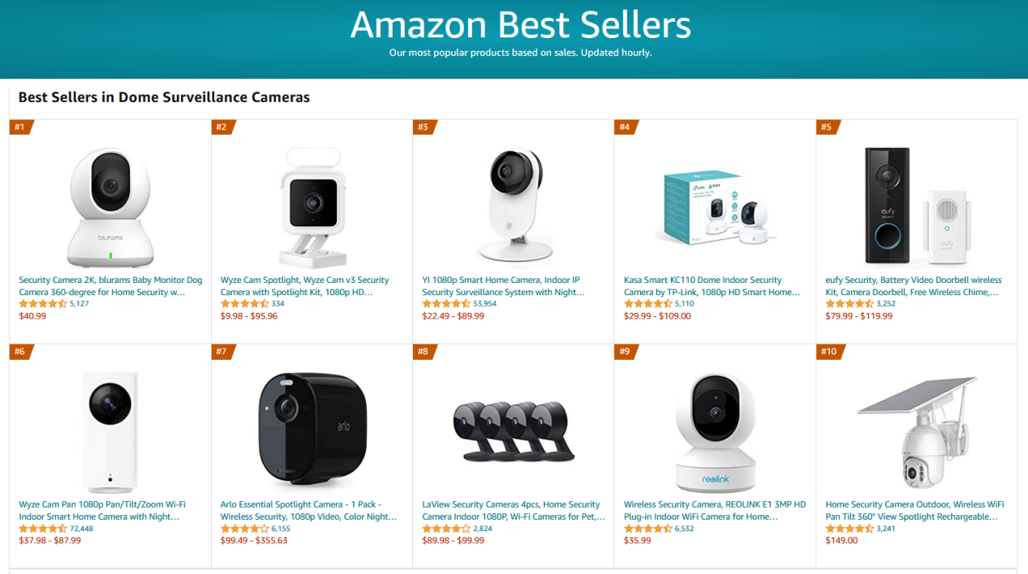
#1 Best Seller on Amazon
Camera & Photo
The largest category of cameras on Amazon
Dome Surveillance Cameras

Slide 4

Blurams Smart Home Solution
Our products work together as an ecosystem via app to cover any size of houses.

Slide 5
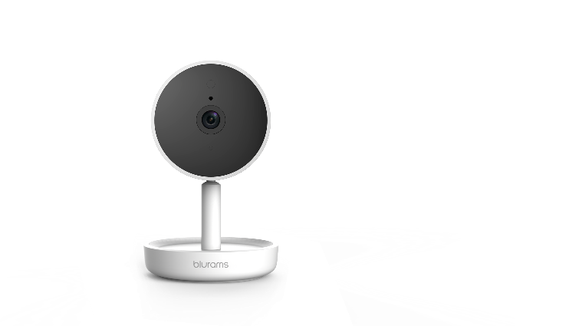
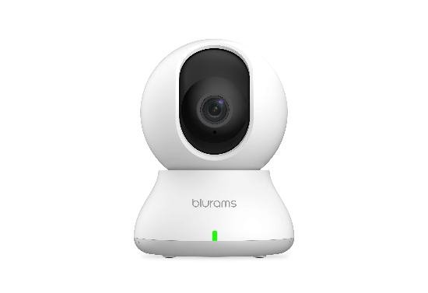
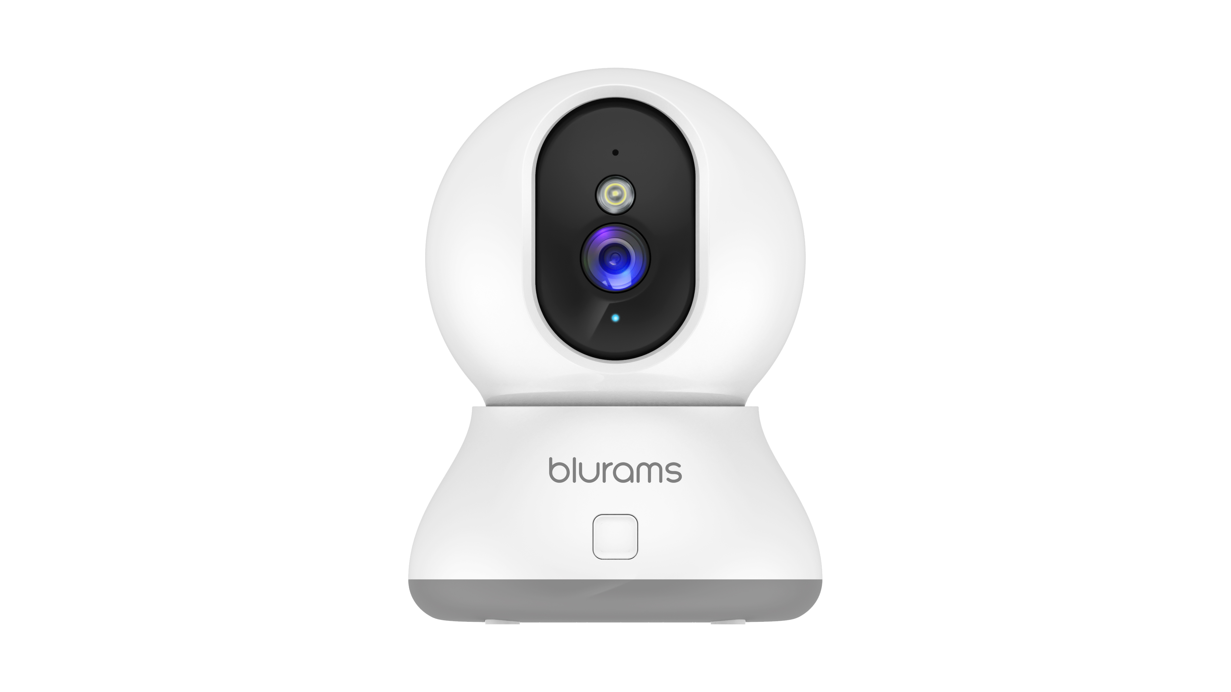
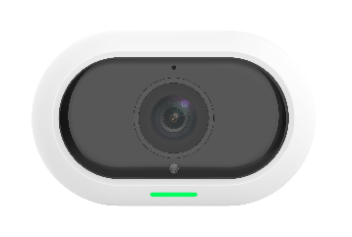
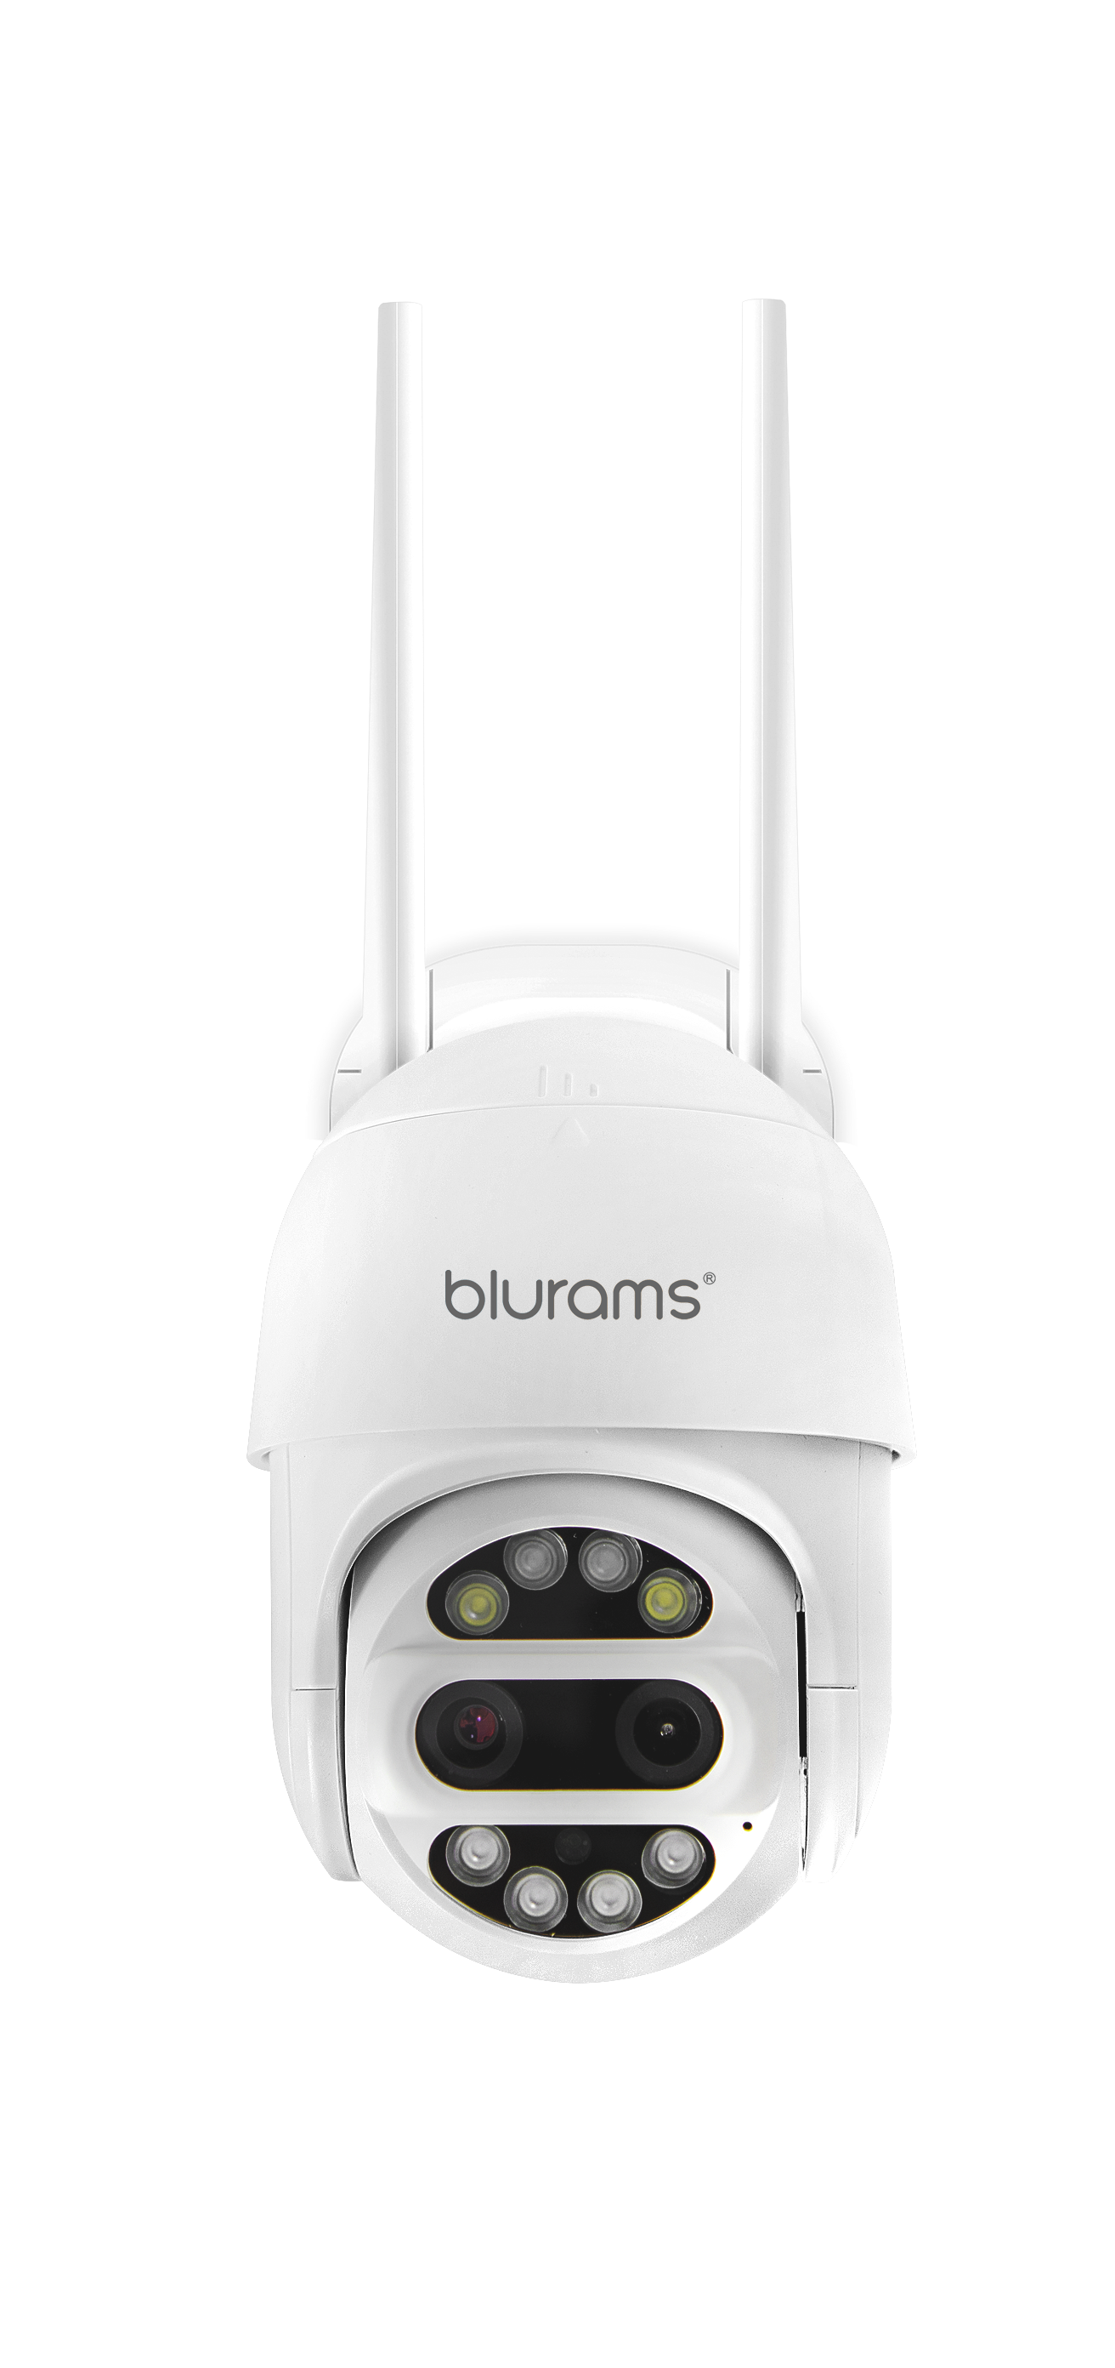
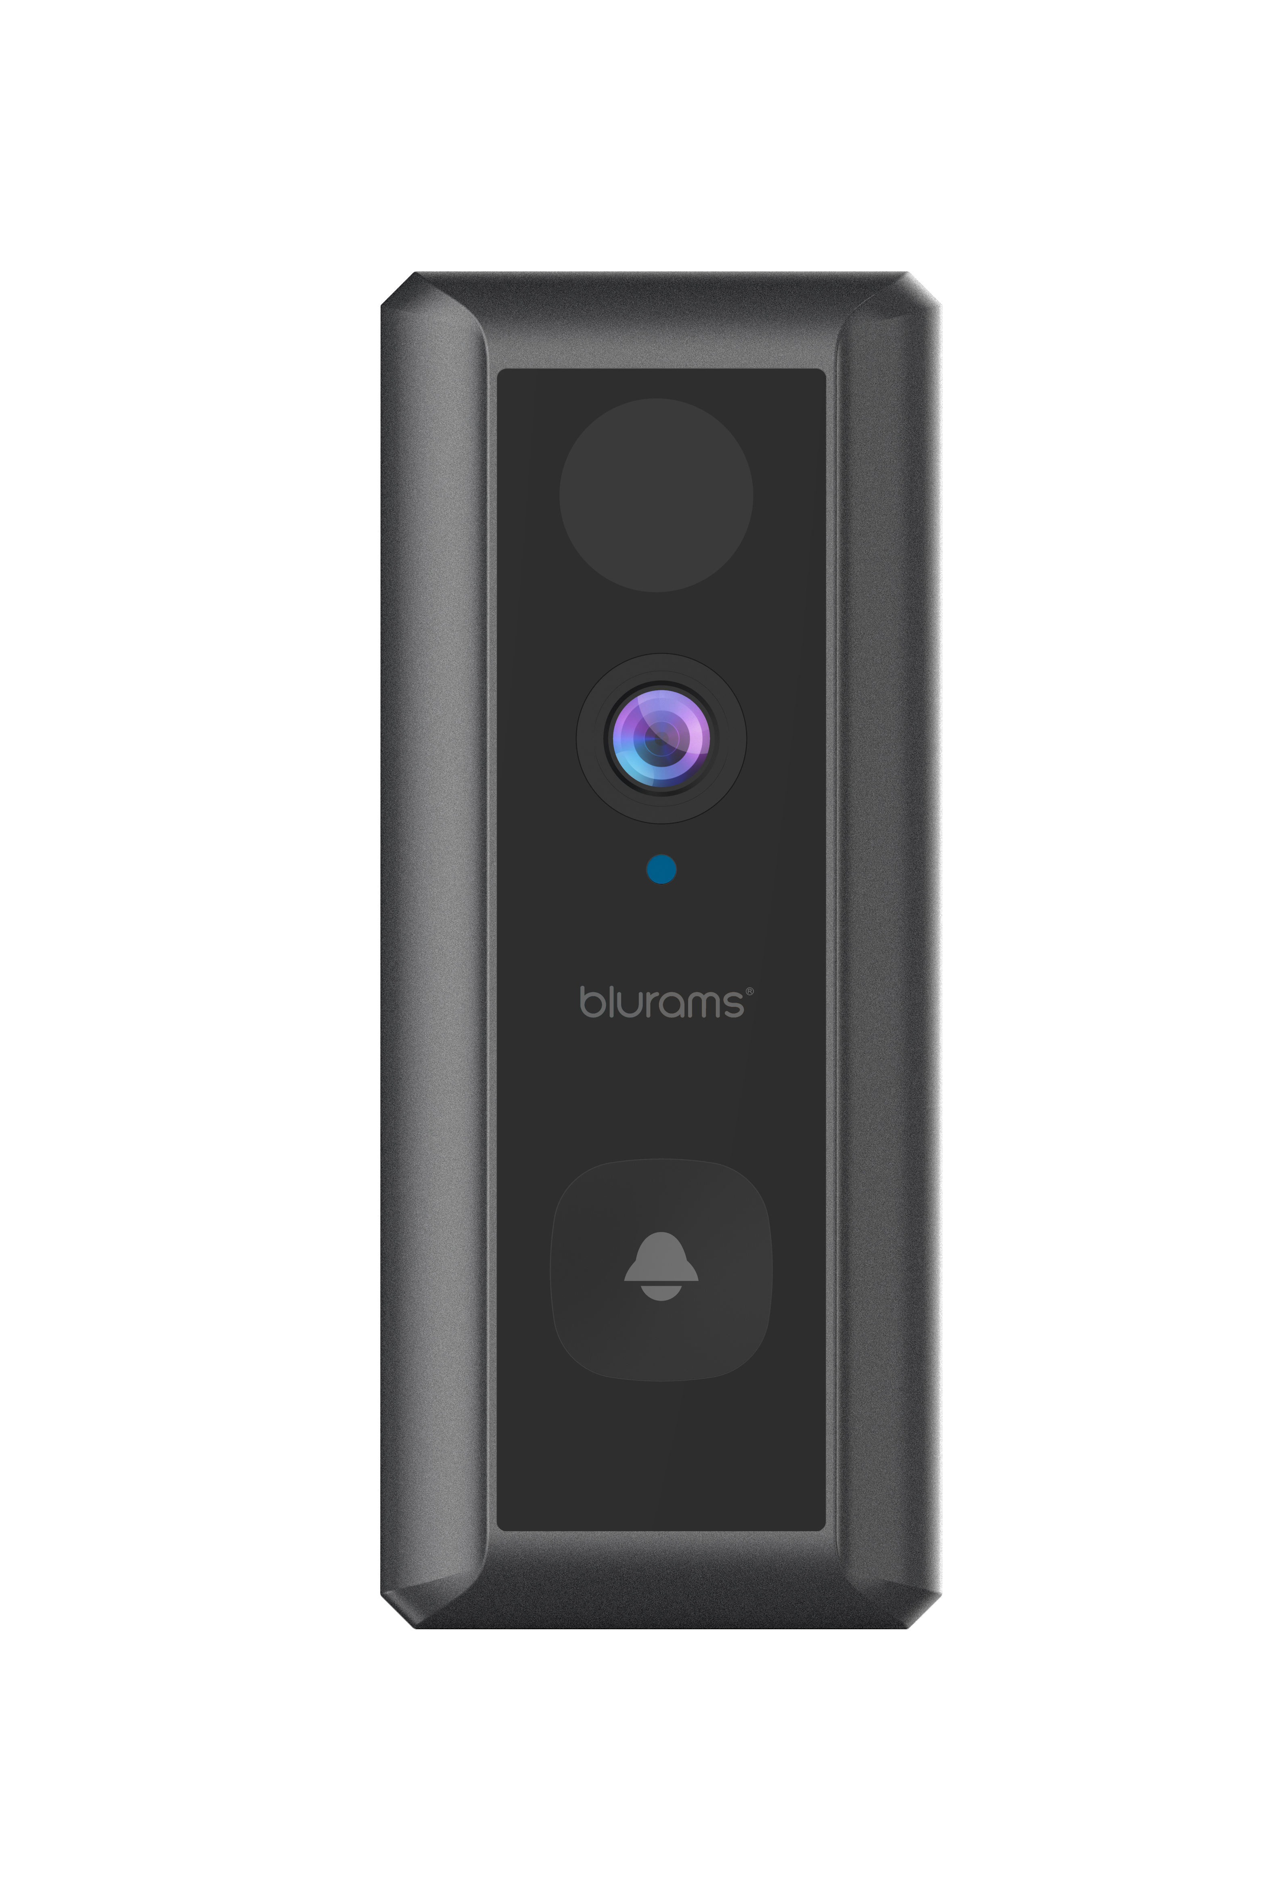
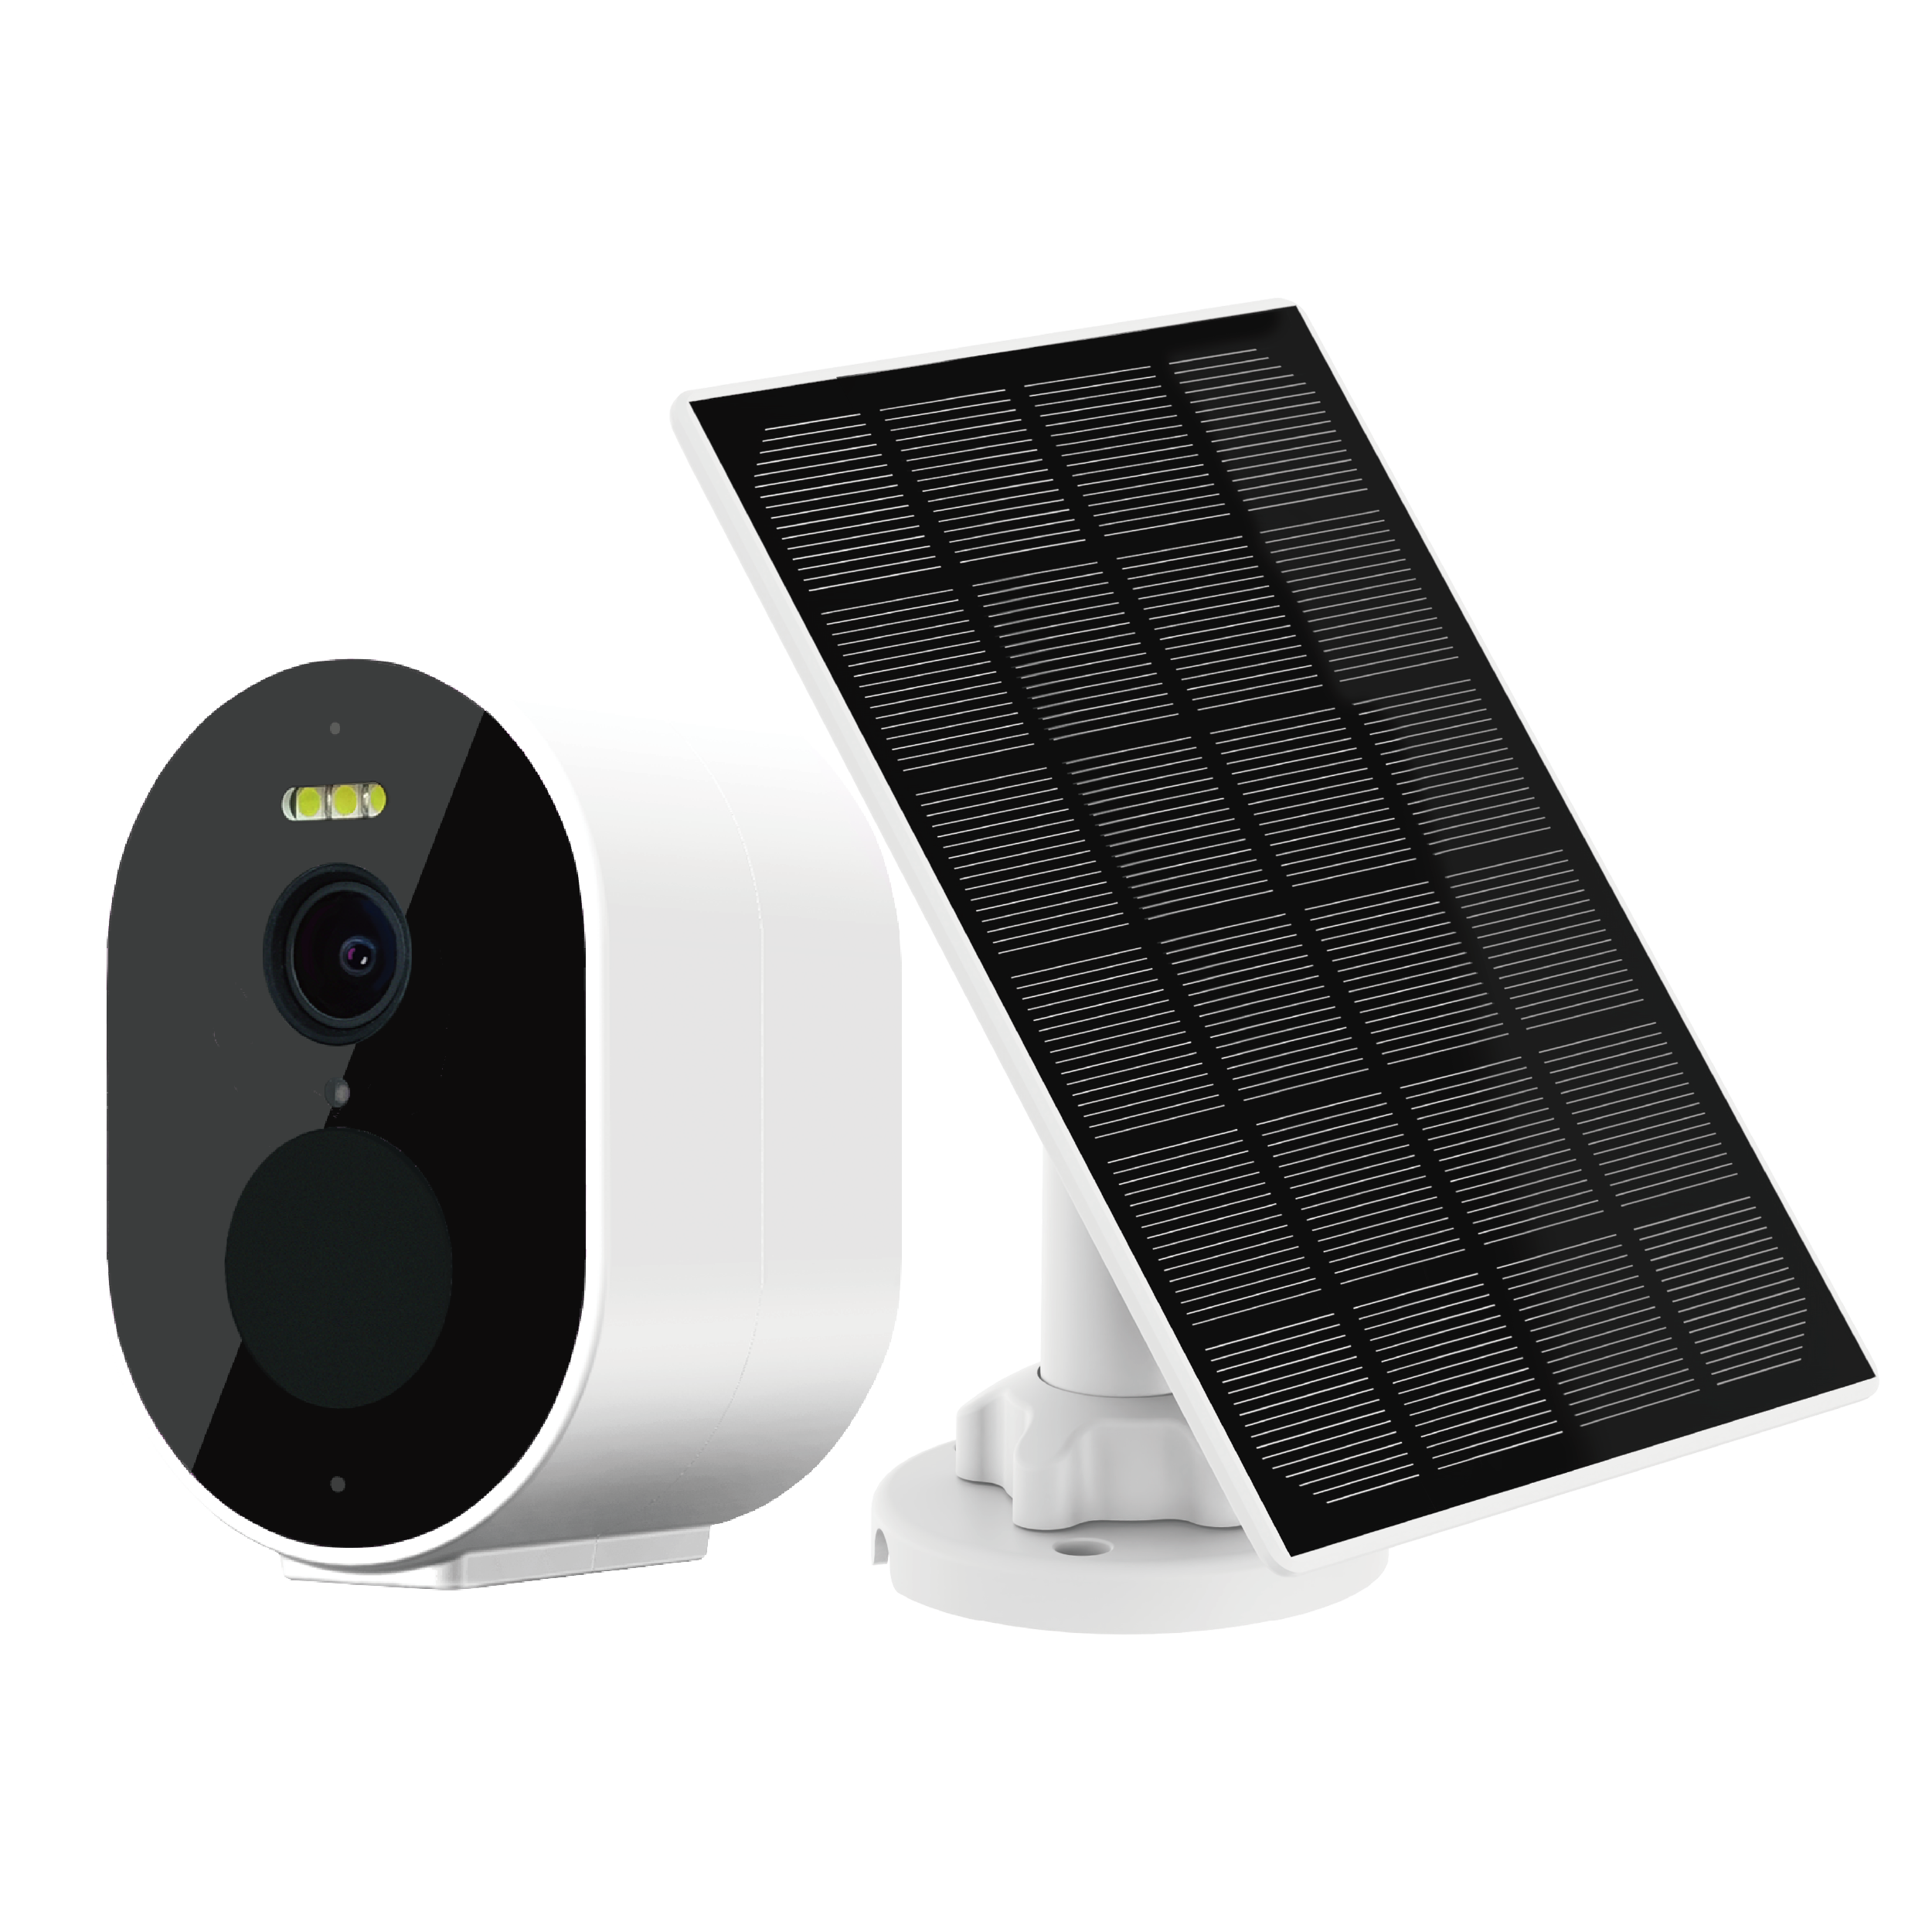
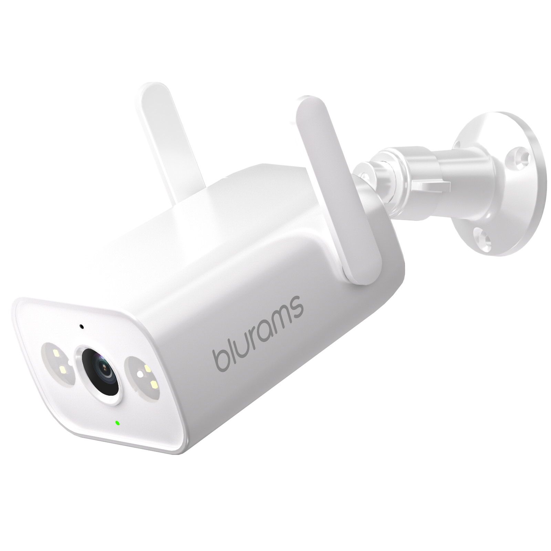
Current Product Portfolio
Blurams Dome Lite 2
Blurams Home Pro 2K
Blurams Outdoor Pro
Blurams Dome Pro 2
Blurams PTZ Dual-Lens
Outdoor Cam 3MP
Blurams Wire-Free
Camera 2K Kit
Blurams Wire-Free
Video Doorbell 2K
Blurams Outdoor Lite 4

Slide 6














Blurams Wire-Free Camera 2K Kit
Free Cloud Storage
Intelligent Alerts
Color Night Vision
2K Resolution
Solar Panel Charging
2-Way Audio
Wi-Fi Connection
Mobile and Web View
IP66
Battery Powered

Slide 7
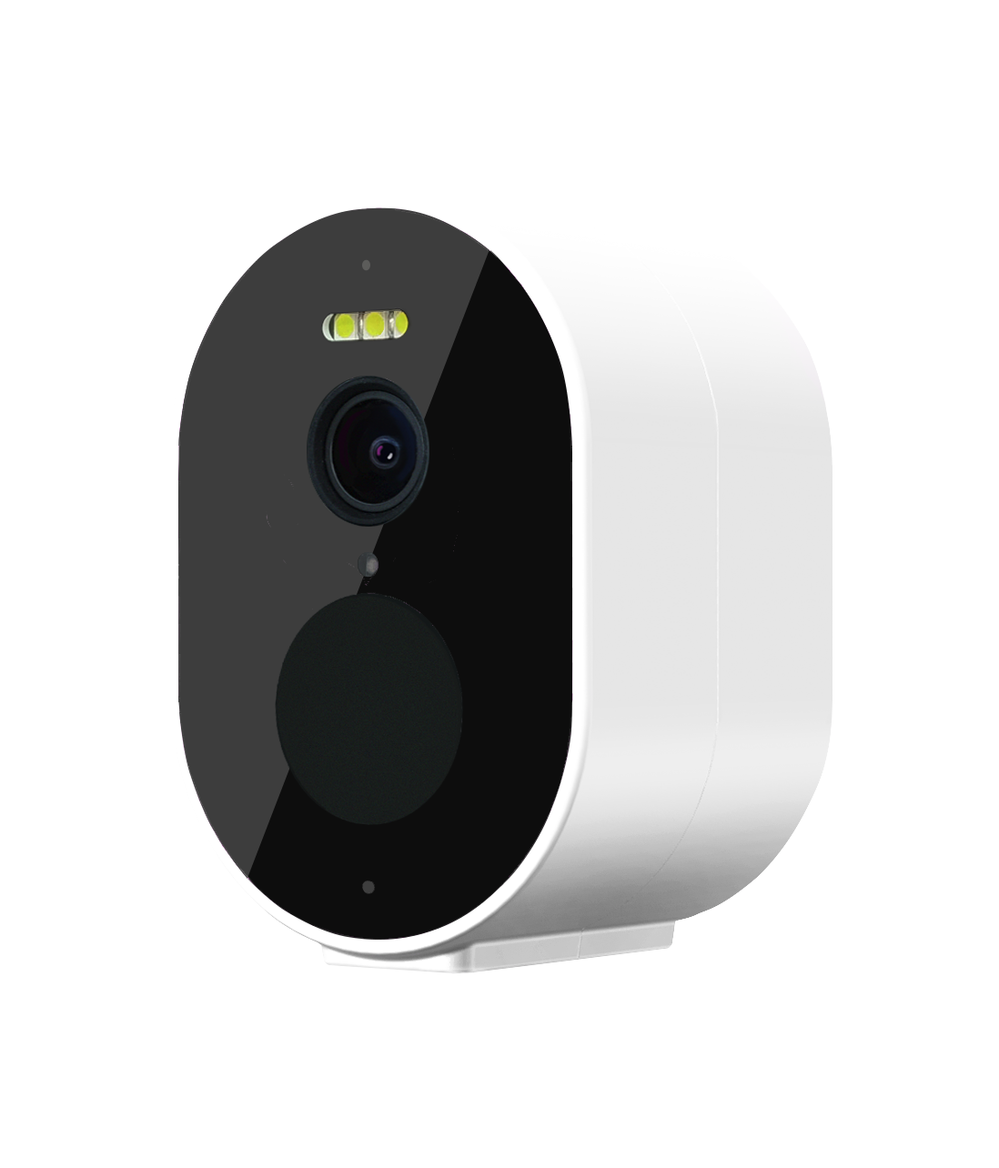
Highlights & Features
Total Wire-Free: Wi-Fi connection and battery-powered design, easy to install anywhere you like, suitable for both outdoors and indoors.
Solar Panel Charging: With weatherproof solar panel and 5200mAh large battery, the camera has endless power to work 24/7, no hassle of removing camera to charge.
Free Cloud Storage: Lifetime 24-hour 15s free cloud event recording makes sure that the camera will records everything important to you and your family.
2K High Resolution: Watch and record crisp-clear videos in more details than ever before.
Instant Alerts: Get instant rich notifications sent to your smartphone when detecting motions & sounds.
Color Night Vision: Built-in four 850nm IR LEDs, you can see farther and clearer videos in full colors even in the pitch dark.
IP66 Waterproof & Weather-Resistant: IP66-certified to withstand the rain, sun, heat or chill.

Slide 8

Intelligent Whole House Protection
Blurams Guard: secure all your Blurams cameras recordings with Blurams Cloud service, using financial-industry level encryption to offer the safest storage solution.
Blurams App: view the live steaming through your mobile phone or PC web and set various functions via App. It only takes 1 minute to get connected.

Slide 9
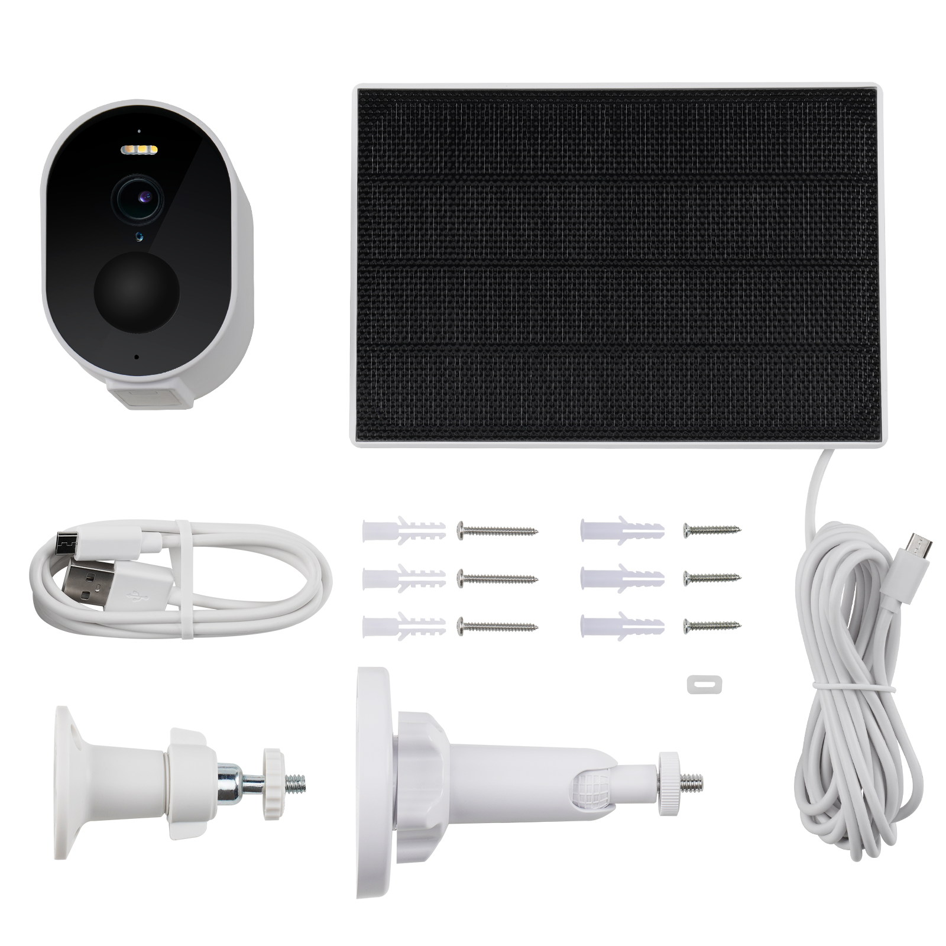
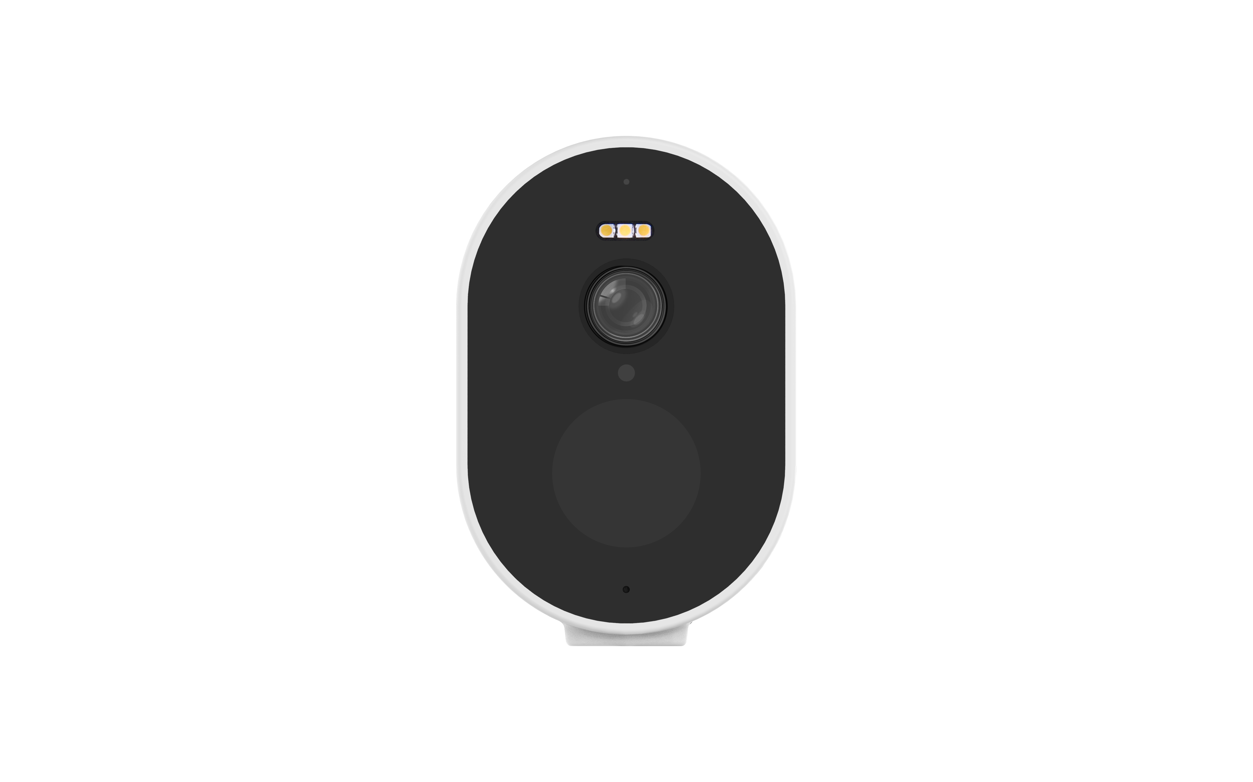

Packing List
90mm
192mm
60mm
56mm
133mm
Camera
Dimension: 90 x 60 x 56mm
Weight: 218g
Solar Panel
Dimension: 192 x 133 x 42mm
Weight: 296g

Slide 10
Technical Specs
Functions | Blurams Wire-Free Camera 2K Kit
Power Supply | Rechargeable Battery (Lithium 18650 Battery *2) & Solar Panel Charging
Operating Temp. | -20°C～45°C
Viewing Angle | 127° Wide Angle
Image/Audio Enhancing | 3D Noise Reduction, 4X Digital Zoom
Image Sensor | 1/2.8" 3MP CMOS SENSOR
Focal Length | 2.95mm
Video Streams | 2304*1296fps
Night Vision | 4*850nm IR LEDs, 5m/16.4ft
Alert Information | Motion, Human & Sound Detection
Microphone/Speaker | Two-Way Audio

Slide 11
Technical Specs
Functions | Blurams Wire-Free Camera 2K Kit
Cloud Storage | Lifetime 24h 15s Event Recording (Standard and Premium Plan Available)
Local Storage | Not Support
Supported App | Mobile: Android/iOS (Windows Phone Not Supported) in 1 Integrated App and PC Web View
Video Coding | H.265/H.264
Wireless Standards | IEEE 802.14b/g/n
IPsec Protocols | WPA/WPA2, WPA-PSK/WPA2-PSK
Solar Panel | Input Power≥2.5W
 | Working Voltage/Current≥4.5V/570mA
 | IP65 Certified Waterproof

Slide 12
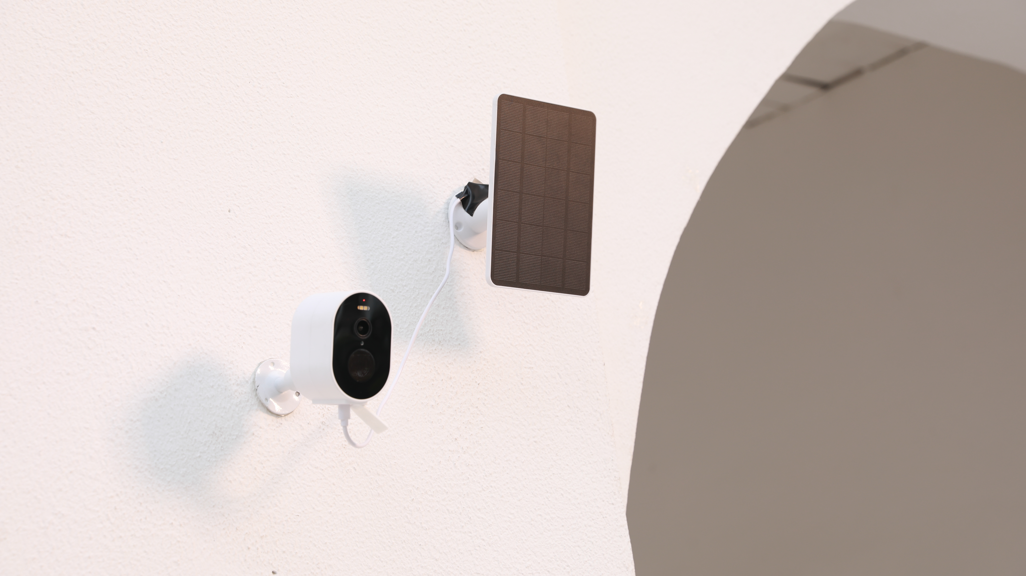

Slide 13

Living Carefree
www.blurams.com

